Slide 1
MARKETING JOURNEYS · THE TRADEWINDS METHOD · CULTIVATE
Session 6.7 · the capstone
Closing the Loop
What if the whole engine could run, and grow, on its own?

Slide 2
WHERE THE WHOLE METHOD COMES TOGETHER
This is where the line
becomes a loop.
Capture, Confirm, Care, Cultivate. Worked together, they stop being a checklist and become a wheel that turns itself, and every cycle runs warmer and easier than the last.

Slide 3
THE LEAKY BUCKET, AND FEAST OR FAMINE
A loop holds what a line spills.
All through Confirm, Care, and Cultivate, we fought one headwind: the Leaky Bucket, every place a good lead or a happy client could slip away. And here, at the end, you seal it, because a loop has no open end to leak from. What flows out of Cultivate, a referral, a repeat booking, flows right back into the top. And when that happens, the oldest headwind of all, Feast or Famine, finally loosens its grip, because warm bookings from people who already love you smooth out the rollercoaster you started with. You do not lurch from full to empty anymore. The wheel keeps turning, and the work gets calmer.
A loop has no open end to leak from. Warm repeat bookings smooth the feast-or-famine rollercoaster for good.

Slide 4
HOW THE END FEEDS THE BEGINNING
Out the bottom, back to the top.
Referrals become new Captures
Repeats become easy Confirms
Every advocate you made in Care and every ask you ran in Cultivate sends a friend to the top of your funnel, already warm. That is Capture, except you skipped the cold part. Your best new leads now come from your old clients.
And every dream you nudged, every client you stayed top of mind with, comes back to book again, already sold. That is Confirm, except the trust is already there. The second trip is far easier to win than the first.
The end of the loop feeds the beginning. Referrals are warm Captures, repeats are easy Confirms.

Slide 5
THE LOOP ONLY PAYS IF YOU WORK IT
Who's ready right now?
A loop that just sits there is a diagram. A loop you work is a business. So the habit that ties this whole method together is simple: regularly, you look at your Manifest and you ask one question. Who is ready, right now, to rebook or refer? Whose trip anniversary is coming? Whose someday dream is suddenly in season? Who just gushed about their trip and is primed for an ask? The answers are sitting in the system you built, waiting for five minutes of your attention. This is the daily-five-minutes habit from Confirm, grown up. Work the loop a little, every week, and it pays you back forever.
Ask your Manifest one question on a rhythm: who's ready to rebook or refer right now? The answers are already there.

Slide 6
THE WHOLE POINT OF THE METHOD
Warmer every cycle.
Step back and see what you have actually built across these six parts. You Aimed, you Built the launchpad once, and then you set a loop spinning: Capture, Confirm, Care, Cultivate, around and around. The first time around, it is work. But each turn, more of your bookings come from people who already trust you, so each turn is warmer, cheaper, and calmer than the last. That is Cruising Altitude. That is the business coming to you instead of you chasing it. That is the destination we named at the very beginning: not passive, but lighter. Profits, and peace. You did not just learn marketing. You built an engine that grows on its own.
Each turn of the loop is warmer, cheaper, and calmer than the last. That is Cruising Altitude: profits and peace.

Slide 7
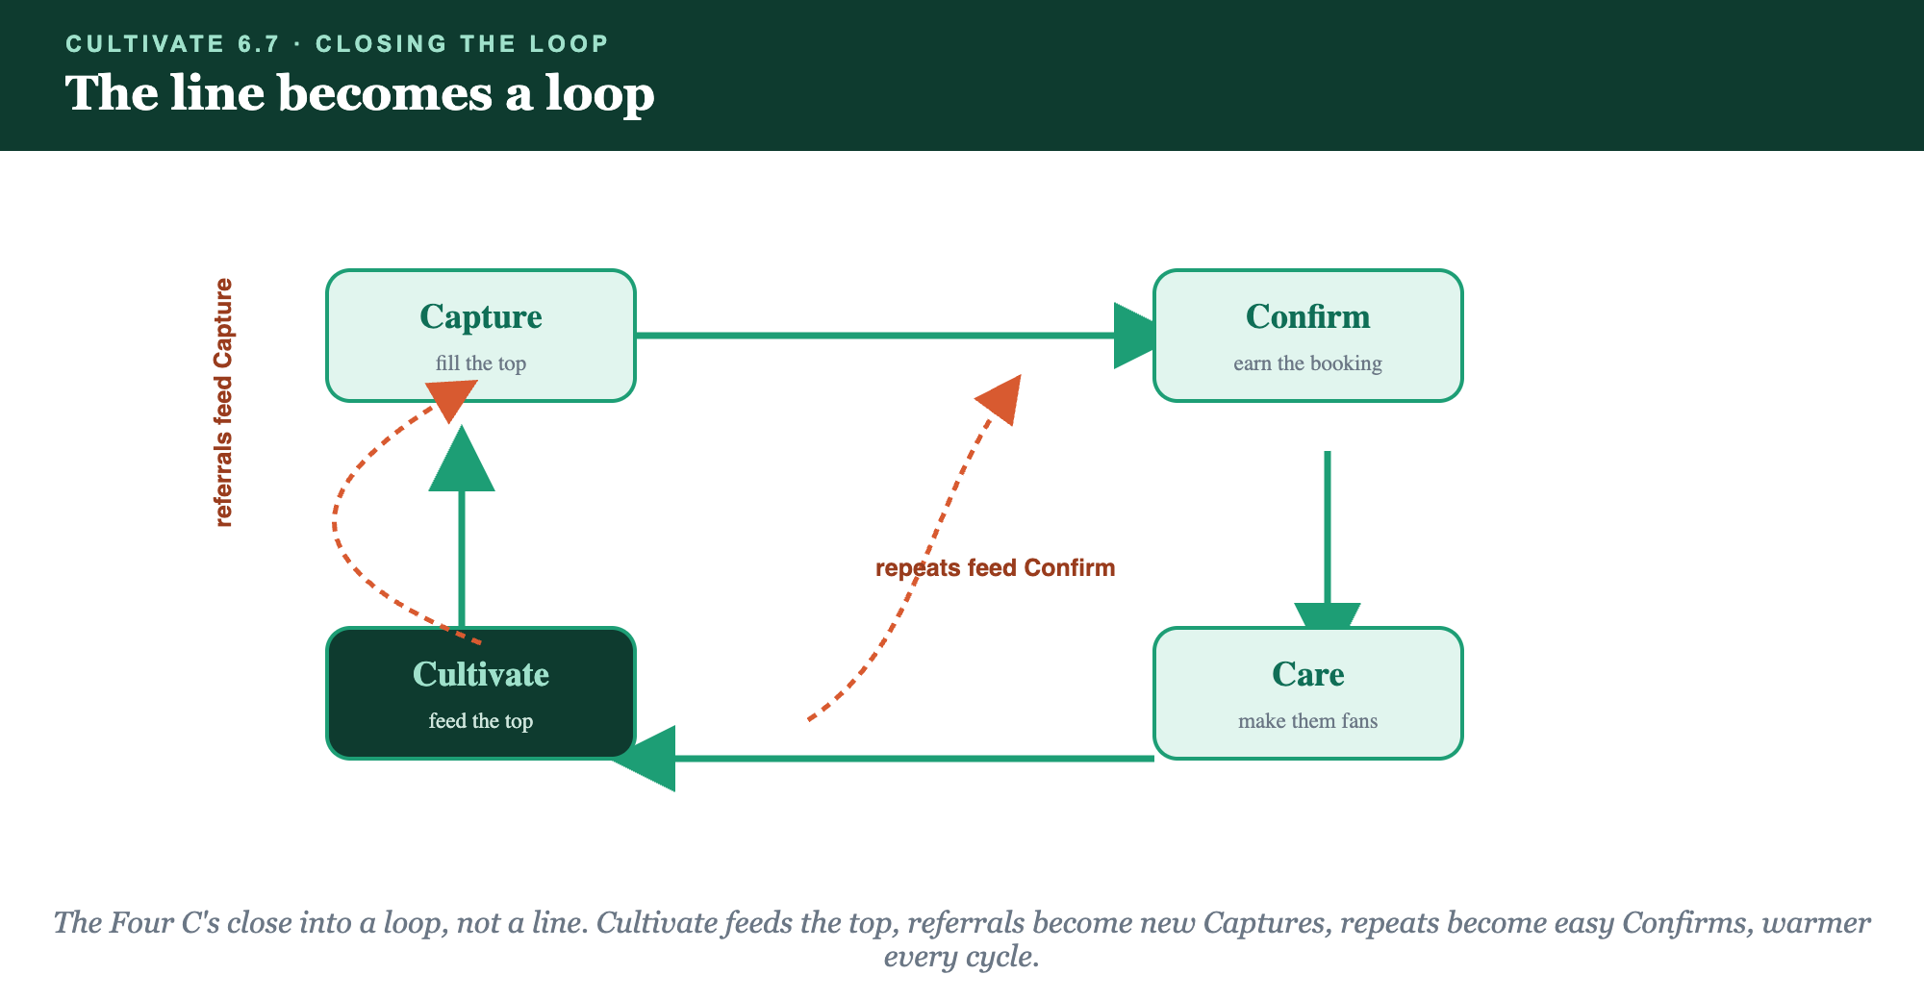
CAPTURE · CONFIRM · CARE · CULTIVATE, AND BACK AGAIN
The line becomes a loop.

Slide 8
PUT YOUR SECOND MATE TO WORK
More than copy. It reads the whole loop.
SPOT
PRIORITIZE
RUN
Who's ready
This week's five
The whole crew
It scans your Manifest and surfaces who is primed to rebook or refer right now.
It hands you a short, ranked list so your weekly loop-work takes minutes.
Across Cultivate, it drafts the touch, the nudge, the ask, so you keep the wheel turning.
Copy-paste example prompts are in the library: How to Prompt Your Second Mate.

Slide 9
YOUR FIRST BRICK
Work your loop.
1
Your weekly look
Set the recurring time you'll open your Manifest and ask who's ready. (The Your Loop worksheet.)
2
Who's ready now
List who, today, is primed to rebook or refer, and the one move for each.
3
Keep it spinning
Make working the loop a habit, the small weekly work that pays you forever.

Slide 10
WANT A HAND WITH THIS PART?
Three ways to get unstuck.
GROUP
ONE-ON-ONE
DONE WITH / FOR YOU
Professor Hours
Book a 1:1
Hire us
Bring your specific question to office hours and ask it live.
We work on yours, screen to screen, until it's done right.
Consultant or coach. We build it with you, or we build it for you.

Slide 11
YOU BUILT THE WHOLE ENGINE
The loop, worked,
ends feast or famine.
Capture, Confirm, Care, Cultivate, running forever. You built an engine that grows on its own. Profits, and peace. This is what we build together.
We build it with you →
That's the method, complete. The journey was never the course. It was your business.
Post who in your Manifest is ready to rebook or refer. You finished the journey, now come fly it with the crew.

