Slide 1
MARKETING JOURNEYS · THE TRADEWINDS METHOD · CULTIVATE
Session 6.6
Dream-Destination Nudges
How many 'someday' trips have my clients told me, that I forgot?

Slide 2
PLANT THE NEXT TRIP
Every client mentioned
a someday trip.
Remembering it, and nudging it at the right moment, is how the next booking starts itself. The dream is already planted. Your job is to water it when the time comes.

Slide 3
THE HEADWIND HERE IS THE LEAKY BUCKET
The someday trip you forgot.
It happens in almost every conversation you have. A client lights up and says, oh, we have always dreamed of seeing Japan in cherry-blossom season, or someday, an African safari for our anniversary. And then the current trip takes over, and that golden little seed of a future booking gets lost. That is a leak, and a painful one, because it is a booking that practically wanted to happen. The dream was real, the desire was there, and the only thing missing was someone to remember it and gently bring it back at the right time. That someone is you, and the dream is sitting in your notes, waiting.
A forgotten 'someday' dream is a booking that wanted to happen. The desire was there, the memory wasn't.

Slide 4
WRITE IT DOWN THE MOMENT YOU HEAR IT
Capture the dreams.
Like every good thing in Cultivate, this lives on one small habit: catching the dream the instant it surfaces and dropping it into your CRM notes. Not just where they want to go, but the why and the when, the anniversary it's tied to, the milestone birthday, the kids-leave-for-college window. Those details are pure gold later. This is exactly what discovery and the Manifest were built for. A dream you heard and admired and then forgot is worth nothing. A dream written down, with its reason and its rough timing, becomes a perfectly aimed nudge a year from now. Capture beats memory, every time.
Catch the dream, the why, and the when, the instant you hear it. A dream in your notes becomes a future booking.

Slide 5
THE RIGHT WORDS AT THE RIGHT TIME
A well-timed, personal nudge.
Time it well
Make it personal
The nudge works because it arrives at the right moment: as their anniversary nears, when flights to that place dip, when the season they dreamed of is months out, the perfect window to book. Right timing turns a someday into a now.
And it works because it's about them. Pull straight from your notes: 'You mentioned wanting Japan for the blossoms, they're forecasting an early bloom next spring, should we start planning?' That's not marketing. That's a friend who remembered.
Right timing plus their own words equals a nudge that feels like a friend remembered, not an ad.

Slide 6
WHERE THE NEXT BOOKING STARTS
Turn a dream into a trip.
Here is why this one matters so much. A cold lead has to be convinced they want to travel at all. But a client with a captured dream already wants it. The desire is fully formed. You are not selling, you are simply giving a long-held wish the little push it needs to become real, and then, because you are you, you make booking it effortless. This is the warmest possible start to a new trip, which means the nudge does not just hand you a booking, it drops that client right back into the top of your loop: discovery, proposal, the whole journey again, except this time they arrive already sold. A remembered dream is the easiest booking you will ever make.
A client with a captured dream already wants it. You're not selling, you're giving a wish the push to come true.

Slide 7
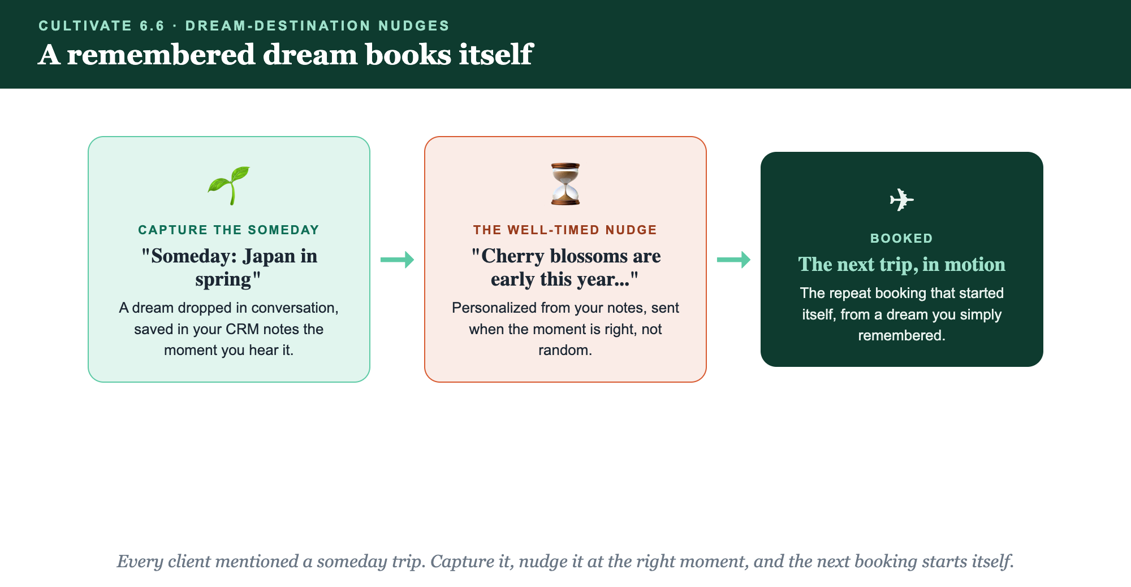
CAPTURE THE SOMEDAY · THE WELL-TIMED NUDGE · BOOKED
A remembered dream books itself.

Slide 8
PUT YOUR SECOND MATE TO WORK
More than copy. Your dream tracker.
DRAFT
TIME
SCAN
The nudge
When to send
Find the dreams
It writes a 'remember when you mentioned...' nudge straight from your CRM notes.
It helps you spot the right window: the anniversary, the season, the booking sweet spot.
It surfaces which clients have a captured someday dream worth nudging now.
Copy-paste example prompts are in the library: How to Prompt Your Second Mate.

Slide 9
YOUR FIRST BRICK
Build your nudges.
1
Three dreams
Pull three clients' someday dreams from your notes, with the why and the when. (The Your Nudges worksheet.)
2
Your nudge
Write the well-timed, personal nudge for each, pulled from what they told you.
3
Make capturing a habit
Decide where the someday dream goes the moment you hear it, so none get lost again.

Slide 10
WANT A HAND WITH THIS PART?
Three ways to get unstuck.
GROUP
ONE-ON-ONE
DONE WITH / FOR YOU
Professor Hours
Book a 1:1
Hire us
Bring your specific question to office hours and ask it live.
We work on yours, screen to screen, until it's done right.
Consultant or coach. We build it with you, or we build it for you.

Slide 11
BUILT WITH YOU, NOT TAUGHT AT YOU
The next booking starts
with a remembered dream.
You can capture three dreams and write their nudges today. Turning the someday trips your clients mention into real bookings is what we build together.
We build it with you →
Next → Closing the Loop: where the whole engine comes together.
Post a captured dream and the nudge you'd send. Questions? Bring them to this week's Professor Hours.

