Slide 1
MARKETING JOURNEYS · THE TRADEWINDS METHOD · CULTIVATE
Session 6.5
The Referral Ask
Are my happiest clients sending me their friends, or just meaning to?

Slide 2
THE ASK THAT GROWS EVERYTHING
Your happiest clients
want to refer you.
In Care you learned why advocates matter. Now you make it a habit you run on purpose: the right moment, the easy words, and a thank-you that makes them want to do it again.

Slide 3
THE HEADWIND HERE IS THE LEAKY BUCKET
They want to. They just forget.
This is the warmest, cheapest growth on earth, and it is the one most advisors leak away completely, because they never ask. Not out of laziness, out of fear: it feels awkward, it feels like begging. So they hope, and hoping does not fill a calendar. Here is the truth that dissolves the fear. Your happy clients are not refusing to refer you. It simply does not cross their mind in the moment a friend mentions a trip. The leak is not their loyalty, it is the silence where a simple, warm ask should be. Close that gap on purpose, as a habit, and referrals stop being luck and start being a system.
The leak isn't their loyalty, it's the silence where an ask should be. Hoping doesn't fill a calendar.

Slide 4
TIMING IS EVERYTHING
Ask at the right moment.
An ask lands or clangs depending entirely on when you make it. The right moment is the peak of the glow: right after a trip they loved, when they call you thrilled, when they leave a five-star review, when they thank you. That is when the goodwill is highest and the ask feels like a natural extension of a happy moment, not a sales move. The wrong moment is out of the blue, or worse, when something just went sideways. So you watch for the high points, the ones Care is busy creating, and you let those be your cue. The peak of delight is the open door. Walk through it.
Ask at the peak of the glow, right after a trip they loved. High goodwill makes the ask feel natural.

Slide 5
THE WORDS, AND THE PATH
Not awkward. And effortless.
Words that aren't awkward
Make it effortless
Confident and warm, never needy. 'It means so much that you loved it. I grow almost entirely through people like you, so if a friend ever mentions a trip, I'd be honored if you passed my name along.' Framed as helping more travelers like them, not begging.
Then remove every hurdle. Hand them the copy-paste line, 'I work with someone who plans [your niche], talk to her,' and the link. The easier you make it, the more it happens. Friction is the only thing between goodwill and a new client.
Confident, never needy. Then give the words and the link, so saying yes takes no effort at all.

Slide 6
THE STEP THAT MAKES IT REPEAT
Thank, and close the loop.
When a referral comes in, what you do next decides whether you ever get another. So you thank the referrer, fast and genuinely, in a way that makes them feel like the hero they are. A heartfelt note, a real call, a small gift, gratitude that lands. And you close the loop: let them know it went well, that you took good care of their friend, because their name was on the line and now they can relax and feel proud. A referrer who feels appreciated refers again, and again. A referral met with silence is the last one you will get from that person. Gratitude is what turns one referral into a stream.
Thank the referrer so warmly they want to do it again. A referral met with silence is the last one you'll get.

Slide 7
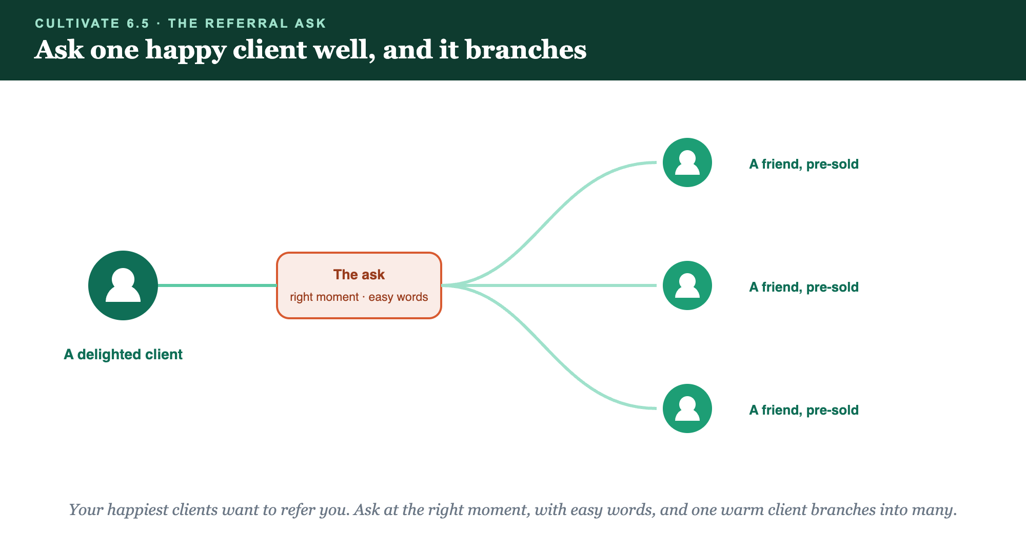
A DELIGHTED CLIENT · THE ASK · FRIENDS, PRE-SOLD
Ask one happy client well, and it branches.

Slide 8
PUT YOUR SECOND MATE TO WORK
More than copy. Your referral desk.
ASK
EQUIP
THANK
The ask
Easy words
The thank-you
It scripts a warm, confident referral ask for each happy client, never needy.
It writes the copy-paste line a client can send a friend with no thinking.
It drafts the genuine thank-you that makes a referrer want to do it again.
Copy-paste example prompts are in the library: How to Prompt Your Second Mate.

Slide 9
YOUR FIRST BRICK
Build your referral ask.
1
Your moments
Decide the high points you'll treat as your cue to ask. (The Your Referral Ask worksheet.)
2
Your words
Write the warm ask and the copy-paste line, plus the link you'll hand them.
3
Your thank-you
Decide how you'll thank a referrer and close the loop so they do it again.

Slide 10
WANT A HAND WITH THIS PART?
Three ways to get unstuck.
GROUP
ONE-ON-ONE
DONE WITH / FOR YOU
Professor Hours
Book a 1:1
Hire us
Bring your specific question to office hours and ask it live.
We work on yours, screen to screen, until it's done right.
Consultant or coach. We build it with you, or we build it for you.

Slide 11
BUILT WITH YOU, NOT TAUGHT AT YOU
Ask, and warm
referrals follow.
You can write your ask, your easy words, and your thank-you today. Turning referrals from luck into a habit you run is what we build together.
We build it with you →
Next → Dream-Destination Nudges: planting the next trip.
Post your referral ask script and when you'll ask. Questions? Bring them to this week's Professor Hours.

