Slide 1
MARKETING JOURNEYS · THE TRADEWINDS METHOD · CULTIVATE
Session 6.4
Re-Engagement Campaigns
How many warm clients have I let quietly go cold?

Slide 2
WAKE THE SLEEPING GOLDMINE
A quiet contact
is not a lost one.
Sitting in your Manifest right now are people who knew you, liked you, and simply drifted. The right nudge brings dormant clients back to life, and it is far cheaper than finding new ones.

Slide 3
THE HEADWIND HERE IS THE LEAKY BUCKET
Quiet is not lost.
Every advisor has them: the people who inquired and went quiet, the client who booked once two years ago, the warm lead that just faded. Most advisors write them off as gone. They are not gone. They are dormant, and dormant is a world away from lost. These are the leaked drops still sitting in the bottom of the bucket, and you can scoop a lot of them back up with a single thoughtful message. It is the cheapest growth there is. You already did the hard work of earning their attention once. Re-engagement is just going back for what you already paid for.
Dormant is not lost. The drops that leaked out are still in the bucket, and a single message can scoop them back.

Slide 4
FIND THEM FIRST
Spot the dormant.
You cannot win back people you cannot see, so the first move is simply to find them. Open your Manifest and look for the quiet ones: past clients who haven't traveled with you in a year or more, old inquiries that never closed, leads that stalled and went silent. This is exactly why you built the system and the tags back in Build and Confirm. A well-kept Manifest hands you this list in seconds. A shoebox of business cards never will. Sort them out, and you are looking at a pile of warm-ish leads you already own, ready for a nudge.
A well-kept Manifest hands you the dormant list in seconds. This is the payoff for tagging as you go.

Slide 5
THE MESSAGE THAT ACTUALLY WORKS
A win-back with a real reason.
Warm, not guilt
Give them a reason
Never 'we miss you' or 'you haven't booked.' Lead with them: 'It's been a while and you crossed my mind, are you still dreaming of Italy?' Personal, light, no pressure. You're reopening a door, not collecting a debt.
A nudge needs a hook: a new destination they'd love, a timely deal window, a where-to-next tied to their old dream. A reason to reply now beats a vague hello. Make re-engaging feel like a gift, not a chore.
Lead with them, not your sales target. Give a real reason to reply now, and the door reopens.

Slide 6
THE QUIET BONUS
Clean the list as you go.
Here is the part nobody expects to love. When you run a re-engagement campaign, some people come roaring back to life, and that is the win. But some never respond, no matter what, and that is also a win, because now you know. A list full of dead names lies to you. It makes you feel like you have more reach than you do, and it costs you money on every platform that charges by contact. So as you re-engage, you also prune: the truly cold get gently retired. You end up with a smaller list that is far more alive, and a list with a pulse is worth ten times a list that just looks big.
Some wake up, some never will, both are wins. A smaller list with a pulse beats a big list of dead names.

Slide 7
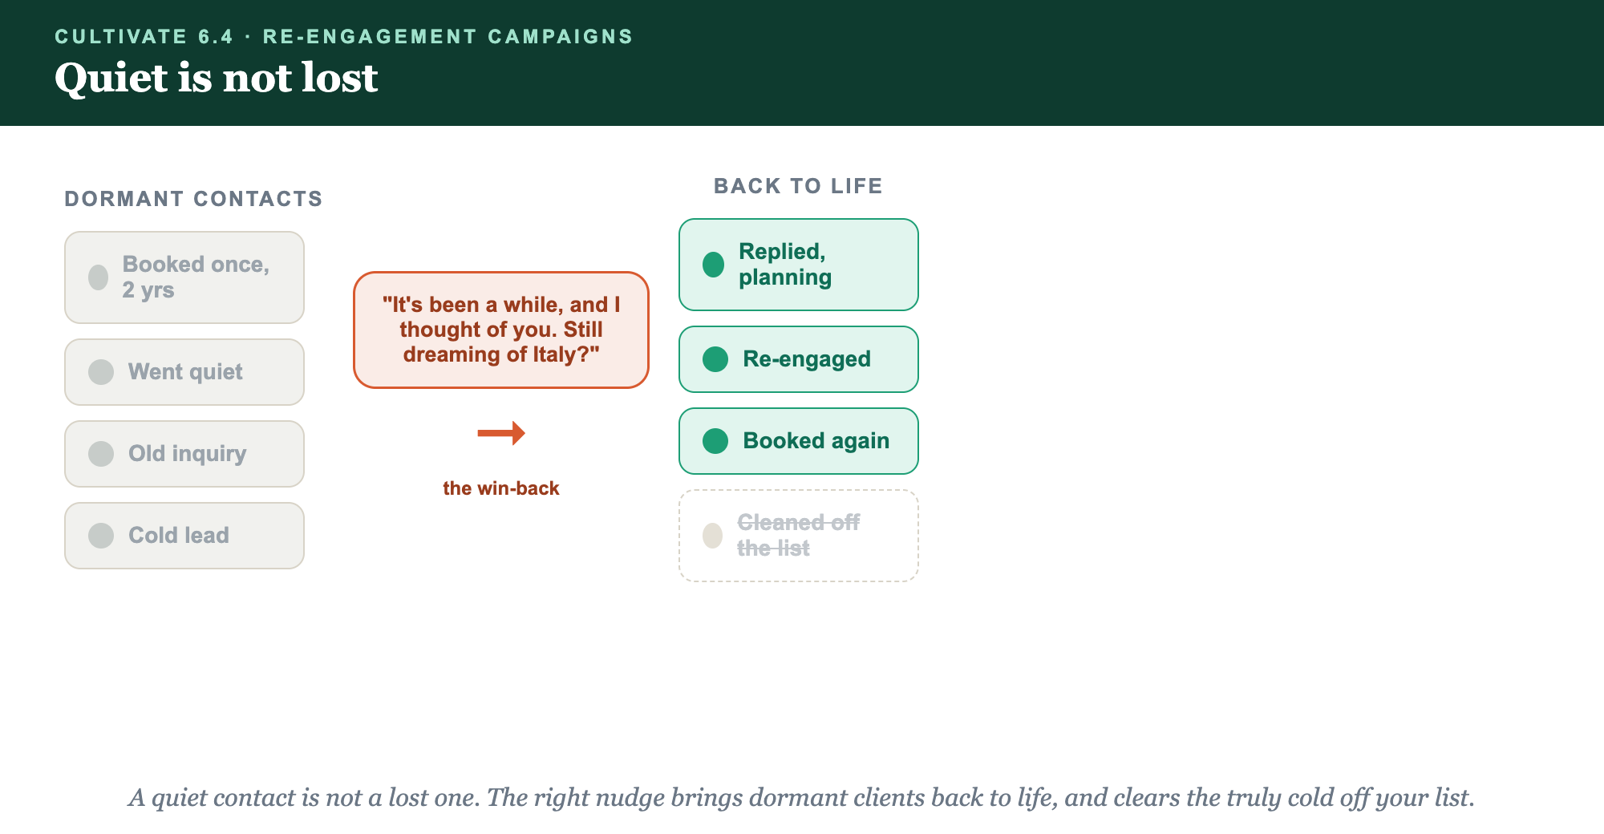
SPOT THE DORMANT · THE WIN-BACK · BACK TO LIFE · CLEAN THE REST
Quiet is not lost.

Slide 8
PUT YOUR SECOND MATE TO WORK
More than copy. Your win-back desk.
WRITE
TAILOR
SORT
The campaign
To the dream
Who's dormant
It writes a warm win-back sequence that leads with them, never with guilt.
It personalizes each nudge to the destination or dream in your old notes.
It helps you scan the Manifest for who's gone quiet and worth waking.
Copy-paste example prompts are in the library: How to Prompt Your Second Mate.

Slide 9
YOUR FIRST BRICK
Build your win-back.
1
Your dormant list
Pull the quiet ones from your Manifest: past clients and stalled leads. (The Your Win-Back worksheet.)
2
Your message
Write the warm win-back that leads with them and gives a real reason to reply.
3
Send and prune
Send it, welcome the ones who return, and gently retire the truly cold.

Slide 10
WANT A HAND WITH THIS PART?
Three ways to get unstuck.
GROUP
ONE-ON-ONE
DONE WITH / FOR YOU
Professor Hours
Book a 1:1
Hire us
Bring your specific question to office hours and ask it live.
We work on yours, screen to screen, until it's done right.
Consultant or coach. We build it with you, or we build it for you.

Slide 11
BUILT WITH YOU, NOT TAUGHT AT YOU
A nudge revives
a dormant client.
You can pull your dormant list and write your win-back today. Reviving the warm clients you already own is what we build together.
We build it with you →
Next → The Referral Ask: the ask that grows everything.
Post who you'll re-engage and your win-back message. Questions? Bring them to this week's Professor Hours.

