Slide 1
MARKETING JOURNEYS · THE TRADEWINDS METHOD · CULTIVATE
Session 6.3
Anniversary & Birthday Touchpoints
Do my clients feel remembered all year, or only when I want a booking?

Slide 2
THE TOUCHES THEY NEVER FORGET
A birthday message costs nothing
and lands like gold.
A well-timed birthday or trip-anniversary note makes a client feel remembered all year long. Captured once, it works on its own, and it is the warmest little marketing you will ever do.

Slide 3
THE HEADWIND HERE IS THE LEAKY BUCKET
The moments worth marking.
Most of your touches in Cultivate are about you reaching out. These two are different, because they are about them, on the days that matter most to them. A birthday. The anniversary of that trip-of-a-lifetime you planned. These are the moments a client feels seen, or feels forgotten, and the gap between the two is enormous. Forgetting is a quiet leak, a slow cooling of a warm relationship. But a single thoughtful message on the right day does the opposite of a leak: it deepens the bond, for the price of almost nothing. The advisor who remembers your birthday is the advisor you never leave.
Forgetting the moments that matter to them is a quiet leak. Remembering them deepens the bond for almost nothing.

Slide 4
YOU CAN'T MARK WHAT YOU DIDN'T CAPTURE
Capture the dates.
None of this works on memory. The whole thing lives or dies on one small habit: capturing the date the moment you learn it, right into your CRM. A birthday that comes up in discovery. The travel dates that become a trip anniversary. The kind of detail that feels too small to write down is exactly the detail that, a year later, lands like you cared all along. So you build it into intake, the same way you tag a lead: when a date matters to them, it goes in the Manifest. A date you meant to remember is a date you will forget. A date in the system fires on its own, forever.
Capture the date the second you hear it. A date you mean to remember is a date you'll forget.

Slide 5
AUTOMATE THE TIMING, NEVER THE WARMTH
Automate the personal touch.
Let the system remember
Keep it human
The CRM watches the calendar so you don't have to. On the day, it surfaces the moment, or fires the message. You never miss one, and it never depends on you having a good week.
Automate the reminder, not the relationship. The message should still feel like you, warm and specific, never a stiff corporate auto-card. The system holds the date; you bring the heart.
Automate the timing so you never miss it. Keep the words warm so it never feels like a robot sent it.

Slide 6
THE NUDGE INSIDE THE MOMENT
The gentle rebook.
Here is the quiet magic of a trip anniversary. A year ago today, this client was somewhere wonderful because of you, and a warm note brings that whole feeling rushing back. That glow is the most natural possible moment to plant the next trip. Not a hard pitch, never that. Just a soft, open door: can you believe it's been a year since Tuscany? Where are we dreaming about next? The birthday lands the love; the anniversary lands the love and, gently, the next booking. You are not selling. You are reminding someone of a feeling they want to have again, and quietly letting them know the way back is you.
A trip anniversary brings the glow rushing back, the most natural moment to softly plant the next trip.

Slide 7
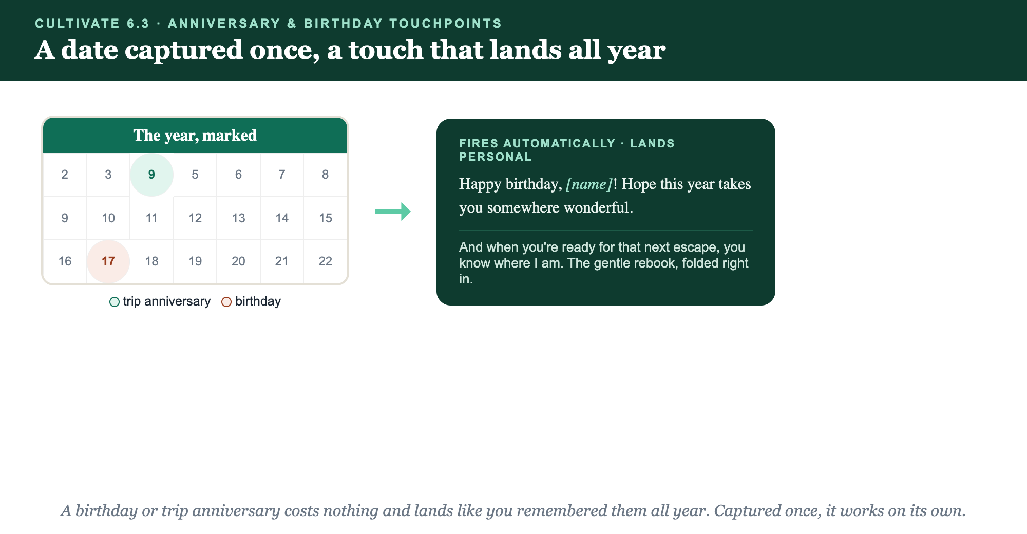
CAPTURE THE DATE · IT FIRES ON ITS OWN · IT LANDS PERSONAL
A date captured once, a touch all year.

Slide 8
PUT YOUR SECOND MATE TO WORK
More than copy. Your memory keeper.
WRITE
REBOOK
SCHEDULE
The message
The soft door
Set and forget
It drafts a warm birthday or anniversary note that sounds like you, not a card.
It folds a gentle where-to-next into the anniversary, never a hard pitch.
It helps you template the touches so the system fires them on the day.
Copy-paste example prompts are in the library: How to Prompt Your Second Mate.

Slide 9
YOUR FIRST BRICK
Build your moments.
1
The dates
Decide which dates you'll capture, birthdays and trip anniversaries, and add them at intake. (The Your Moments worksheet.)
2
Your message
Write the warm birthday note and the anniversary note with its gentle rebook door.
3
Make it fire
Set the touches in your CRM so the day never depends on you remembering.

Slide 10
WANT A HAND WITH THIS PART?
Three ways to get unstuck.
GROUP
ONE-ON-ONE
DONE WITH / FOR YOU
Professor Hours
Book a 1:1
Hire us
Bring your specific question to office hours and ask it live.
We work on yours, screen to screen, until it's done right.
Consultant or coach. We build it with you, or we build it for you.

Slide 11
BUILT WITH YOU, NOT TAUGHT AT YOU
Remembered clients
come back.
You can pick your dates and write your messages today. Building the touches that make a client feel remembered all year is what we build together.
We build it with you →
Next → Re-Engagement Campaigns: waking the quiet ones before they forget you.
Post the dates you'll capture and your birthday message. Questions? Bring them to this week's Professor Hours.

