Slide 1
MARKETING JOURNEYS · THE TRADEWINDS METHOD · CULTIVATE
Session 6.2
The Email Newsletter
Am I the advisor they think of, or the one they forgot?

Slide 2
THE CHANNEL THAT KEEPS YOU CLOSE
A newsletter is not a chore.
It is staying top of mind.
It is the easiest, lowest-pressure way to stay in front of your whole list at once, so when a trip comes up, you are the one they think of, and the one they refer.

Slide 3
THE HEADWIND HERE IS THE LEAKY BUCKET
Out of sight is out of business.
People do not leave you because they got angry. They leave because they forgot. A client books a wonderful trip, loves you, fully intends to use you again, and then eighteen quiet months go by and a coworker mentions an advisor, and they book with that person, not because they liked them more, but because that person was simply in front of them at the right moment. That is the leak: not a complaint, just a fade. A newsletter plugs it, gently and at scale. It keeps you in front of everyone at once, so when the someday trip finally becomes a real one, your name is the one already in their head.
Clients don't leave angry, they leave because they forgot. The newsletter keeps you in front of all of them at once.

Slide 4
SIMPLE ENOUGH THAT YOU ACTUALLY SEND IT
A simple, repeatable format.
The reason most advisor newsletters die after issue two is that they were too ambitious. A glossy magazine you dread building is a newsletter you stop sending. So keep it dead simple and the same every time: a warm personal note from you, one genuinely useful idea or destination, and one gentle invitation to reach out. That is it. A format you can fill in your sleep is a format you will still be sending a year from now. Boring and consistent beats brilliant and abandoned, every single time.
A glossy newsletter you dread is one you'll stop sending. Same simple shape every time, so it survives.

Slide 5
WHAT TO ACTUALLY WRITE ABOUT
Be a person, not a brochure.
Write this
Not this
A trip you loved, a destination that's having a moment, a real travel tip, a behind-the-scenes story, a quick where-to-next idea. Things that are genuinely useful or genuinely human. Give them something worth opening.
A wall of sales pitches. Constant 'book now.' Generic supplier copy anyone could send. Promotional noise gets ignored and unsubscribed. The personal, useful note gets read, and keeps you welcome in the inbox.
Personal and useful gets opened. Promotional noise gets unsubscribed. Be the human in their inbox.

Slide 6
THE RHYTHM WITHOUT THE DREAD
A cadence you can keep.
Once a month is plenty. Once a quarter still works. What matters is not frequency, it is that you actually keep it, because a newsletter that shows up reliably builds trust, and one that vanishes for a year and reappears feels like a stranger. Pick a cadence you can sustain on your worst, busiest month, then protect it. And here is where it stops being a burden: your Second Mate can turn a few bullet points into a finished, warm newsletter in minutes. You bring the idea and the personal note, it does the heavy lifting of the writing. That is how the dread disappears and the rhythm survives.
Pick a cadence you can keep on your busiest month, then protect it. Showing up reliably is the whole game.

Slide 7
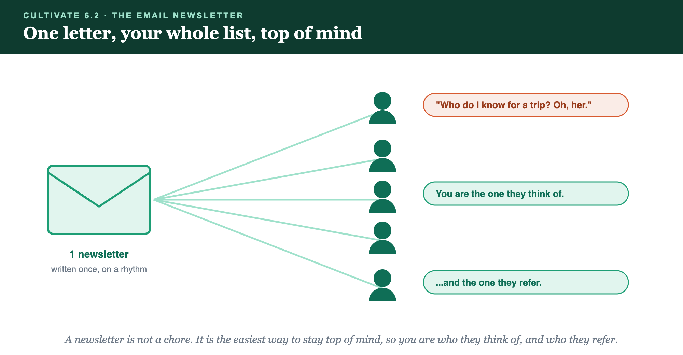
ONE LETTER · YOUR WHOLE LIST · TOP OF EVERY MIND
One letter, your whole list, top of mind.

Slide 8
PUT YOUR SECOND MATE TO WORK
More than copy. Your newsletter desk.
DRAFT
IDEAS
POLISH
From bullets
What to send
Subject lines
Give it a few rough notes and it writes the whole warm newsletter in your voice.
Stuck for a topic? It suggests a month of newsletter ideas tied to your niche.
It writes subject lines worth opening, so your letter doesn't die unread.
Copy-paste example prompts are in the library: How to Prompt Your Second Mate.

Slide 9
YOUR FIRST BRICK
Build your newsletter.
1
Your format
Lock your three simple parts: a note from you, one useful idea, one gentle invitation. (The Your Newsletter worksheet.)
2
Your cadence
Pick the rhythm you can keep on your busiest month, monthly or quarterly.
3
Draft issue one
Hand a few bullets to your Second Mate and ship your first newsletter.

Slide 10
WANT A HAND WITH THIS PART?
Three ways to get unstuck.
GROUP
ONE-ON-ONE
DONE WITH / FOR YOU
Professor Hours
Book a 1:1
Hire us
Bring your specific question to office hours and ask it live.
We work on yours, screen to screen, until it's done right.
Consultant or coach. We build it with you, or we build it for you.

Slide 11
BUILT WITH YOU, NOT TAUGHT AT YOU
Top of mind
is top of the referral list.
You can lock your format and draft issue one today. Building a newsletter you'll actually keep sending is what we build together.
We build it with you →
Next → Anniversary and Birthday Touchpoints: the personal moments they remember.
Post your newsletter format and cadence. Questions? Bring them to this week's Professor Hours.

