Slide 1
MARKETING JOURNEYS · THE TRADEWINDS METHOD · CULTIVATE
Session 6.1
Your Stay-in-Touch System
Is my Manifest a living databank, or a graveyard?

Slide 2
WORKING THE MANIFEST
Most advisors close a sale,
then let it go dead.
The quiet goldmine is not a new lead, it is the roster of people who already know you. Worked on a rhythm, the Manifest pays you forever.

Slide 3
THE HEADWIND HERE IS THE LEAKY BUCKET
Don't let your databank go dead.
Here is what happens to most client lists. You make the sale, you deliver a wonderful trip, and then, quietly, you move on to the next fire. Months pass. A year passes. And that client, who adored you, slowly forgets your name, because you went silent. That is the biggest leak in the whole bucket, and it is invisible, because nothing dramatic happens. There is no angry email, no complaint. There is just a slow, silent fade, a databank going cold one forgotten name at a time. You worked hard to fill this bucket. You will not let it leak out the bottom from simple neglect. The fix is not more clients. The fix is a rhythm.
A client list left alone goes cold one forgotten name at a time. Neglect is the quietest, biggest leak.

Slide 4
THE FIX IS A RHYTHM, NOT A SCRAMBLE
The stay-in-touch rhythm.
A relationship does not stay warm on its own, and it does not stay warm because you blast everyone the week you happen to feel guilty. It stays warm because you show up on a steady, gentle beat, the same way a heartbeat keeps a body alive. A few light, genuine touches across the year, spaced out, never crowding, is all it takes. That is the difference between a databank with a pulse and a flatline. And the beautiful part is that the rhythm does the remembering for you. You do not have to think did I reach out to her? The system already knows. You just keep the beat.
Warm is not a one-time blast, it's a steady beat. A few light touches across the year keep the pulse alive.

Slide 5
WHAT TO SEND, AND HOW OFTEN
Light, genuine, and useful.
What to send
How often
Not constant pitches. A genuine check-in, a helpful tip, a where-to-next idea, a happy-birthday note, a newsletter. Personal beats promotional every time. Each touch should give something, not ask for something.
Often enough to stay top of mind, rarely enough to never be a pest. A light touch every month or two, plus the personal moments. The rest of Cultivate, the newsletter, the birthdays, the nudges, fills this calendar in.
Give, don't ask. Light enough to never annoy, steady enough to never be forgotten.

Slide 6
SO YOU ACTUALLY KEEP IT
Sustainable, not a second job.
Now hear me, because this is where good intentions go to die. If your stay-in-touch plan depends on you remembering, feeling inspired, and finding the time, it will fail by March. Every time. The only rhythm that survives is the one you build into a system once and then mostly let run. You set the cadence in your CRM, you let the automatic touches fire, and your Second Mate drafts the words so a blank page never stops you. You stay the human, you add the personal note, but the machine keeps the beat. That is how a forever-rhythm stays sustainable instead of becoming one more thing you abandon.
A rhythm that needs willpower dies by March. Build it once, let it run, and add the human touch.

Slide 7
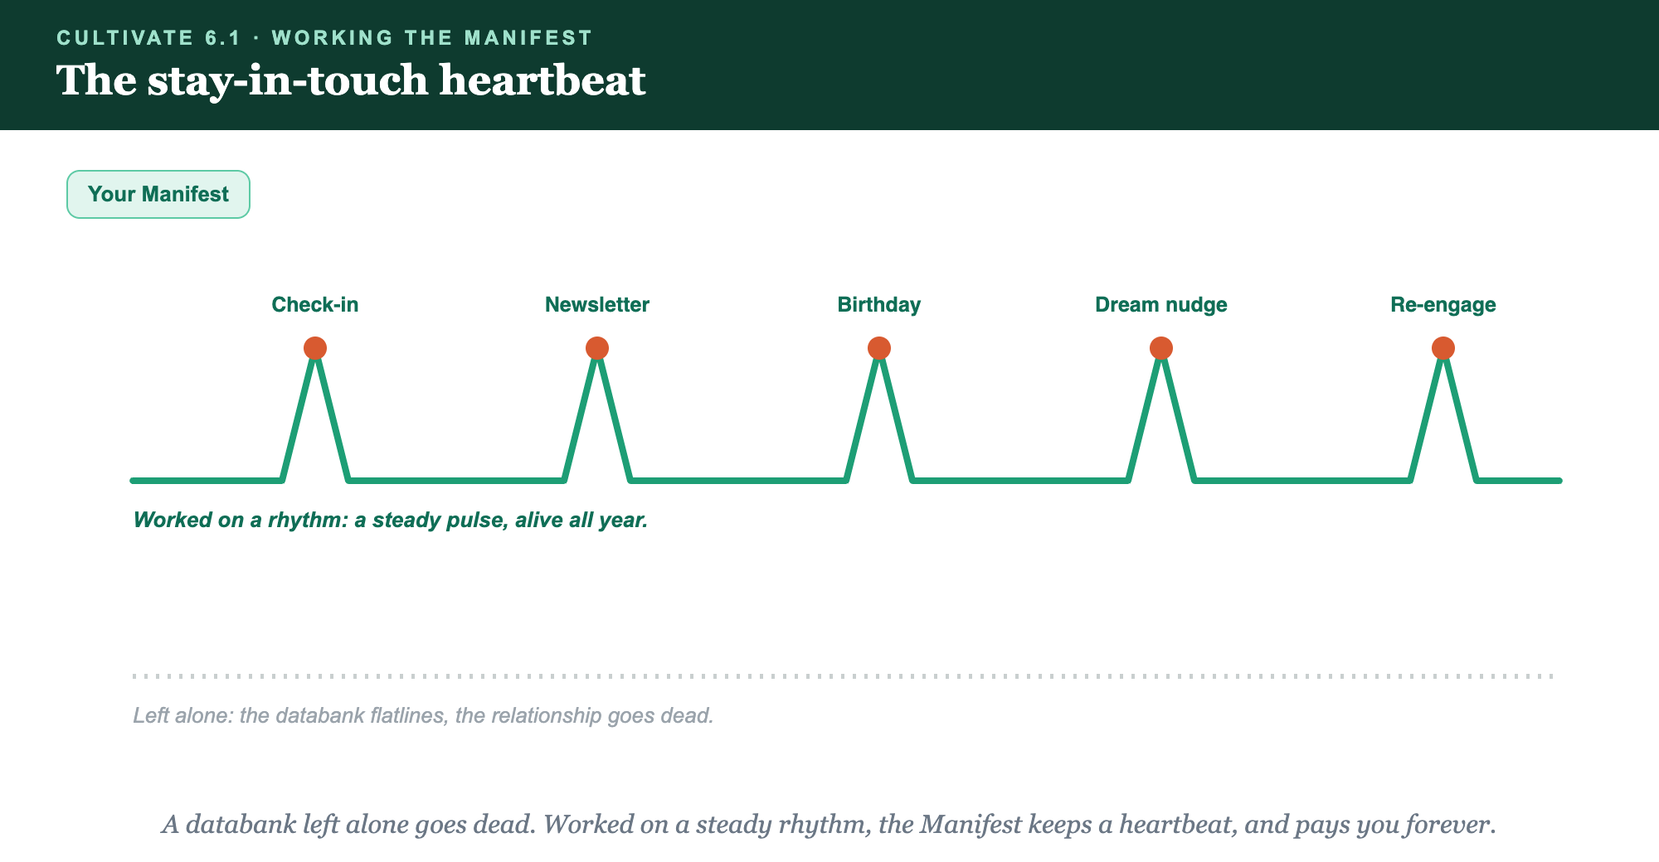
CHECK-IN · NEWSLETTER · BIRTHDAY · DREAM NUDGE · RE-ENGAGE
The stay-in-touch heartbeat.

Slide 8
PUT YOUR SECOND MATE TO WORK
More than copy. It keeps the beat.
DESIGN
WRITE
REMEMBER
Your cadence
The messages
Who's due
It maps a simple, sustainable stay-in-touch rhythm to your client list.
It drafts each touch, the check-in, the tip, the where-to-next, in your voice.
It flags who you haven't touched in too long, so no one quietly fades.
Copy-paste example prompts are in the library: How to Prompt Your Second Mate.

Slide 9
YOUR FIRST BRICK
Build your cadence.
1
Your beat
Decide how often you'll touch your Manifest, light enough to never annoy. (The Your Cadence worksheet.)
2
Your touches
List what you'll send: the check-in, the tip, the where-to-next, the personal note.
3
Make it run
Set it in your CRM and let your Second Mate draft the words, so it survives a busy month.

Slide 10
WANT A HAND WITH THIS PART?
Three ways to get unstuck.
GROUP
ONE-ON-ONE
DONE WITH / FOR YOU
Professor Hours
Book a 1:1
Hire us
Bring your specific question to office hours and ask it live.
We work on yours, screen to screen, until it's done right.
Consultant or coach. We build it with you, or we build it for you.

Slide 11
BUILT WITH YOU, NOT TAUGHT AT YOU
Worked on a rhythm,
the Manifest pays forever.
You can set your cadence and your first few touches today. Turning a cold list into a living databank with a heartbeat is what we build together.
We build it with you →
Next → The Email Newsletter: the heartbeat of staying in touch.
Post your stay-in-touch cadence, who, what, how often. Questions? Bring them to this week's Professor Hours.

