Slide 1
MARKETING JOURNEYS · THE TRADEWINDS METHOD · CARE
Session 5.7
Turning Clients into Advocates
Are my happiest clients quietly growing my business for me?

Slide 2
THE CAPSTONE OF CARE
Your happiest clients are
your best salespeople.
A referral arrives already trusting you, pre-sold before you say a word. Everything you built in Care now pays you back, in the easiest, warmest clients you will ever get.

Slide 3
THE HEADWIND HERE IS THE LEAKY BUCKET
A happy client is your best marketing.
Think about how much time and money the world spends chasing cold strangers. And then look at what is sitting right in your hands: a roster of clients who adore you, who would happily tell the world about you. A referral from a friend skips every hard part of marketing, there is no doubt, no price-shopping, no proving yourself, they arrive already trusting you completely. That is the warmest lead on earth, and you earned a pile of them through everything you did in Care. The leak here is simply letting all that goodwill sit silent and unused, while you go out and pay to chase strangers. Your fans are a goldmine. This session is about gently opening it.
A referral skips the doubt, the price-shopping, the proving. Your fans are the warmest leads on earth.

Slide 4
THE STEP MOST ADVISORS SKIP
Don't wait for it. Ask.
Here is the quiet tragedy: most advisors just hope referrals happen, and then wonder why so few do. Your clients are not withholding them out of stinginess, it simply does not occur to them, they are busy living their lives. So you have to ask, warmly and specifically. Not a needy who do you know, but a gentle, confident invitation: I would love to help more travelers like you, so if a friend ever mentions a trip, I would be honored if you sent them my way. Asking is not pushy, it is permission for someone who already loves you to do the kind thing they would have been glad to do anyway. The ones who do not ask, do not get. So ask.
Clients don't withhold referrals, they just don't think of it. Ask warmly, and the floodgate opens.

Slide 5
LOWER EVERY BIT OF FRICTION
Make it easy to refer.
Give them the words
Give them the path
Most people want to refer you but freeze on what to say. Hand them an easy line: 'just tell them I help with [your niche], and send them my way.' Take the thinking out of it.
And the simplest next step: a link, your details, a card to pass along. The easier you make referring, the more it happens. Friction is the only thing standing between goodwill and a new client.
People want to help, they just need it easy. Give them the words and the link, and remove every hurdle.

Slide 6
WHERE CARE BECOMES GROWTH
The advocate flywheel.
Step back and see the beautiful machine you have built. You care deeply for a client, so they become genuinely delighted. A delighted client refers and reviews, which brings you new clients who already trust you. You care deeply for them too, and they become advocates as well. That is a flywheel, and every single turn makes it spin faster and easier. This is the great secret of a business that grows without grinding: you do not chase growth, you earn it, by caring so well that your clients cannot help but send you more. And notice where the wheel points next, all this advocacy feeds the very top of your funnel, which is exactly where Cultivate, the final part, picks up.
Care makes advocates, advocates bring clients, the wheel spins faster. Grow by caring, not by grinding.

Slide 7
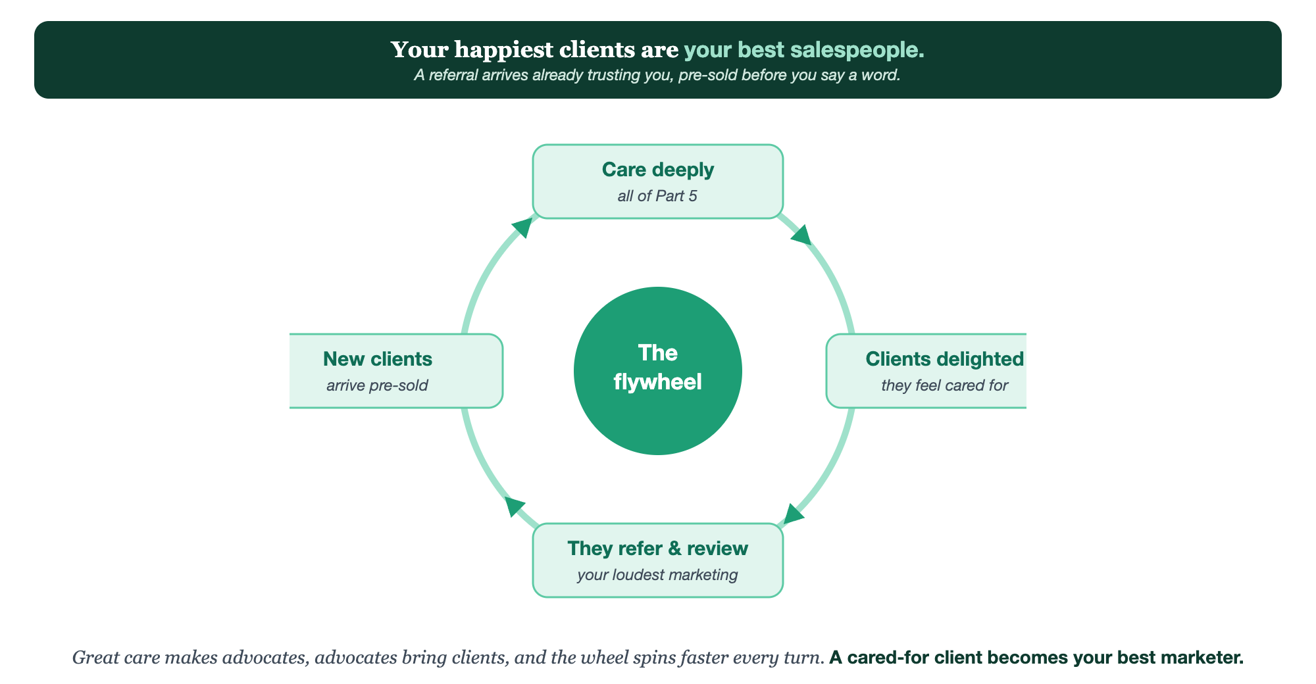
CARE DEEPLY · CLIENTS DELIGHTED · THEY REFER & REVIEW · NEW CLIENTS, PRE-SOLD
The advocate flywheel.

Slide 8
PUT YOUR SECOND MATE TO WORK
More than copy. Your referral engine.
ASK
EQUIP
THANK
The warm ask
The easy words
The thank-you
It writes your referral request, confident and warm, never needy, in your voice.
It drafts the simple line a happy client can copy and paste to refer you.
It writes a genuine thank-you that makes a referrer want to do it again.
Copy-paste example prompts are in the library: How to Prompt Your Second Mate.

Slide 9
YOUR FIRST BRICK
Build your referral ask.
1
Your warm ask
Write the gentle, confident way you'll invite referrals. (The Your Advocates worksheet.)
2
Your easy words
Write the simple line a client can pass along, plus the link or detail to send.
3
Your thank-you
Decide how you'll thank a referrer so generously they want to do it again.

Slide 10
WANT A HAND WITH THIS PART?
Three ways to get unstuck.
GROUP
ONE-ON-ONE
DONE WITH / FOR YOU
Professor Hours
Book a 1:1
Hire us
Bring your specific question to office hours and ask it live.
We work on yours, screen to screen, until it's done right.
Consultant or coach. We build it with you, or we build it for you.

Slide 11
BUILT WITH YOU, NOT TAUGHT AT YOU
A cared-for client
is your best marketer.
You can write your referral ask and your easy words today. Turning quiet goodwill into a flywheel of warm, pre-sold clients is what we build together.
We build it with you →
Next → Part 6, Cultivate: feeding the whole engine, so it grows on its own.
Post your referral ask, the words most people never find. Questions? Bring them to this week's Professor Hours.

