Slide 1
MARKETING JOURNEYS · THE TRADEWINDS METHOD · CARE
Session 5.6
Staying Top of Mind
Between trips, am I the advisor they'll remember, or the one they forget?

Slide 2
THE LONG GAME, BETWEEN TRIPS
Out of sight is
out of business.
A trip might be a year away, or more. The advisor a client remembers in that long gap is the advisor they rebook. Stay warm, and you stay their advisor for life.

Slide 3
THE HEADWIND HERE IS THE LEAKY BUCKET
You're forgotten, not replaced.
Here is the quiet truth about losing past clients: you rarely lose them to a better advisor. You lose them to forgetting. They had a wonderful trip with you, they fully intended to use you again, and then a year of ordinary life rolled by in silence, and when they finally booked, a different name happened to be in front of them. They did not betray you. They just forgot you existed. That is the slowest, most invisible leak in the whole bucket, and it is the easiest one to plug. You do not need to win them back, you only need to stay gently, warmly present, so that when the travel itch returns, yours is the only name in their head.
You don't lose past clients to a rival. You lose them to forgetting. Stay present, and you stay theirs.

Slide 4
LIGHT, WARM, ALL YEAR
The between-trips cadence.
Staying top of mind is not a big campaign, it is a light, warm rhythm across the year. A handful of touches, no more: a birthday note, a hello on the anniversary of their trip, a remember when, a thought of you when something reminds you of them, a gentle where to next when the season turns. That is it. A few personal moments a year, spaced out, that quietly say I still think about you. You set the rhythm once, your CRM reminds you when, and you stay present without it ever eating your week. And like everything in Care, it compounds: every warm touch deepens a bond that pays you back for years.
Not a campaign, a rhythm. A few warm, personal touches a year, set once and reminded by your CRM.

Slide 5
THE MISTAKE ALMOST EVERYONE MAKES
Personal beats promotional.
Promotional (gets ignored)
Personal (gets remembered)
The generic monthly newsletter of deals and packages. It screams 'I want to sell you something,' so it goes straight to the trash, unread, and quietly trains them to tune you out.
A note that's about them, their birthday, their trip, the thing they mentioned. It says 'I remember you,' which is what builds the bond that brings them back.
A deals newsletter trains them to ignore you. A personal note makes them feel remembered. Choose personal.

Slide 6
KEEP THE NEXT DREAM ALIVE
The "where to next?"
Woven gently through that yearly rhythm is one warm, recurring question that keeps the next trip alive without ever pushing: where to next? You planted the seed at the welcome home, and now you simply keep it watered. Saw this and thought of your someday-Japan dream. The shoulder season for Portugal is gorgeous, just so it's on your radar. You are not chasing a sale, you are keeping a shared dream warm between the two of you, so that booking the next trip feels less like a decision and more like the natural continuation of a conversation you never really stopped having. When the itch finally hits, you are already mid-dream together, and the rebooking is effortless.
Keep a shared dream warm, gently, all year. Then the next booking is just the conversation continuing.

Slide 7
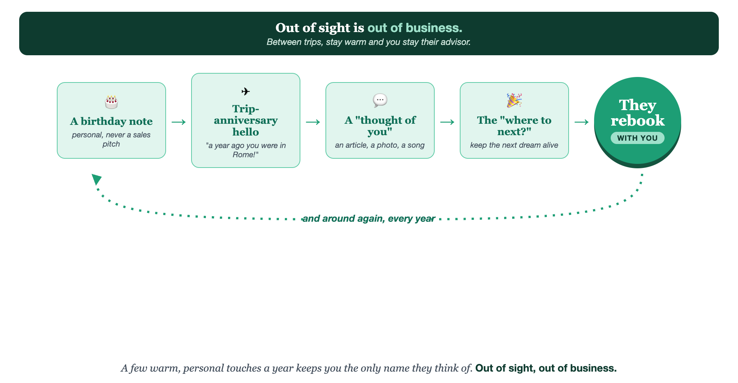
A FEW WARM TOUCHES A YEAR · PERSONAL, NOT PROMOTIONAL · AND THEY REBOOK
Staying top of mind.

Slide 8
PUT YOUR SECOND MATE TO WORK
More than copy. Your year-round secretary.
PLAN
PERSONAL
SPOT
The yearly rhythm
The warm note
Who's due
It maps a light, personal touch calendar for your past clients across the year.
Give it the client and the occasion; it writes a personal note, never a sales blast.
It helps you spot which past clients are quiet and ready for a warm hello.
Copy-paste example prompts are in the library: How to Prompt Your Second Mate.

Slide 9
YOUR FIRST BRICK
Build your stay-in-touch plan.
1
Your yearly touches
Pick the handful of personal touches you'll send past clients each year. (The Your Long Game worksheet.)
2
Make it run
Note the dates in your CRM so each touch reminds you, instead of relying on memory.
3
Your 'where to next'
Write the warm, no-pressure way you'll keep the next dream alive.

Slide 10
WANT A HAND WITH THIS PART?
Three ways to get unstuck.
GROUP
ONE-ON-ONE
DONE WITH / FOR YOU
Professor Hours
Book a 1:1
Hire us
Bring your specific question to office hours and ask it live.
We work on yours, screen to screen, until it's done right.
Consultant or coach. We build it with you, or we build it for you.

Slide 11
BUILT WITH YOU, NOT TAUGHT AT YOU
Stay warm,
stay their advisor.
You can map your yearly touches and your where-to-next today. Building a light, personal rhythm that keeps you top of mind without ever being a pest is what we set up together.
We build it with you →
Next → 5.7, Turning Clients into Advocates: your happiest clients as your best marketing.
Post your favorite between-trips touch for the group to borrow. Questions? Bring them to this week's Professor Hours.

