Slide 1
MARKETING JOURNEYS · THE TRADEWINDS METHOD · CARE
Session 5.5
The Welcome Home
Am I using the homecoming, or letting the magic fade in silence?

Slide 2
THE MOMENT ALMOST EVERYONE WASTES
The trip isn't over
when they land.
Your client comes home glowing, full of stories, more in love with travel than ever. That glow is precious, and it fades fast. The welcome home is where a great trip becomes a forever client.

Slide 3
THE HEADWIND HERE IS THE LEAKY BUCKET
The glow fades fast.
The day they get home, your client is at their absolute peak: thrilled, grateful, bursting to tell someone. And then, for most advisors, silence. The trip ends, the advisor moves on, and that beautiful glow just quietly fades into ordinary life. Within a couple of weeks the magic is gone, and with it your easiest testimonial, your warmest referral, and the open door to their next trip. That is the leak this session plugs, and it is a heartbreaking one, because the gold was right there for the taking. Show up at the homecoming, while the glow is high, and you capture everything that the silence lets slip away.
They're at peak glow the day they land. Go silent and it fades, taking the testimonial and the next trip.

Slide 4
SHOW UP FOR THE HOMECOMING
Welcome home, then listen.
The welcome-home touch
The debrief
A warm note, or a small gift waiting when they walk in: welcome back, I've been dying to hear about it. The magic bookends the trip, and they feel cared for to the very end.
Then you ask, and you genuinely listen. How was it? What was the best moment? You're not fishing, you care, and their answers are pure gold for the trip you'll plan next.
A warm welcome-home, then a real debrief. You're closing the loop and opening the next one at once.

Slide 5
ASK WHILE THE GLOW IS HIGH
Capture the magic.
This is the moment, the only moment, to ask for the testimonial and the review, and you ask while the glow is at its peak. A week later they are buried back in work and the spark is gone; today, they are still floating, and they would love nothing more than to gush about you. So you make it easy and specific: I am so glad you had a wonderful time, would you mind sharing a few words about your experience? It would mean the world. Capture their story now, in their words, while it is warm. That single testimonial, caught at peak glow, will go on to earn you clients for years.
The testimonial is easiest at peak glow. Ask the week they're home, make it easy, capture it warm.

Slide 6
OPEN THE DOOR, GENTLY
Plant the seed of next.
And right here, with the glow still high, you do one last quiet, powerful thing: you plant the seed of the next trip. Not a pitch, never a pitch. Just a warm, open door. You know, with how much you loved the cooking class, you would adore Tuscany, let us dream about that whenever you are ready. You are not selling, you are continuing a relationship, signaling that this was the first of many adventures together, not a one-time transaction. That tiny seed, planted at the peak of their love for travel, is what quietly turns a single happy trip into a lifetime of them booking with you, and only you.
Plant the next trip as a warm open door, not a pitch. One trip becomes a lifetime of booking with you.

Slide 7
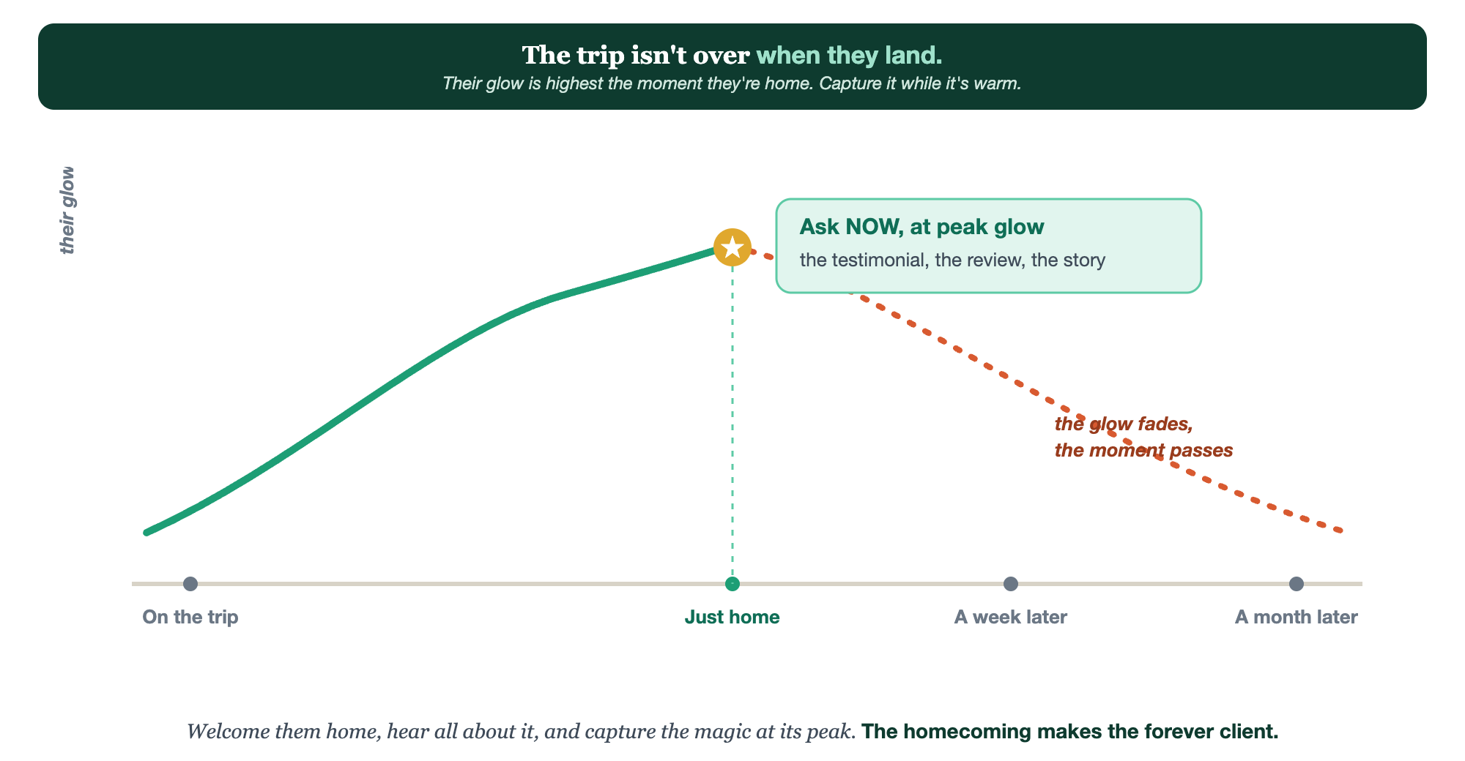
PEAK GLOW THE DAY THEY LAND · WELCOME HOME · DEBRIEF · CAPTURE · SEED THE NEXT
The welcome home.

Slide 8
PUT YOUR SECOND MATE TO WORK
More than copy. Your homecoming host.
WRITE
POLISH
SEED
The welcome-home
Their words
The next idea
It drafts your warm welcome-back note and your easy, specific testimonial request.
Paste their debrief; it shapes it into a clean testimonial for them to approve.
From what they loved, it suggests the next-trip seed to plant, gently.
Copy-paste example prompts are in the library: How to Prompt Your Second Mate.

Slide 9
YOUR FIRST BRICK
Build your welcome home.
1
Your welcome-home touch
Write the warm note or pick the gift that greets every client on return. (The Your Welcome Home worksheet.)
2
Your debrief and ask
Write your how-was-it questions and your easy, specific testimonial request.
3
Your next-trip seed
Note how you'll gently open the door to the next adventure.

Slide 10
WANT A HAND WITH THIS PART?
Three ways to get unstuck.
GROUP
ONE-ON-ONE
DONE WITH / FOR YOU
Professor Hours
Book a 1:1
Hire us
Bring your specific question to office hours and ask it live.
We work on yours, screen to screen, until it's done right.
Consultant or coach. We build it with you, or we build it for you.

Slide 11
BUILT WITH YOU, NOT TAUGHT AT YOU
The homecoming makes
the forever client.
You can write your welcome-home and your testimonial ask today. Capturing the magic at its peak and gently opening the next door, every trip, is what we build together.
We build it with you →
Next → 5.6, Staying Top of Mind: the long game that keeps you their advisor between trips.
Post your testimonial-request wording for the group to refine. Questions? Bring them to this week's Professor Hours.

