Slide 1
MARKETING JOURNEYS · THE TRADEWINDS METHOD · CARE
Session 5.4
The Safety Net
While my client is traveling, do they feel held, or alone?

Slide 2
WHILE THEY'RE TRAVELING
Be the calm
they can reach.
Your job while they're away is not to disappear, and it is not to hover. It is to be the safety net: the steady, reachable presence that means nothing can truly go wrong.

Slide 3
THE HEADWIND HERE IS THE LEAKY BUCKET
Reachable, not absent.
The trip is when your client is most exposed, far from home, out of their routine, and quietly hoping nothing goes wrong. So if you go fully dark the moment they leave, you confirm a small fear: I am on my own out here. And the advisor who lets a client feel alone at the scariest moment is the advisor they replace, no matter how lovely the booking was. You do not need to babysit them. You need to make one thing unmistakable before they go: I am right here, one message away, the whole time. That single sentence is the safety net, and it is what keeps a client loyal long after they land.
Go dark while they travel and they feel alone. "I'm one message away" is the whole safety net.

Slide 4
PRESENCE, NOT HOVERING
The proactive check-in.
There is a sweet spot between vanishing and smothering, and it is the light, well-timed check-in. Not a barrage, just a touch or two at the right moments: a quick how was the arrival, settling in okay? early on, maybe a have an amazing time at the thing you were most excited about. It says I am thinking of you, without ever making them feel watched. The magic of the proactive check-in is that they did not have to reach out with a worry, you got there first. That is the difference between a vendor who waits to be summoned and a trusted advisor who is simply, warmly present. One or two light touches across a trip, and they feel held the whole way.
A touch or two at the right moments. You reach out first, so they never feel watched or abandoned.

Slide 5
WHEN SOMETHING GOES SIDEWAYS
The hiccup is your finest hour.
Here is the reframe that changes everything: a problem on the trip is not a disaster, it is your single greatest opportunity to earn a client for life. A flight cancels, a hotel disappoints, a bag goes missing. The DIY traveler is now panicking alone in a foreign airport. But your client just calmly texts you, and you handle it. That moment, you fixing the thing they could not, is worth more than a flawless trip, because it is the story they will tell forever: you would not believe what went wrong, and you would not believe how fast my advisor fixed it. Do not fear the hiccup. It is the exact moment your whole value becomes undeniable.
A problem handled fast is worth more than a flawless trip. The hiccup is where your value proves itself.

Slide 6
WHAT THEY'RE REALLY PAYING FOR
The calm is the product.
Strip it all the way down and here is what your client is truly buying: peace of mind. Not just a trip, the freedom to relax completely because someone capable has their back. So your own composure is not a nice-to-have, it is the actual product. When something goes wrong, your steady, unbothered, I have got this is the thing they paid for, and the thing they will remember. Anyone can hand someone an itinerary. Almost no one can hand them the deep, settled calm of knowing they are not alone out there. Be that calm, especially in the storm, and you become irreplaceable. That is the whole job while they are away.
They're buying peace of mind. Your calm is the product. Be unbothered, and you become irreplaceable.

Slide 7
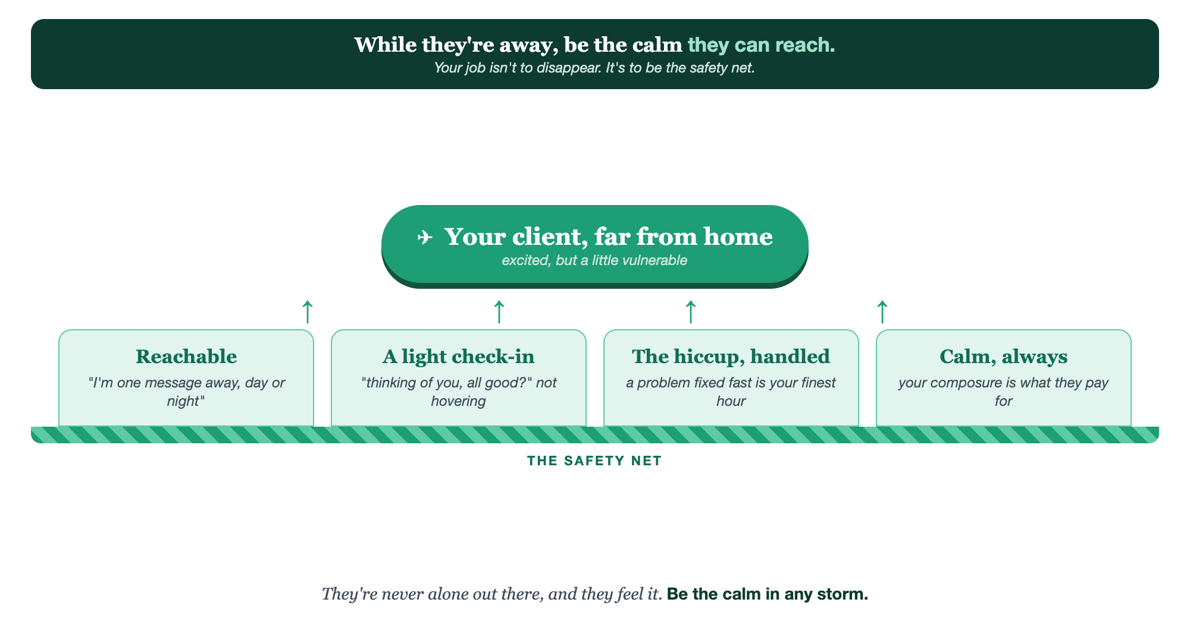
REACHABLE · A LIGHT CHECK-IN · THE HICCUP HANDLED · CALM ALWAYS
The safety net.

Slide 8
PUT YOUR SECOND MATE TO WORK
More than copy. Your calm in a crisis.
PLAN
SOLVE
WRITE
The check-in plan
Fast options
The calm message
It maps the light, well-timed check-ins for a trip, so you're present without hovering.
In a hiccup, it helps you think through options and next steps quickly and calmly.
It drafts the steady, reassuring note to send a stressed client mid-problem.
Copy-paste example prompts are in the library: How to Prompt Your Second Mate.

Slide 9
YOUR FIRST BRICK
Build your safety net.
1
Your reachable line
Write how you'll tell every client "I'm one message away" before they go. (The Your Safety Net worksheet.)
2
Your check-in points
Decide the one or two light mid-trip touches you'll send, and when.
3
Your hiccup plan
Note how you'll handle a problem: stay calm, reassure first, then fix.

Slide 10
WANT A HAND WITH THIS PART?
Three ways to get unstuck.
GROUP
ONE-ON-ONE
DONE WITH / FOR YOU
Professor Hours
Book a 1:1
Hire us
Bring your specific question to office hours and ask it live.
We work on yours, screen to screen, until it's done right.
Consultant or coach. We build it with you, or we build it for you.

Slide 11
BUILT WITH YOU, NOT TAUGHT AT YOU
Be the calm
in any storm.
You can set your reachable line and your check-in points today. Being the steady, unbothered presence that handles the hiccup and holds the client is what we build together.
We build it with you →
Next → 5.5, The Welcome Home: the return, the debrief, and capturing the magic while it's warm.
Post your "I'm one message away" line for the group to warm up. Questions? Bring them to this week's Professor Hours.

