Slide 1
MARKETING JOURNEYS · THE TRADEWINDS METHOD · CARE
Session 5.3
Surprise and Delight
Am I creating the little moments clients can't help but talk about?

Slide 2
THE MOMENTS PEOPLE ACTUALLY REMEMBER
The little things
are the big things.
Nobody comes home and raves about an itinerary. They rave about the small, unexpected, personal touch that made them feel truly seen. Those little moments are what they remember, and retell.

Slide 3
THE HEADWIND HERE IS THE LEAKY BUCKET
Delight is cheap loyalty.
A client who is merely satisfied is not loyal, they are available. Satisfied clients leak, because the next advisor with a slightly better price can lure them away. But a client you have genuinely delighted does not leave, and they do not shop around, because you made them feel something no spreadsheet can compete with. That is the leak that surprise and delight plugs: the slow drift of clients who had a perfectly fine experience and felt no reason to stay. A small, well-timed delight costs you very little and buys you the one thing price can never buy, an emotional bond. Delight is the cheapest loyalty money can buy.
Satisfied clients are available. Delighted clients stay. A small touch buys a bond price can't.

Slide 4
THE TWO INGREDIENTS
Unexpected and personal.
Unexpected
Personal
The magic is in the surprise. A gift they paid for is a transaction; a gift they didn't see coming is a moment. It's not the size, it's the surprise that lands.
It has to show you were listening. A generic basket says 'a client'; a nod to the thing they mentioned on the call says 'you, specifically.' Personal is what makes it land.
Unexpected plus personal is the whole formula. Small and thoughtful beats big and generic, every time.

Slide 5
BUILD A SMALL REPERTOIRE
A few signature touches.
You do not need to reinvent delight for every client, and you should not try, because that is exhausting and it does not last. Instead, build a small repertoire, just a few signature touches you can reach for again and again. A handwritten note at a certain moment. A small treat that arrives at the hotel. A celebration of the occasion behind the trip. Pick three or four you love, that fit your brand and your budget, and make them your trademark. Now delight is a system, not a scramble, and your clients start to associate that feeling specifically with you. The personal part you tailor in a sentence; the rest just runs.
Don't reinvent it every time. Pick three or four signature touches and make them your trademark.

Slide 6
WHY THIS IS MARKETING, NOT AN EXPENSE
Delight gets retold.
Here is why a small touch is one of the smartest investments you will ever make. Delight does not stop with the client. It ripples. They remember how you made them feel, so they retell the story, at dinner, at work, on social media, and that story ends with you have to use my travel advisor. One small, thoughtful gesture quietly becomes referrals, reviews, and repeat trips. This is the truth at the heart of our whole philosophy: the best marketing is not selling, it is caring out loud. Delight is marketing disguised as kindness, and it is the cheapest, most powerful kind there is.
One small touch gets remembered, retold, and referred. Delight is marketing disguised as kindness.

Slide 7
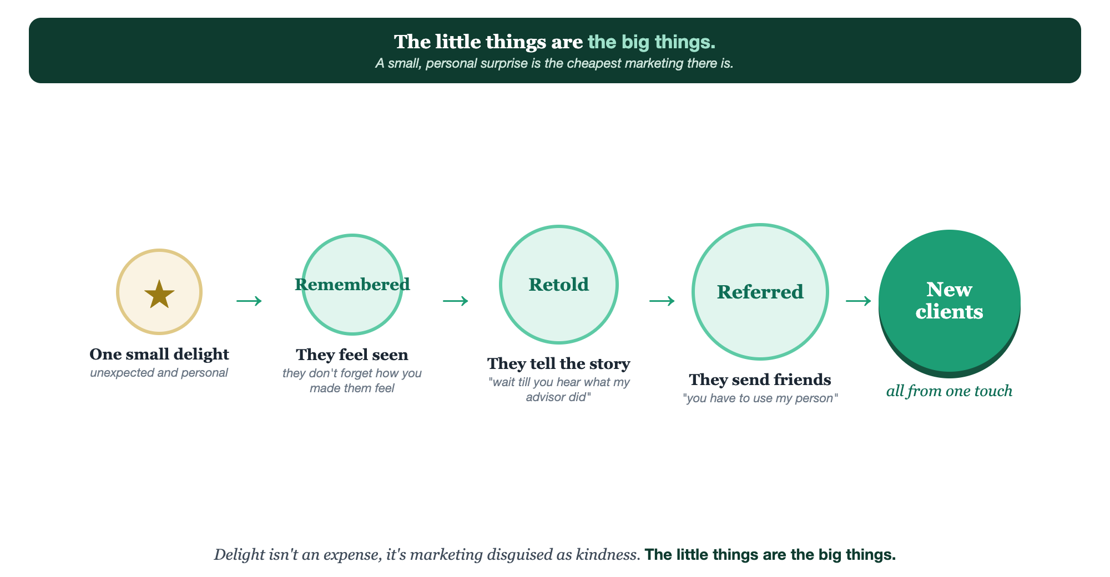
ONE SMALL DELIGHT · REMEMBERED · RETOLD · REFERRED
The ripple of delight.

Slide 8
PUT YOUR SECOND MATE TO WORK
More than copy. Your delight desk.
IDEAS
REPERTOIRE
WRITE
Tailored touches
Your signatures
The note
Give it the client and the occasion; it suggests personal delight ideas you'd never have thought of.
It helps you design three or four repeatable signature touches that fit your brand and budget.
It drafts the handwritten-feeling note that makes the gesture personal.
Copy-paste example prompts are in the library: How to Prompt Your Second Mate.

Slide 9
YOUR FIRST BRICK
Build your signature touches.
1
Your three signatures
Pick three or four repeatable delight touches that fit your brand and budget. (The Your Delight worksheet.)
2
Make it personal
For each, note the one-line way you'll tailor it to the specific client.
3
Pick the moment
Decide when each lands, welcome, pre-trip, in-trip, or welcome home.

Slide 10
WANT A HAND WITH THIS PART?
Three ways to get unstuck.
GROUP
ONE-ON-ONE
DONE WITH / FOR YOU
Professor Hours
Book a 1:1
Hire us
Bring your specific question to office hours and ask it live.
We work on yours, screen to screen, until it's done right.
Consultant or coach. We build it with you, or we build it for you.

Slide 11
BUILT WITH YOU, NOT TAUGHT AT YOU
Marketing disguised
as kindness.
You can choose your signature touches today. Designing delight that's unexpected, personal, and repeatable, so clients can't help but talk about you, is what we build together.
We build it with you →
Next → 5.4, The Safety Net: being their calm, steady presence while they're traveling.
Post your favorite signature touch for the group to borrow. Questions? Bring them to this week's Professor Hours.

