Slide 1
MARKETING JOURNEYS · THE TRADEWINDS METHOD · CARE
Session 5.2
Building Anticipation
Am I turning the wait before the trip into part of the magic?

Slide 2
THE WAIT IS NOT DEAD TIME
Anticipation is
half the trip.
The weeks between booking and departure are not empty time to be ignored. The joy of looking forward is real, and it is yours to grow. Turn the countdown into part of the magic.

Slide 3
THE HEADWIND HERE IS THE LEAKY BUCKET
Don't go quiet in the gap.
Here is where so many advisors quietly drop the ball: they book the trip, send a welcome, and then vanish for two months until departure. In that long silence, two bad things grow. The client's excitement fades, and their little worries get loud, did the advisor forget me, is everything actually handled? A warm client can cool right off in an empty gap. But that same gap, filled with a light, planned rhythm of touches, becomes the best part of the wait. You are not pestering them, you are feeding their excitement and quietly reassuring them, again and again, that they are in wonderful hands.
A long silence cools a warm client. Fill the gap with light touches and the wait becomes magic.

Slide 4
A LIGHT, PLANNED RHYTHM
The pre-trip touch points.
You do not improvise this, you plan a simple rhythm of touches across the countdown. Something like: the countdown begins, a cheerful here is what we are building toward. Then, a month or so out, the prep touch, what to pack, what to read, what to know, with a taste of the dream woven in. Then, a week out, the final details, calm and complete, everything handled. And then the send-off, the day before. Five or so light touches, spaced out, each one easy and warm. Set this rhythm up once and it runs for every client, turning a nerve-wracking wait into a delightful, building countdown.
Plan a handful of light touches across the countdown. Set it once, and it warms every trip.

Slide 5
EVERY TOUCH DOES TWO JOBS
Reassure and excite.
Reassure
Excite
Each touch quietly says: I've got this, you're handled, nothing's been forgotten. The practical side, packing, documents, details, calms every nerve before it can start.
And each touch feeds the dream: a photo, a story, a what-to-look-forward-to. You're keeping the joy alive and growing, so the trip glows brighter the closer it gets.
The best pre-trip touches do both at once: they calm the nerves and they fan the excitement.

Slide 6
THE SEND-OFF THEY'LL REMEMBER
The bon voyage.
Do not let them leave without a proper send-off. The day before they go, you send one last warm message, the bon voyage. Have the most wonderful time. You are completely set, so relax and soak up every moment. I cannot wait to hear all about it. It takes thirty seconds and it lands enormously, because it is the final thing they feel from you before the adventure begins, and it sends them off the threshold cared for, confident, and glowing. That little send-off is also the natural bridge into the trip itself, where, in the next sessions, you will keep being their calm, steady presence. End the countdown on warmth.
Send them off with a warm bon voyage the day before. Thirty seconds, and they leave glowing.

Slide 7
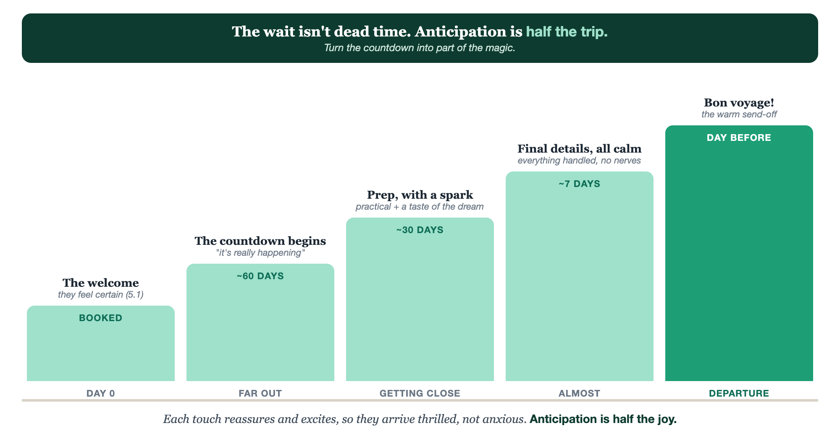
THE COUNTDOWN, RISING · REASSURE AND EXCITE · BON VOYAGE
Building anticipation.

Slide 8
PUT YOUR SECOND MATE TO WORK
More than copy. Your countdown crew.
BUILD
TAILOR
SEND-OFF
The sequence
To the trip
The bon voyage
It drafts your full pre-trip touch rhythm, each message reassuring and exciting.
It tunes the prep tips and the dream-sparks to their specific destination.
It writes the warm day-before send-off you can fire in seconds, every time.
Copy-paste example prompts are in the library: How to Prompt Your Second Mate.

Slide 9
YOUR FIRST BRICK
Build your countdown.
1
Your touch rhythm
Map your pre-trip touches across the countdown, from booking to the day before. (The Your Countdown worksheet.)
2
Reassure and excite
For each touch, note how it calms a nerve and feeds the dream.
3
Your bon voyage
Write the warm day-before send-off every client gets.

Slide 10
WANT A HAND WITH THIS PART?
Three ways to get unstuck.
GROUP
ONE-ON-ONE
DONE WITH / FOR YOU
Professor Hours
Book a 1:1
Hire us
Bring your specific question to office hours and ask it live.
We work on yours, screen to screen, until it's done right.
Consultant or coach. We build it with you, or we build it for you.

Slide 11
BUILT WITH YOU, NOT TAUGHT AT YOU
Anticipation is
half the joy.
You can map your countdown and write your bon voyage today. Turning a quiet, nervous wait into a building, delightful one, every trip, is what we set up together.
We build it with you →
Next → 5.3, Surprise and Delight: the little touches that get remembered and retold.
Post your bon voyage message for the group to warm up. Questions? Bring them to this week's Professor Hours.

