Slide 1
MARKETING JOURNEYS · THE TRADEWINDS METHOD · CONFIRM
Session 4.9
Following Up Until They Book
Do I follow up until they decide, or quit after one try?

Slide 2
THE LAST LEAK TO PLUG, AND THE BIGGEST
The money is in
the follow-up.
Most bookings are not lost to a no. They are lost in the silence after the first no-reply, when the advisor simply gave up too soon. The follow-up is where the money is.

Slide 3
THE HEADWIND HERE IS THE LEAKY BUCKET
Most leads need several touches.
Here is the leak that drains more good leads than all the others combined: quitting too early. A lead goes quiet after your first message, and you decide they are not interested and move on. But they did not say no. They got busy. Life happened, the email got buried, they meant to reply and forgot. One no-reply is not a no, it is a not right this second. Most people need several gentle touches before they book, and most advisors quit after one or two, right before the yes. The fortune, like we said back in 3.6, is in the follow-up.
One no-reply is not a no. Most advisors quit at touch two. The yes often waits at touch five.

Slide 4
PERSISTENT WITHOUT BEING A PEST
Warm, not naggy.
The fear that stops people from following up is sounding desperate or annoying. The fix is a cadence: a planned rhythm of touches, spaced out and friendly, so you are persistent without ever being a pest. You do not message them daily, hat in hand. You reach out on a comfortable schedule, something like a few days, then a week, then a couple of weeks, with each touch warm and easy and low-pressure. Spacing is what separates persistence from nagging. A well-spaced, genuinely warm follow-up never feels like pressure, it feels like an advisor who actually cares enough to stay in touch.
A cadence, not a barrage. Space your touches, keep them warm, and persistence never reads as nagging.

Slide 5
THE CORE OF A GOOD FOLLOW-UP
Value, not "just checking in."
Here is the rule that makes follow-up feel good to send and good to receive: every single touch gives them something. Just checking in is about you and your commission, and everyone can feel that. A real follow-up is about them. So each message carries a little value: a helpful tip, a new idea for their trip, an answer to a worry they raised, a genuine deadline, a quick story of someone who is glad they went. Give, do not nudge. When every touch hands them something useful, you are never annoying, you are useful, and useful is welcome in anyone's inbox as many times as you like.
"Just checking in" is about you. Make every touch give them something. Be useful, not naggy.

Slide 6
WHAT EACH TOUCH CAN GIVE
Every touch carries something.
HELPFUL
TIMELY
HUMAN
A useful nudge
A real reason now
A warm moment
A tip, a fresh idea for their trip, or an answer to the worry they raised on the call.
Dates filling, a price or availability change, a deadline. True urgency, never fake.
A short story of a happy client, or a note about the life detail they shared.
Rotate these so no two touches feel the same, and not one of them is empty.

Slide 7
CLOSE THE LOOP, KEEP THE DOOR OPEN
When to let go.
Following up does not mean forever. After a warm, respectful sequence, if they are still quiet, you let go, gracefully, with the door wide open. You send one last easy note: I will stop filling your inbox for now, but I am here whenever the time is right, just reach out. Two things happen, and both are good. Often, that graceful exit is the very message that finally gets a reply, because it relieves the pressure. And when it does not, you have left them warm, with a great taste of you, so when they are ready, in a month or a year, they come back to you. Letting go well is part of the cadence, never a failure.
Let go gracefully, door open. The exit note often gets the reply, and always keeps them warm.

Slide 8
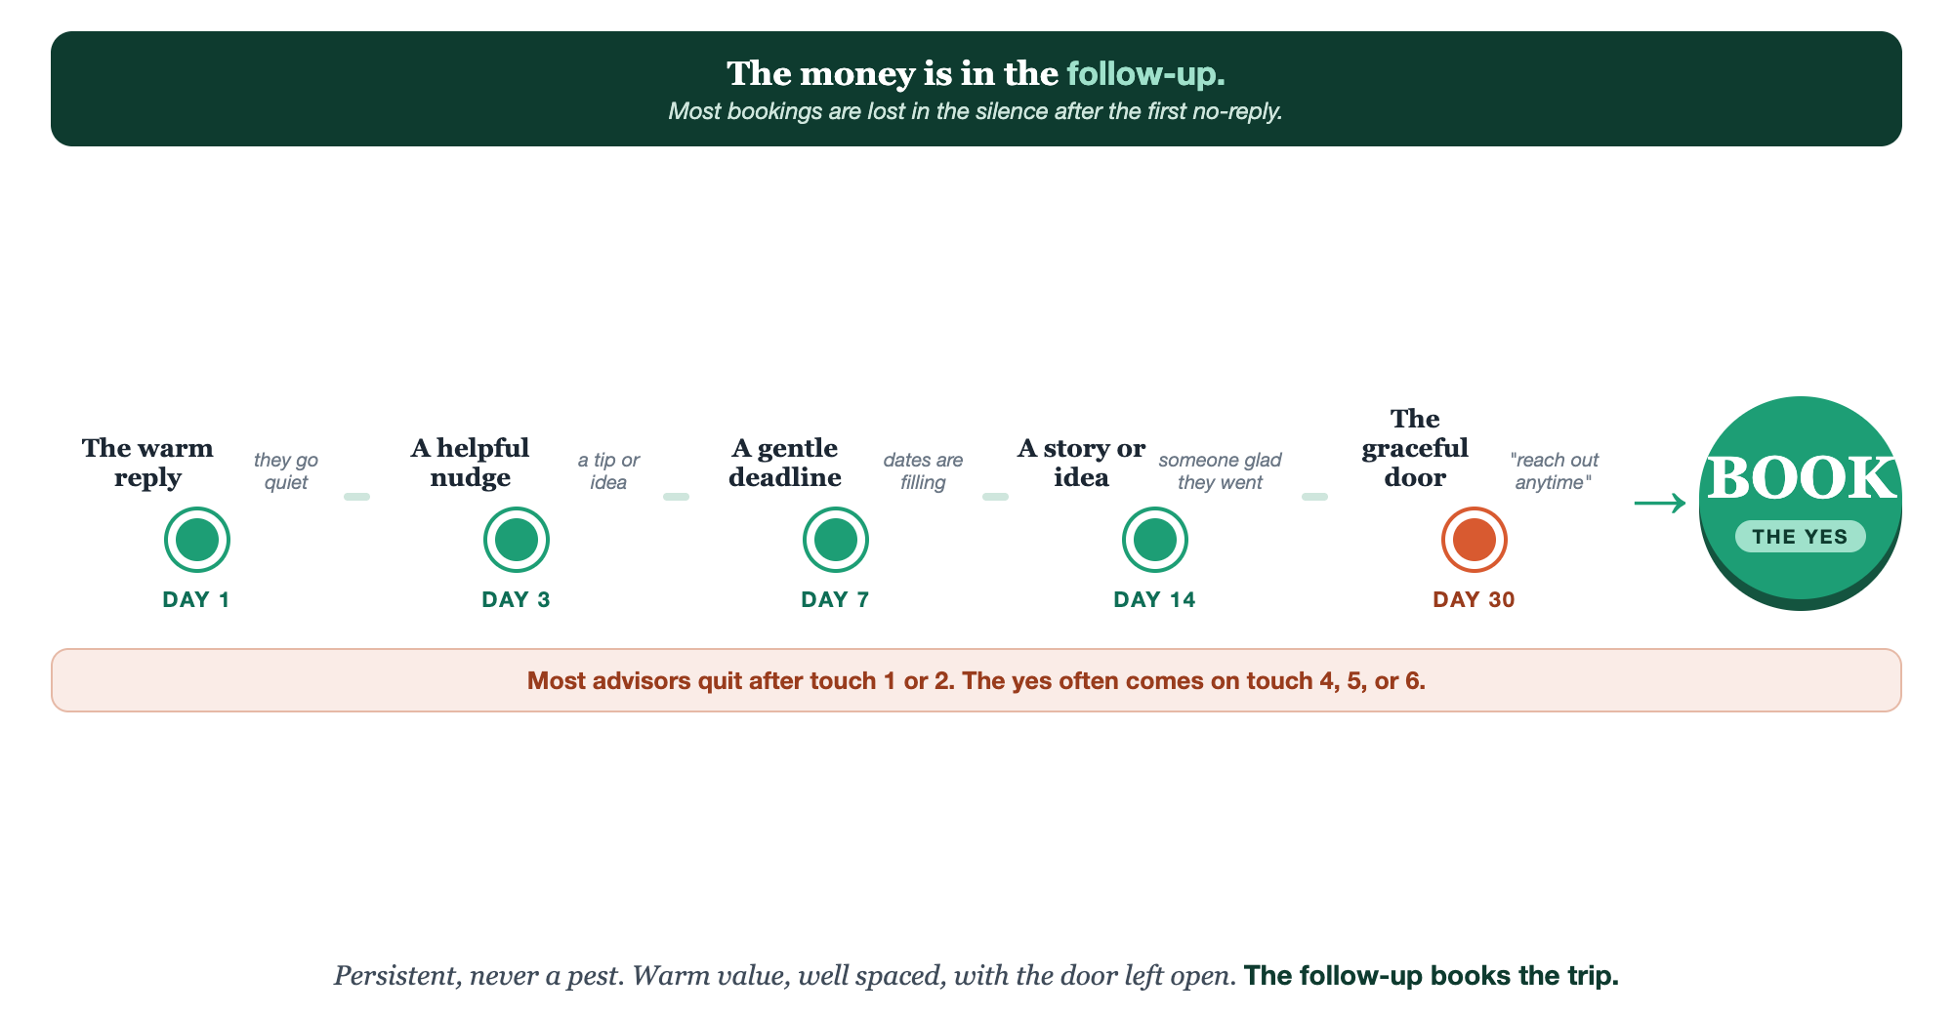
SEVERAL WARM TOUCHES · WELL SPACED · THE DOOR LEFT OPEN
The follow-up cadence.

Slide 9
PUT YOUR SECOND MATE TO WORK
More than copy. Your follow-up writer.
SEQUENCE
PERSONALIZE
EXIT
The whole cadence
To this lead
The graceful door
It drafts your full follow-up sequence, several warm touches, each with real value.
Paste their notes; it tailors each touch to what they actually told you.
It writes the warm let-go note that keeps them with you for next time.
Copy-paste example prompts are in the library: How to Prompt Your Second Mate.

Slide 10
YOUR FIRST BRICK
Build your follow-up.
1
Your cadence
Decide your spacing: when each touch goes out, and where it ends. (The Your Follow-Up worksheet.)
2
Your three messages
Write three warm touches, each giving real value, not "just checking in."
3
Your graceful exit
Write the warm let-go note that leaves the door wide open.

Slide 11
WANT A HAND WITH THIS PART?
Three ways to get unstuck.
GROUP
ONE-ON-ONE
DONE WITH / FOR YOU
Professor Hours
Book a 1:1
Hire us
Bring your specific question to office hours and ask it live.
We work on yours, screen to screen, until it's done right.
Consultant or coach. We build it with you, or we build it for you.

Slide 12
BUILT WITH YOU, NOT TAUGHT AT YOU
The follow-up
books the trip.
You can write your cadence and your first three touches today. Making each one warm, useful, and well-timed, and knowing when to let go, is what we build together.
We build it with you →
Next → Part 5, Care: they booked, now turn a client into a fan for life.
Post your graceful let-go note, the one most people never write. Questions? Bring them to this week's Professor Hours.

