Slide 1
MARKETING JOURNEYS · THE TRADEWINDS METHOD · CONFIRM
Session 4.8
Working Your CRM
Do I work my pipeline every day, or does it quietly work against me?

Slide 2
THE INQUIRY STAGE · WORK IT OR IT FAILS
You didn't become an advisor
to work a CRM.
Let's face it, nobody got into this to push leads around a database. But there is gold in those hills. The bookings are already sitting in your pipeline, waiting on a little daily attention.

Slide 3
THE HEADWIND HERE IS THE LEAKY BUCKET
Work it, or it fails.
A CRM is not a magic box. It does not work because you bought it, it works because you work it. An unopened pipeline is the single biggest leak in this whole business, and here is why it stings: the leads in there did not say no. They just got forgotten. A warm inquiry sat untouched for two weeks, went cold, and booked with someone who simply followed up. That is not a marketing problem, it is a neglect problem, and it is completely fixable with a light daily rhythm. The gold is already in the hills. You just have to show up and dig a little each day.
Forgotten beats rejected as a way to lose a booking. An unworked pipeline is the biggest leak there is.

Slide 4
SMALL AND CONSISTENT WINS
The daily five minutes.
This does not take an hour, and it should not. You build one small, light habit: open your CRM once a day, at the same time, and run a quick pass. Who is new? Who is waiting on me? Who has gone quiet? That is it. Five minutes, not five hours. Remember Cruising Altitude from 3.3, the engine runs on short, steady bursts, not heroic marathons you cannot sustain. A five-minute review done every single day will beat a three-hour cleanup done once a month, easily, because nothing ever piles up high enough to scare you off. Same time, every day, a quick look. That is the whole rhythm.
Open it once a day, same time, quick pass. Five minutes daily beats three hours once a month.

Slide 5
KEEP THE PIPELINE FLOWING
Move every lead.
A pipeline is only healthy when things are flowing through it. So in your daily pass, your one job is to keep leads moving, stage by stage, the same stages you built into your Manifest back in 2.4. A new inquiry becomes a discovery booked. A discovery becomes a proposal sent. A proposal becomes a deposit paid. The danger sign is always the same: a lead that has been sitting in one stage too long. That one is stalling, and a stalled lead is a leaking lead. You do not have to close everyone today, you just have to make sure nobody is stuck. Nudge the ready ones forward, every day.
A lead stuck in one stage too long is leaking. Your daily job: nudge the ready ones forward.

Slide 6
YOUR MEMORY DOESN'T SCALE, YOUR CRM DOES
Notes for every lead.
You will not remember. You think you will, but with thirty conversations going at once, you will not, and a forgotten detail is how warm leads quietly cool. So every time you touch a lead, you leave a note: what you talked about, what they want, where you left it. The note is the difference between, hi, just following up, and, hi, did your daughter ever decide between Rome and Florence for the graduation trip? One of those feels like a salesperson. The other feels like a friend who remembers. Your CRM is your second brain, so feed it, every single time you talk to someone.
Leave a note every time you touch a lead. "Following up" loses to remembering the detail that matters.

Slide 7
THE ONE RULE THAT PLUGS THE BIGGEST LEAK
Every lead always has a next step.
If you take one rule from this entire session, take this one, because it plugs the biggest leak by itself. Every lead, always, has a next step with a date on it. The instant you finish talking to someone, before you close that record, you answer one question: what is the next action, and when? Send the proposal Tuesday. Follow up Friday. Check in after their trip. A lead with no scheduled next step is not a lead, it is a lead you have quietly abandoned, and it will leak out without you ever noticing. No record gets closed until it has a next step and a date. Hold that one line, and almost nothing slips.
A lead with no next step is a lead you've abandoned. Never close a record without a next action and a date.

Slide 8
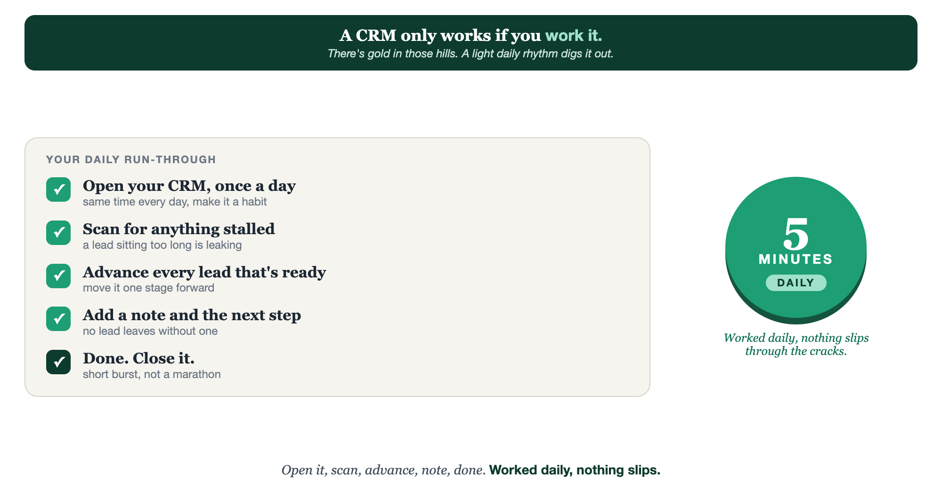
OPEN IT · SCAN FOR STALLS · ADVANCE · NOTE & NEXT STEP · DONE
The daily five minutes.

Slide 9
PUT YOUR SECOND MATE TO WORK
More than copy. Your pipeline assistant.
NOTE
REMIND
SURFACE
Write the note
The next step
Who's stalling
Dump the messy details after a call; it writes the clean note for your record.
It turns each conversation into a clear next action and a date you can set.
Paste your pipeline; it flags the leads sitting too long and who to nudge first.
Copy-paste example prompts are in the library: How to Prompt Your Second Mate.

Slide 10
YOUR FIRST BRICK
Set your daily rhythm.
1
Your daily time
Pick the same five minutes every day to open your CRM. (The Your Rhythm worksheet.)
2
Your next-step rule
Write the rule: no lead is ever left without a next step and a date. No exceptions.
3
Run it once
Do today's five-minute pass: scan, advance the ready ones, leave notes and next steps.

Slide 11
WANT A HAND WITH THIS PART?
Three ways to get unstuck.
GROUP
ONE-ON-ONE
DONE WITH / FOR YOU
Professor Hours
Book a 1:1
Hire us
Bring your specific question to office hours and ask it live.
We work on yours, screen to screen, until it's done right.
Consultant or coach. We build it with you, or we build it for you.

Slide 12
BUILT WITH YOU, NOT TAUGHT AT YOU
Worked daily,
nothing slips.
You can run your first five-minute pass today. Building the daily habit, and the discipline of a next step on every lead, is what we set up together so the gold stops slipping out.
We build it with you →
Next → 4.9, The Follow-Up: the last leak to plug, following up until they book.
Post your daily CRM time and your next-step rule to stay accountable. Questions? Bring them to this week's Professor Hours.

