Slide 1
MARKETING JOURNEYS · THE TRADEWINDS METHOD · CONFIRM
Session 4.7
Segmentation
Does the right message reach the right person, automatically?

Slide 2
NOT EVERY LEAD IS THE SAME
One size
fits none.
Blast the same message to your whole list and it lands for no one. A honeymooner, a family of five, and a past client need different words. Tagging them means the right message reaches the right person, automatically.

Slide 3
THE HEADWIND HERE IS THE LEAKY BUCKET
Why one size fits none.
When every lead sits in one undifferentiated pile, you can only do one of two things, and both leak. You go silent, because writing to everyone feels like writing to no one. Or you send one generic blast that is mildly irrelevant to all of them. Irrelevance is a slow leak: people quietly tune out, unsubscribe, and forget you. Segmentation fixes this at the root. When you tag who someone is and what they want, you can finally speak to them like an individual, and relevance is what keeps a name warm in your bucket instead of slipping out the bottom.
A generic message is irrelevant to everyone. Irrelevance is a slow leak. Relevance keeps names warm.

Slide 4
THE HANDFUL THAT MATTER FOR TRAVEL
The tags that matter.
WHERE THEY ARE
WHAT THEY WANT
WHERE & WHEN
Stage
Trip type
Source & timing
Their place in your pipeline: New, Nurturing, Booked, Past client. Straight from your Manifest in 2.4.
Their niche or dream: honeymoon, family, luxury, the kind of travel they're after.
Where they came from and when they travel: referral or social, this year or someday.
Four families cover almost everything: where they are, what they want, where they came from, and when.

Slide 5
A FEW, USED WELL
Don't drown in tags.
Here is the trap, and it is the same lesson as picking your routes back in 1.6. People discover tagging, get excited, and create fifty hyper-specific tags they will never once use, and the whole system collapses into noise. Resist it. A small, consistent set of tags you actually apply to every lead beats a sprawling taxonomy you abandon in a week. Pick your handful, write them down, and use the exact same ones every single time. Boring and consistent wins here. The goal is not a beautiful filing system, it is the ability to find the right group in three seconds and speak to them.
A few tags you use every time beat fifty you abandon. Consistent beats clever.

Slide 6
SHOW YOUR SCREEN · SET THEM UP
Set them up in your CRM.
Now make it real in your tool. In a CRM like Tern, you create your short list of tags once, then the only discipline that matters is applying them the moment a lead comes in, right alongside the discovery notes you are already capturing. Tag at intake, while you know the most, and the lead is sorted forever. Do not let it become a someday cleanup project, because a list you tag later is a list you never tag. A minute of tagging at the front door saves you from a messy, unworkable pile at the back. Set the tags up today, then apply them from the very next inquiry on.
Create the tags once, then tag at intake, every time. A list you'll tag later is a list you never tag.

Slide 7
THIS IS THE WHOLE PAYOFF
Tags drive the follow-up.
And here is why all of this matters. Tags are not decoration, they are the switchboard for your follow-up. Once people are tagged, you can send the honeymoon nurture only to honeymooners, the warm welcome-back only to past clients, the fast personal reply only to your hot, this-year leads. Each person hears from you about the thing they actually care about, and to them it feels like you remembered them personally. That is what turns a dead list into a living one, and it is what makes the follow-up systems coming next almost run themselves. Tag well, and the right message reaches the right person on its own.
Tags are the switchboard. Each group hears about the thing they care about, and it feels personal.

Slide 8
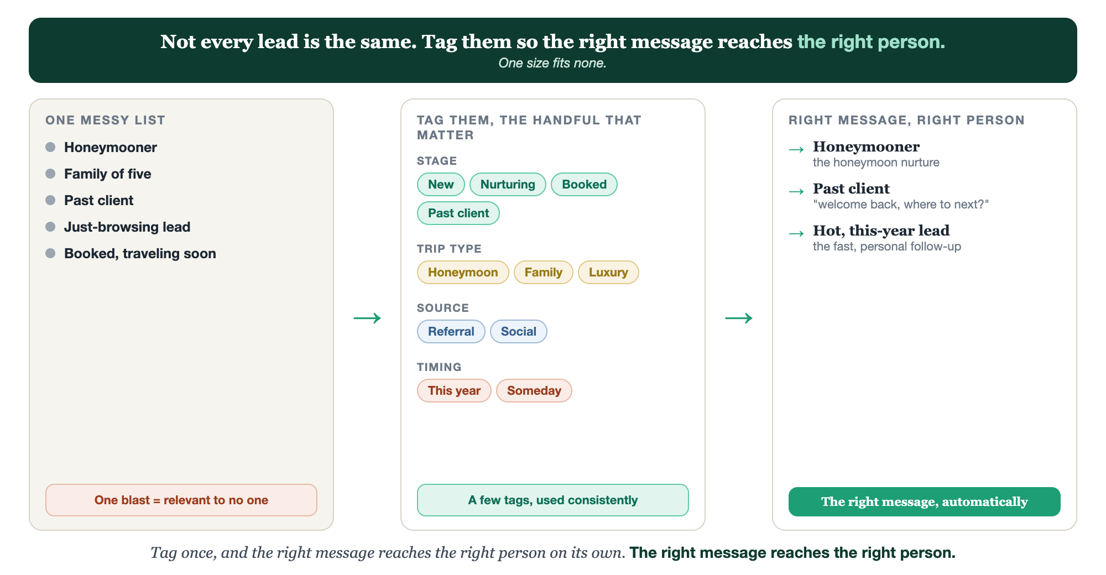
ONE MESSY LIST · TAG THEM · RIGHT MESSAGE, RIGHT PERSON
Segmentation.

Slide 9
PUT YOUR SECOND MATE TO WORK
More than copy. Your list organizer.
SUGGEST
SORT
SEGMENT
Your tag set
Tag the backlog
Find the group
It proposes a clean handful of tags built around your niche, so you don't overthink it.
Paste a messy lead list; it suggests the right tag for each so you can catch up fast.
Ask who to message about a deal or idea; it names the exact segment to send it to.
Copy-paste example prompts are in the library: How to Prompt Your Second Mate.

Slide 10
YOUR FIRST BRICK
Build your tag set.
1
Your core tags
Write your short handful: stage, trip type, source, timing. (The Your Tags worksheet.)
2
What each one changes
Next to each tag, note the follow-up it triggers, so a tag always means something.
3
Set them up
Create them in your CRM today, and tag every lead from the next inquiry on.

Slide 11
WANT A HAND WITH THIS PART?
Three ways to get unstuck.
GROUP
ONE-ON-ONE
DONE WITH / FOR YOU
Professor Hours
Book a 1:1
Hire us
Bring your specific question to office hours and ask it live.
We work on yours, screen to screen, until it's done right.
Consultant or coach. We build it with you, or we build it for you.

Slide 12
BUILT WITH YOU, NOT TAUGHT AT YOU
The right message
reaches the right person.
You can build a clean handful of tags today. Deciding the few that matter for your business, and wiring each one to a real follow-up, is what we set up together.
We build it with you →
Next → 4.8, Working the Pipeline: turning your tagged, sorted list into a daily habit that books.
Post your core tag list for the group to refine. Questions? Bring them to this week's Professor Hours.

