Slide 1
MARKETING JOURNEYS · THE TRADEWINDS METHOD · CONFIRM
Session 4.6
Sales Language and the Close
Can I move a warm lead to yes without ever feeling pushy?

Slide 2
A TASTE OF NLP, USED WITH WARMTH
Closing is
not pressure.
It is making it easy and natural to say the yes they already want to say. You are not twisting an arm, you are removing the small frictions between a warm client and the trip they already love.

Slide 3
THE HEADWIND HERE IS THE LEAKY BUCKET
The yes they already want.
Most advisors do everything right, the discovery, the proposal, the calm money talk, and then they just stop, hoping the client will close themselves. They rarely do. Not because they do not want the trip, but because deciding is hard and the door was left ajar. That is the leak this whole session plugs. Closing is not a pressure tactic, it is a kindness: you gently help a warm, ready person take the step they already want to take. A light, honest nudge at the end is not pushy. It is the most service-minded thing you can do.
Warm leads don't leak because they don't want it. They leak because no one helped them decide.

Slide 4
A TASTE OF NLP · KEEP IT HONEST
Tie-downs and gentle agreement.
Here is your first light tool, a tie-down: a small, honest agreement question woven into the conversation. Doesn't that sound perfect? Wouldn't that be the trip you described? That's exactly what you were hoping for, right? Each little yes builds quiet momentum and keeps you and the client aligned, nodding together, all the way to the big yes. One caution, and it matters: this only works when it is true. A tie-down on something they genuinely love is rapport. A tie-down used to trick someone is manipulation, and they feel it. Use these to confirm real agreement, never to manufacture a fake one.
Small honest yeses build momentum to the big one. Confirm real agreement, never manufacture it.

Slide 5
THE HANDFUL YOU'LL HEAR, AND A CALM HANDLE
Objection handles.
You will hear the same few objections your whole career, so stop fearing them and start preparing them. I need to think about it. It's a lot of money. Let me check with my partner. I could just book it myself. Notice none of these are a no, they are a not yet, a request for reassurance. The handle is always the same calm three-step: acknowledge it warmly, reframe it gently, then ask a question that moves forward. That makes total sense, and the reason I'd hate for you to wait is the dates we loved are filling, would it help if I held them while you and your partner talk tonight?
Most objections are "not yet," not "no." Acknowledge, reframe, ask. Have a calm handle ready for each.

Slide 6
THE STORY BEATS THE FACT SHEET
Stories sell.
Facts inform, but stories move people, and a decision is an emotional act. So when a client wavers, do not pile on more features and bullet points. Tell a short, true story instead. I had a couple just like you, nervous about the splurge, and a year later they told me it was the best money they ever spent, their kids still talk about it. A story lets them see themselves on the other side of the yes, already happy they took the leap. Keep a few real ones ready, one for the hesitant client, one for the budget worry, one for the my-partner-isn't-sure. The right story at the right moment does what no list ever could.
Don't add more facts to a wavering client. Tell a true story that lets them see themselves saying yes.

Slide 7
THE STEP MOST PEOPLE SKIP
Ask for the booking.
And here is the simplest, most overlooked step of all: actually ask. So many advisors do everything beautifully and then never directly invite the decision, they trail off with let me know your thoughts and let the moment die. Do not skip the ask. Say it plainly and warmly: shall I get you booked? Are you ready to make this real? Want me to lock it in? Then, exactly like the money conversation, you stop talking and let them answer. Asking directly is not aggressive, it is clear, and clarity is a gift to someone standing on the edge of a yes. The ask is the whole point of the close.
Then actually ask. "Shall I get you booked?" Say it warmly, then go quiet. Clarity is kindness.

Slide 8
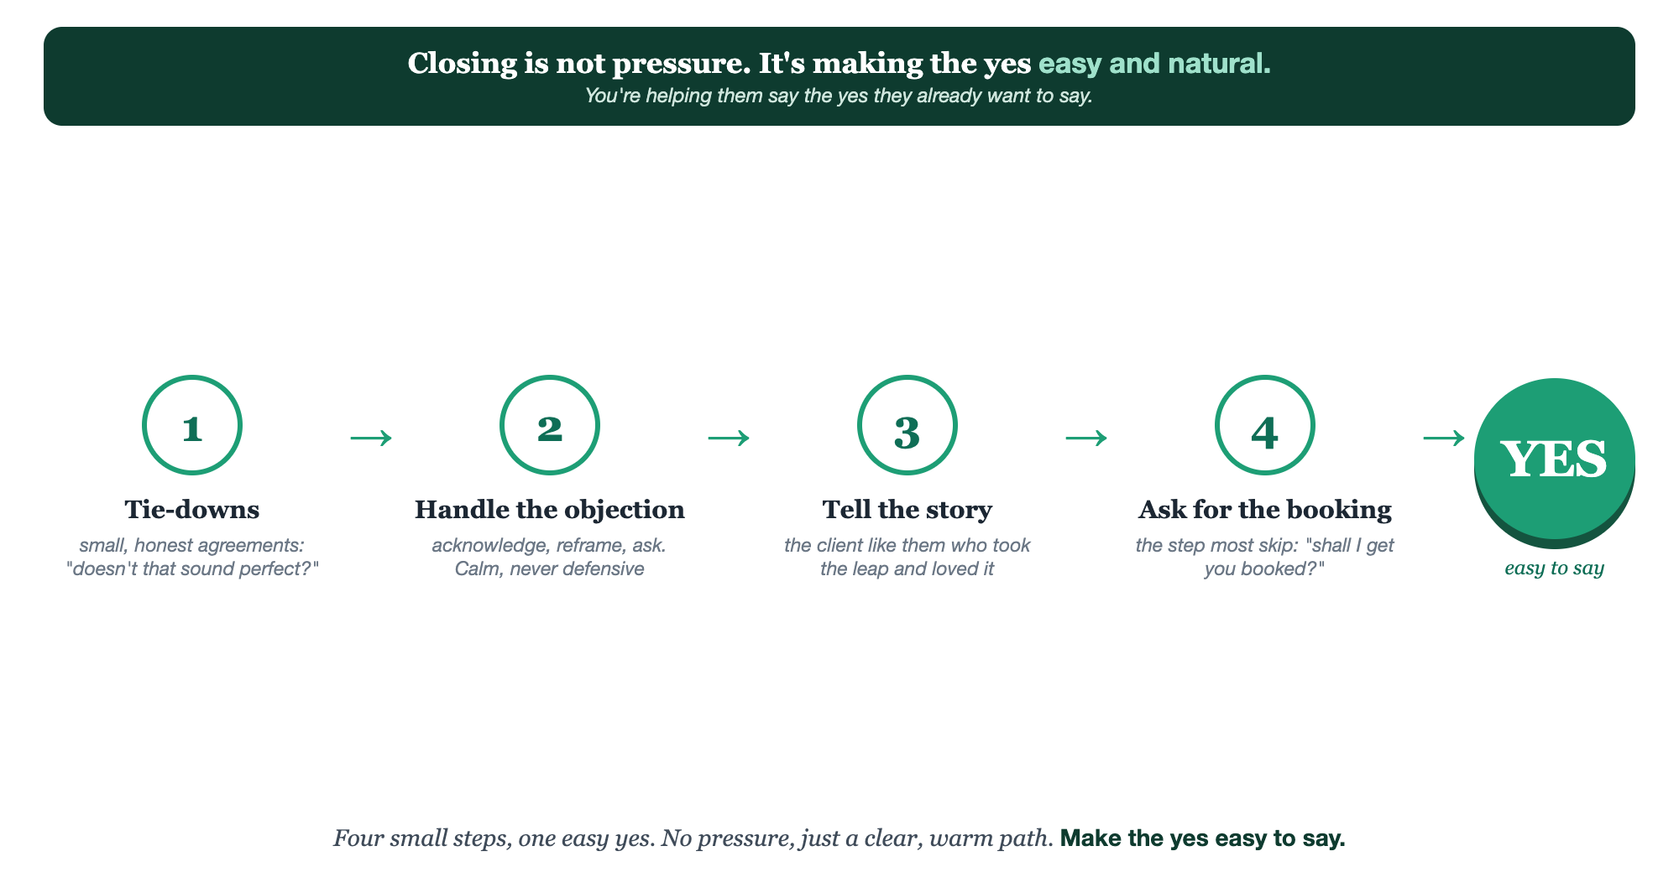
TIE-DOWNS · OBJECTION HANDLES · STORIES · ASK FOR THE BOOKING
The close, step by step.

Slide 9
PUT YOUR SECOND MATE TO WORK
More than copy. Your closing coach.
GENERATE
STORY
ROLE-PLAY
Tie-downs & handles
Shape the story
Practice the close
It writes honest tie-downs and a calm handle for each objection you actually hear.
It turns a real client win into a short, moving story for the wavering moment.
It plays a hesitant client so you can rehearse the ask until it feels natural.
Copy-paste example prompts are in the library: How to Prompt Your Second Mate.

Slide 10
YOUR FIRST BRICK
Build your close.
1
Your three objections
Write the three you hear most and a calm acknowledge-reframe-ask handle for each. (The Your Close worksheet.)
2
Your one story
Pick one true client story that helps a hesitant person see themselves saying yes.
3
Your ask line
Write the one warm, direct line you'll use to ask for the booking, then practice going quiet.

Slide 11
WANT A HAND WITH THIS PART?
Three ways to get unstuck.
GROUP
ONE-ON-ONE
DONE WITH / FOR YOU
Professor Hours
Book a 1:1
Hire us
Bring your specific question to office hours and ask it live.
We work on yours, screen to screen, until it's done right.
Consultant or coach. We build it with you, or we build it for you.

Slide 12
BUILT WITH YOU, NOT TAUGHT AT YOU
Make the yes
easy to say.
You can write your objection handles, your story, and your ask line today. Delivering them warmly, so a close feels like service and never pressure, is what we rehearse together.
We build it with you →
Next → 4.7, Segmentation: keeping your pipeline clean so the right follow-up reaches the right person.
Post your one ask line for the group to warm up. Questions? Bring them to this week's Professor Hours.

