Slide 1
MARKETING JOURNEYS · THE TRADEWINDS METHOD · CONFIRM
Session 4.5
The Money Conversation
Can I name my price, fees, and deposit without flinching?

Slide 2
TALK MONEY WITH CALM CONFIDENCE
Do not
flinch.
The moment you flinch about price, so does your client. The number did not change, but your face told them it was too much. Today you learn to talk money with calm confidence.

Slide 3
THE HEADWIND HERE IS THE LEAKY BUCKET
When you flinch, they flinch.
Price is felt as much as it is heard. When you say your number and your voice wobbles, or you rush to soften it, or you start nervously justifying before they have said a word, you have just told them, with your whole body, that even you are not sure it is worth it. And if you are not sure, why on earth would they be? That tiny flinch is where a warm, ready-to-book client suddenly hesitates, asks to think about it, and quietly leaks away. Your calm is not a performance. It is the most honest signal that what you are offering is worth every dollar.
The flinch is contagious. Hesitate on the number and a ready client suddenly does too.

Slide 4
THE WHOLE SKILL IN ONE MOVE
Name it, then stop talking.
Here is the entire technique, and it is gloriously simple. State your price, plainly and warmly, in a complete sentence. Then stop. Say nothing. Do not fill the silence with a discount, a disclaimer, or a nervous laugh. The silence after a price feels like an eternity to you and like a totally normal pause to them, so let it sit. They are thinking, not rejecting. The advisor who names a number and then keeps talking is negotiating against themselves before anyone has objected. So practice this until it is muscle memory: the price, a period, and a calm, comfortable quiet.
State the price in a full sentence. Then go quiet. Don't negotiate against yourself.

Slide 5
YOU ARE NOT AN ORDER-TAKER
Charge for your expertise.
Let us put to rest the lie that good advisors work for free. You are not just charging for the trip, you are charging for you: your years of knowing, your relationships, the hours you save them, the disasters you quietly prevent. A planning fee or a deposit is not you being greedy, it is you valuing your own expertise, and clients respect what is valued. Remember 1.3, charge more and chase less. The fee filters for the people who want a professional, not a search engine with a pulse. When you believe your judgment is worth paying for, naming the fee stops being scary and starts being simple.
You're not charging for the trip, you're charging for you. Valued expertise earns respect, not pushback.

Slide 6
A NUMBER ONLY FEELS BIG IN A VACUUM
Frame against the dream, and the alternative.
A price floating on its own always feels big. So you never leave it floating. You frame it against two things. First, the dream it buys: this is the milestone, the once-in-a-lifetime, the memory the whole family will tell stories about for twenty years. Against that, the number is small. Second, the alternative: the forty hours they would lose to research, the booking mistakes, the honeymoon spent fixing a problem you would have caught in a heartbeat. Price next to value almost always shrinks. You are not defending the cost, you are simply reminding them what it is standing next to.
Never let the price float alone. Frame it against the dream it buys and the alternative it prevents.

Slide 7
THE NEXT STEP, NOT A HURDLE
The deposit ask.
The deposit is not a wall to get over, it is simply the next step, and you ask for it exactly like the clear next step from your proposal. Warmly, plainly, and expectantly, because you genuinely expect a yes, you earned it. So you say something like: wonderful, to lock this in and start building, the next step is a deposit of this much, and I will send the link right now. Then, you guessed it, you stop talking. Do not apologize for it, do not soften it, do not pre-negotiate it. The deposit ask, said with the same calm as everything before it, is what quietly turns an interested client into a booked one.
The deposit is just the next step. Ask warmly and expectantly, send the link, then go quiet.

Slide 8
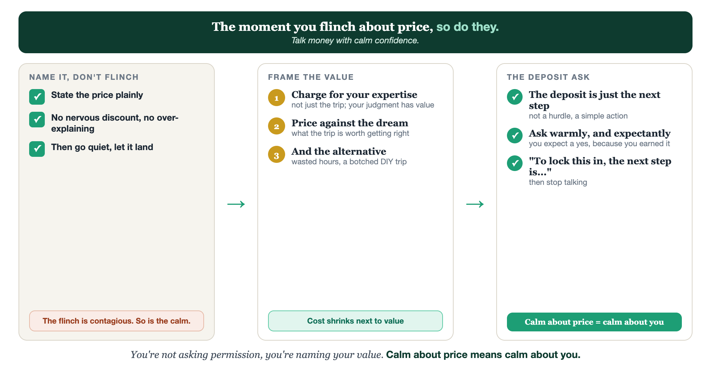
NAME IT, DON'T FLINCH · FRAME THE VALUE · THE DEPOSIT ASK
The money conversation.

Slide 9
PUT YOUR SECOND MATE TO WORK
More than copy. Your rehearsal partner.
REHEARSE
SCRIPT
FRAME
Role-play the talk
The deposit ask
Value framing
It plays a price-sensitive client so you can practice naming your number, calm, out loud.
It scripts your deposit ask, word for word, warm and expectant, in your voice.
It gives you lines that frame the price against the dream and the alternative.
Copy-paste example prompts are in the library: How to Prompt Your Second Mate.

Slide 10
YOUR FIRST BRICK
Write your money script.
1
Your fee structure
Decide your planning fee or deposit and what it's for: your expertise. (The Your Money Script worksheet.)
2
Your deposit ask
Write your deposit ask word for word, warm and expectant, then plan to go quiet.
3
Say it out loud
Rehearse naming your price plainly, with your Second Mate or a mirror, until it's calm.

Slide 11
WANT A HAND WITH THIS PART?
Three ways to get unstuck.
GROUP
ONE-ON-ONE
DONE WITH / FOR YOU
Professor Hours
Book a 1:1
Hire us
Bring your specific question to office hours and ask it live.
We work on yours, screen to screen, until it's done right.
Consultant or coach. We build it with you, or we build it for you.

Slide 12
BUILT WITH YOU, NOT TAUGHT AT YOU
Calm about price
means calm about you.
You can write your fee and your deposit ask today. Saying your number out loud without flinching, and holding your value when they push, is what we rehearse together until it's calm.
We build it with you →
Next → 4.6, Sales Language and the Close: the gentle words that move a yes.
Post your deposit ask, word for word, for the group to refine. Questions? Bring them to this week's Professor Hours.

