Slide 1
MARKETING JOURNEYS · THE TRADEWINDS METHOD · CONFIRM
Session 4.4
Proposal Mastery
Does my proposal sell the dream, or just list a price?

Slide 2
THE DOCUMENT THAT EARNS THE YES
A proposal is not
a price list.
It is the dream, made concrete, with an easy way to say yes. A price list invites them to comparison-shop. A proposal invites them to come home to the trip you both already pictured.

Slide 3
THE HEADWIND HERE IS THE LEAKY BUCKET
The anatomy of a yes.
A proposal that converts has a shape, and it is not a spreadsheet. It opens with their dream, in their own words from discovery, so they feel instantly understood. It paints the transformation. Then it shows the trip as the vehicle for that dream, the days held lightly. It offers a few clear options, not one take-it-or-leave-it number. And it ends with one obvious next step. Hand someone a bare price and they go shop it against three other quotes and leak away. Hand them their dream made real, and there is nothing to compare it to.
A bare price gets comparison-shopped and leaks. A dream made concrete has no competition.

Slide 4
THE CORE OF THE WHOLE SESSION
Sell the transformation, not the itinerary.
This is the shift that changes everything. Amateurs sell the itinerary: day one this hotel, day two this transfer, day three this tour. Nobody lies awake dreaming about a transfer. What your client actually wants is the transformation: the kids finally unplugged and laughing, the anniversary that feels like the honeymoon you never took, coming home different than you left. So lead with that. Describe how the trip will feel and who they will be in it, and let the logistics sit quietly underneath, in service of the dream. People do not book itineraries. They book the version of themselves they are chasing.
Nobody dreams about a transfer. Sell how it will feel and who they'll be. The days serve the dream.

Slide 5
MAKE THE YES EASY · PART ONE
Good, better, best.
One price is a yes or no
Three options is which one
A single number is a wall: they either clear it or they don't, and if they hesitate, they leave to think and never come back.
Good, better, best changes the question from whether to which. They self-select, the middle usually wins, and they stay in the decision.
Don't ask them to decide yes or no. Give three ways to yes, and let them choose their level.

Slide 6
MAKE THE YES EASY · PART TWO
One clear next step.
A proposal should never end on let me know your thoughts. That is a door left ajar, and warm leads wander right out of it. End on one clear, obvious next step, and make it almost frictionless to take. A button to book. A link to place a hold. A simple reply to confirm their option. A deposit link, a quick call to lock it in. Tell them exactly what to do next, in one sentence, and remove every bit of effort between them and yes. The easier you make the step, the more often they take it. Clarity is kindness, and it converts.
Never end on "let me know." Give one frictionless next step, and tell them exactly how to take it.

Slide 7
SPEED MATTERS HERE TOO
Send it warm.
Remember the five-minute rule from 4.1? It does not stop at the first reply. The glow from a great discovery call fades fast, so the proposal has to ride that warmth, not arrive a week later when the feeling is gone and life has crowded back in. A good proposal sent today beats a perfect one sent next Tuesday, every single time. This is exactly where a tool like Tern earns its keep: your discovery notes are already in there, so you build and send a beautiful proposal in minutes, not days, while they can still feel the dream you just helped them name.
The discovery glow fades. A good proposal sent warm beats a perfect one sent cold.

Slide 8
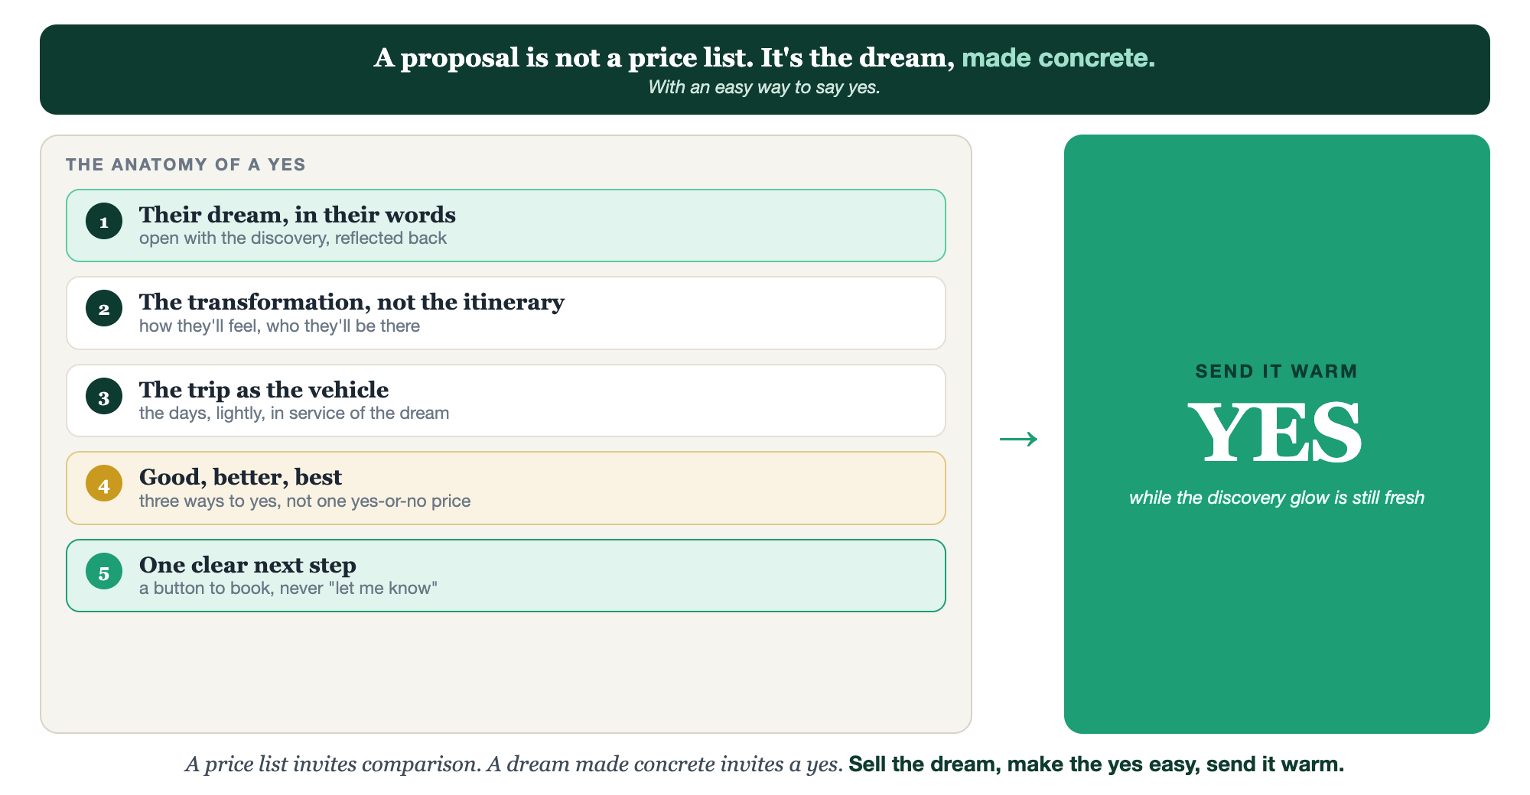
THE DREAM · THE TRANSFORMATION · GOOD, BETTER, BEST · ONE NEXT STEP · SENT WARM
The proposal that gets a yes.

Slide 9
PUT YOUR SECOND MATE TO WORK
More than copy. Your proposal writer.
DRAFT
FRAME
TRANSFORM
From your notes
Good, better, best
Itinerary to dream
Paste your discovery notes; it drafts the full proposal, dream-led, in your voice.
It shapes your three options so the value ladder is clear and the middle shines.
It rewrites flat day-by-day lines into the feeling and the transformation.
Copy-paste example prompts are in the library: How to Prompt Your Second Mate.

Slide 10
YOUR FIRST BRICK
Build your proposal template.
1
Your template sections
Lay out the parts: their dream, the transformation, the trip, the options, the next step. (The Your Proposal worksheet.)
2
Your good, better, best
Define your three standard option tiers so you're not reinventing them each time.
3
Your one next step
Write the single, frictionless call to action you'll end every proposal with.

Slide 11
WANT A HAND WITH THIS PART?
Three ways to get unstuck.
GROUP
ONE-ON-ONE
DONE WITH / FOR YOU
Professor Hours
Book a 1:1
Hire us
Bring your specific question to office hours and ask it live.
We work on yours, screen to screen, until it's done right.
Consultant or coach. We build it with you, or we build it for you.

Slide 12
BUILT WITH YOU, NOT TAUGHT AT YOU
Sell the dream.
Make the yes easy.
You can build a dream-led proposal template today. Shaping the options and the words so the yes feels obvious, and sending it warm in a tool like Tern, is what we build together.
We build it with you →
Next → 4.5, The Money Conversation: talking price with confidence, without flinching.
Post your good, better, best option tiers for the group to react to. Questions? Bring them to this week's Professor Hours.

