Slide 1
MARKETING JOURNEYS · THE TRADEWINDS METHOD · CONFIRM
Session 4.2
Discovery
Do I really understand what they want, or am I guessing?

Slide 2
THE CONVERSATION THAT EARNS THE BOOKING
The pro asks
before they pitch.
You don't earn the booking by talking the most. You earn it by understanding them best. Discovery is not a step before the service, it is where the service begins.

Slide 3
THE HEADWIND HERE IS THE LEAKY BUCKET
Why discovery wins.
You cannot recommend a trip until you understand the traveler. The second you skip the asking and start assuming, you are guessing, and a guess that misses tells the client you were not really listening. So they drift to the advisor who was. That is the leak. Every great recommendation you will ever make starts here, with you understanding them so well that the right trip is obvious. Discovery is not the small talk before the work. It is the work.
Assume, and you guess. Guess wrong, and they leak out to whoever actually listened.

Slide 4
DRAW OUT THE DREAM
It's about them, even if they don't know it yet.
Here is the heart of it. A client comes to you and asks for a place, a date, a price. But that is rarely what they actually want. Under the request is a dream they often cannot put into words yet: the occasion they are marking, the feeling they are chasing, the person they are doing it for, the why. Your job is not to take their order. Your job is to draw that dream out, gently, with good questions, until they hear themselves say the thing they did not know they were looking for. That is the moment they know you are the one.
They ask for a destination. You uncover the dream underneath it. Most clients don't know it until you ask.

Slide 5
PICK YOUR DEPTH
The spectrum: 4 questions to 20.
Keep it simple
Go deep
A 4-question sheet. Fast, warm, enough for a straightforward trip or a first conversation. Never makes them work too hard.
A detailed 20-point questionnaire. The full picture for a honeymoon, a milestone, a complex multi-stop dream where the details matter.
You pick the depth, and you match it to the trip and the client. Don't interrogate a weekend, don't wing a honeymoon.

Slide 6
THE EXACT QUESTIONS COME NEXT SESSION
Logistics, then the dream.
Logistics (necessary, not enough)
Dream questions (where the gold is)
Where, when, how many, how much. You need these, but anyone can ask them, and they tell you nothing about the dream.
Open-ended, and all about them. What should this trip feel like? What would make it unforgettable? Listen for the why.
A good question is open-ended and about them. The exact set, the dream, budget, and timeline, is all of 4.3.

Slide 7
WHERE TRUST IS ACTUALLY BUILT
Listen, note, reflect back.
Asking is only half of it. The other half is what you do with the answers. Talk less than they do, and write down what they say, their words, not your summary. Then reflect it back: so what I am hearing is, you want the kids exhausted and happy, and one quiet dinner just for the two of you. When a client hears their own dream said back to them clearly, they feel understood in a way almost nobody makes them feel, and that feeling is what earns the booking. Then capture it all into your system, your Manifest in Tern, so not one detail leaks before you build the proposal.
Reflecting their dream back is what makes them feel understood. Capture every word in Tern so nothing leaks.

Slide 8
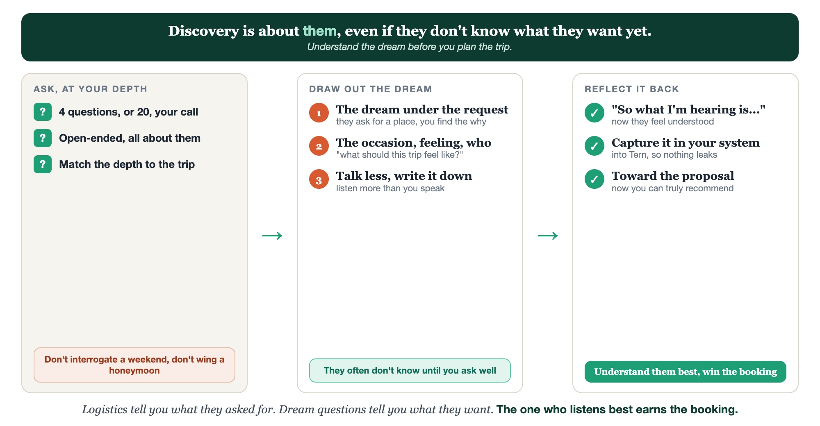
ASK AT YOUR DEPTH · DRAW OUT THE DREAM · REFLECT IT BACK
The discovery conversation.

Slide 9
PUT YOUR SECOND MATE TO WORK
More than copy. Your discovery partner.
BUILD
BRIEF
SURFACE
Your questionnaire
Answers to a brief
The follow-ups
It drafts a discovery sheet tailored to your niche, at the depth you choose.
Paste their raw answers; it turns them into a clean, organized trip brief.
It suggests the one or two deeper questions worth asking this client next.
Copy-paste example prompts are in the library: How to Prompt Your Second Mate.

Slide 10
YOUR FIRST BRICK
Build your discovery sheet.
1
Pick your depth
Choose where you sit on the spectrum: a 4-question sheet or a fuller set. (The Your Discovery Questions worksheet.)
2
Write the dream question
Name the one open-ended question you'll always ask to surface the why.
3
Plan the reflect-back
Decide how you'll capture answers and say them back, then store it in Tern.

Slide 11
WANT A HAND WITH THIS PART?
Three ways to get unstuck.
GROUP
ONE-ON-ONE
DONE WITH / FOR YOU
Professor Hours
Book a 1:1
Hire us
Bring your specific question to office hours and ask it live.
We work on yours, screen to screen, until it's done right.
Consultant or coach. We build it with you, or we build it for you.

Slide 12
BUILT WITH YOU, NOT TAUGHT AT YOU
Understand the dream
before you plan the trip.
You can build a simple discovery sheet today. Learning to draw out the dream a client can't yet name, and reading the room as you do it, is what we practice together.
We build it with you →
Next → 4.3, The Right Discovery Questions: the dream, the budget, and the timeline, without the interrogation.
Post your one dream question for the group to borrow. Questions? Bring them to this week's Professor Hours.

