Slide 1
MARKETING JOURNEYS · THE TRADEWINDS METHOD · CONFIRM
Session 4.1
Lead Response System
When a lead comes in, how fast, and how well, do I answer?

Slide 2
PART 4 · CONFIRM · TURNING INTEREST INTO BOOKINGS
You filled the bucket.
Now stop the leaks.
Every route in Part 3 poured interest into your list. Confirm is where you keep it from leaking out. And the very first leak is the slow reply: a lead is hottest the second it arrives, and it cools fast.

Slide 3
THE HEADWIND HERE IS THE LEAKY BUCKET
Five minutes beats five hours.
A lead is never hotter than the moment it lands. They just thought of you, they are sitting there, ready. An hour later that heat is fading. A day later it is usually gone. The studies are brutal and they all say the same thing: answer in five minutes and you are worlds ahead of the advisor who answers in five hours. Speed is not about being pushy, it is about catching people while they still care. You worked hard to fill this bucket. Do not let the first reply be the hole it leaks out of.
The lead is hottest the second it arrives. Answer while it's hot, or it leaks away.

Slide 4
DON'T KID YOURSELF
They filled out more than one.
Here is the truth nobody wants to hear: that lead almost never came to you and only you. They filled out a few. They are comparing. So the first warm, human reply does not just answer them, it often wins them, before the others even wake up. Let me make it real. I recently needed a window replaced, so I went looking for a quote, and I contacted twenty-two companies. Twenty-two. You know how many called me back? One. ONE. That one had my business before the others ever picked up the phone, because the other twenty-one let me leak out of their bucket.
Be the one who answers. The first good reply usually wins, before the rest wake up.

Slide 5
WRITE IT ONCE, READY TO SEND
Your first-response template.
You should never be writing your first reply from scratch, panicked, while the clock runs. You write it once, today, calm, and keep it ready. A good one does four small things: it thanks them warmly and by name, it confirms you have got their note, it sets a clear expectation for what happens next, and it asks one simple question to open the conversation. Warm, human, short. Not a brochure, not a hard sell, just a real person saying I am on it, and here is the next step.
Thank them, confirm you've got it, set the next step, ask one question. Written once, ready always.

Slide 6
THE ROBOT BUYS YOU TIME, IT DOESN'T DO THE JOB
Auto-acknowledge, then converse.
The instant acknowledgment
The real conversation
An automatic reply fires the second a lead comes in, day or night. Got your note, thank you, I'll be in touch personally within the hour. It kills the silence so no one sits and wonders.
Then you, personally, as soon as you can. Warm, by name, one good question. The auto-reply holds the door open; you are the one who walks through it.
Automate the acknowledgment so nothing waits. Never automate the relationship.

Slide 7
WHERE MOST ADVISORS DROP IT
The handoff to a real reply.
Here is the trap: people set up the auto-reply, feel covered, and then let it do the whole job. The robot was never meant to do that. The instant acknowledgment buys you minutes, that is all, it holds the door so the lead does not feel ignored. But if a real, personal reply never follows, the door swings shut and they go book with the advisor who actually showed up. So build the handoff on purpose: the auto-reply goes out in seconds, and your real reply follows in minutes, not days. That handoff is the whole system.
The auto-reply buys minutes. The personal reply earns the booking. Never skip the second one.

Slide 8
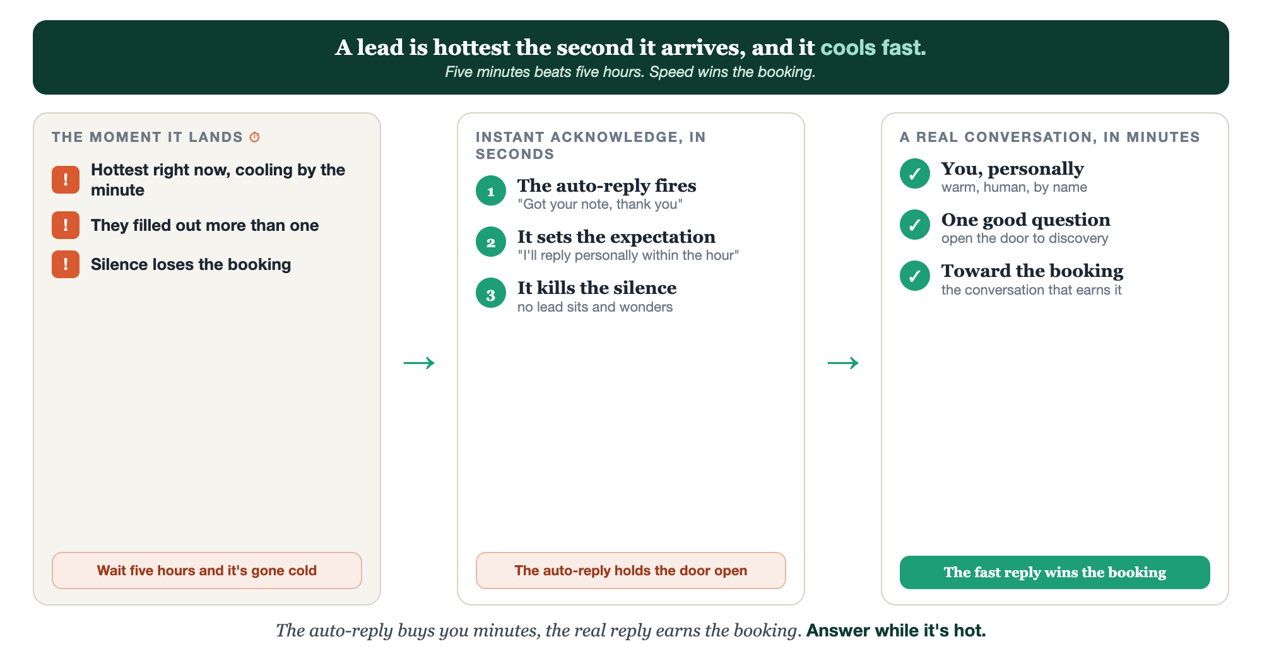
THE MOMENT IT LANDS · ACKNOWLEDGE IN SECONDS · CONVERSE IN MINUTES
The lead response system.

Slide 9
PUT YOUR SECOND MATE TO WORK
More than copy. Your fast hands.
WRITE
AUTOMATE
PERSONALIZE
Your template
The auto-text
Fast and human
It drafts a warm, on-brand first reply, and a few variations to choose from.
It writes the instant acknowledgment that fires the second a lead lands.
Paste the lead's note; it tailors your reply in seconds so you can send now.
Copy-paste example prompts are in the library: How to Prompt Your Second Mate.

Slide 10
YOUR FIRST BRICK
Build your first reply.
1
Write the reply
Draft your first-response message, warm, by name, one question. (The Your First Reply worksheet.)
2
Set the speed
Decide how fast you'll reply, and the tool that fires the instant acknowledgment for you.
3
Test it live
Send yourself a fake lead. Did the auto-reply fire? Could you answer for real in minutes?

Slide 11
WANT A HAND WITH THIS PART?
Three ways to get unstuck.
GROUP
ONE-ON-ONE
DONE WITH / FOR YOU
Professor Hours
Book a 1:1
Hire us
Bring your specific question to office hours and ask it live.
We work on yours, screen to screen, until it's done right.
Consultant or coach. We build it with you, or we build it for you.

Slide 12
BUILT WITH YOU, NOT TAUGHT AT YOU
The fast reply
wins the booking.
You can write your first reply and turn on an instant acknowledgment today. Building the system so no hot lead ever leaks again is what we do together.
We build it with you →
Next → 4.2, Discovery: the conversation that earns the booking.
Post your first-response template for a quick gut-check. Questions? Bring them to this week's Professor Hours.

