Slide 1
MARKETING JOURNEYS · THE TRADEWINDS METHOD · CAPTURE
Session 3.9
Get Found / Search
When my person searches, do they find me, or someone else?

Slide 2
THE WARMEST INTENT THERE IS
People already
looking for you.
Every other route, you reached out to them. Here they reach out, because they're already searching, right now, for exactly what you do. The only question is whether they find you, or someone else.

Slide 3
THE HEADWIND HERE IS THE VANITY TRAP
SEO, in plain language.
Forget the jargon. SEO is just this: figure out the exact words your people type when they're looking, and make sure your site says those words clearly. Someone types best honeymoon advisor in Austin, or family trip to Italy with kids. Those phrases are gold, because the person typing them is ready. The Vanity Trap chases a thousand followers who'll never book; one searcher with intent is worth more than all of them.
A thousand idle followers can't beat one person searching for exactly what you do tonight.

Slide 4
THE FOUNDATION, ESPECIALLY LOCAL
Google Business Profile and directories.
The single highest-return thing most advisors never do: set up your Google Business Profile. It's free, and it's what shows up when someone searches your name or your service nearby, with your reviews, your link, your details. Then get listed in the directories that matter for travel and your niche. These are the listings that make you look real and findable the moment someone looks. Claim them, fill them out completely, keep them current.
Step-by-step setup for your Google Business Profile lives in the Specialty Library.

Slide 5
TWO SEARCH ENGINES IN DISGUISE
Pinterest and YouTube are search, too.
Remember from 3.4: Pinterest isn't really social, it's a search engine. And so is YouTube, in fact YouTube is the second most used search engine in the world, right behind Google. People go there and type exactly what they want, and your content can surface for months or years, not hours. For travel that's a perfect fit. A pin or a video that answers a real question keeps working long after you posted it. Evergreen search, while you sleep.
On Pinterest and YouTube, one good answer can be found for years. That's leverage.

Slide 6
THE NEW LAYER: ANSWER ENGINES
SEO meets AEO.
Here is what's changing fast. People don't only search Google anymore, they ask AI: ChatGPT, Perplexity, the AI answer on top of Google. That's AEO, answer engine optimization, making sure you're the source the AI names when someone asks for a travel advisor. The good news, it rewards the same things: clear, helpful, specific content that genuinely answers the question. Write to be the answer, and you show up whether they search the old way or the new way.
Write to be the answer, not just to rank. The engines reward genuinely helpful, specific content.

Slide 7
SEARCH IS ALSO THE VETTING STEP
They will check you out.
Here is the part people miss: search isn't only how strangers find you cold. It's how everyone vets you. After a referral, after you meet at an event, after a partner mentions you, the very next thing they do is look you up. They check your Google Business Profile, your socials, your LinkedIn. So every route you've built feeds into this moment. Make sure that when they look, what they find is consistent, current, and makes them think: yes, this is a pro.
Every other route ends with them Googling you. Make sure you pass the look-you-up test.

Slide 8
DON'T JUST GET FOUND, GET THE EMAIL
Searcher to subscriber.
Getting found is only half the win. A visitor who finds you and leaves is gone, and you may never know they came. So the same rule as always: turn the searcher into a subscriber. Every page they land on should offer the magnet and a reason to join your list. They came looking for an answer, so give them a great one, then invite them to stay. Found, then captured, then yours.
Being found is worthless if they leave. Capture the searcher onto your list.

Slide 9
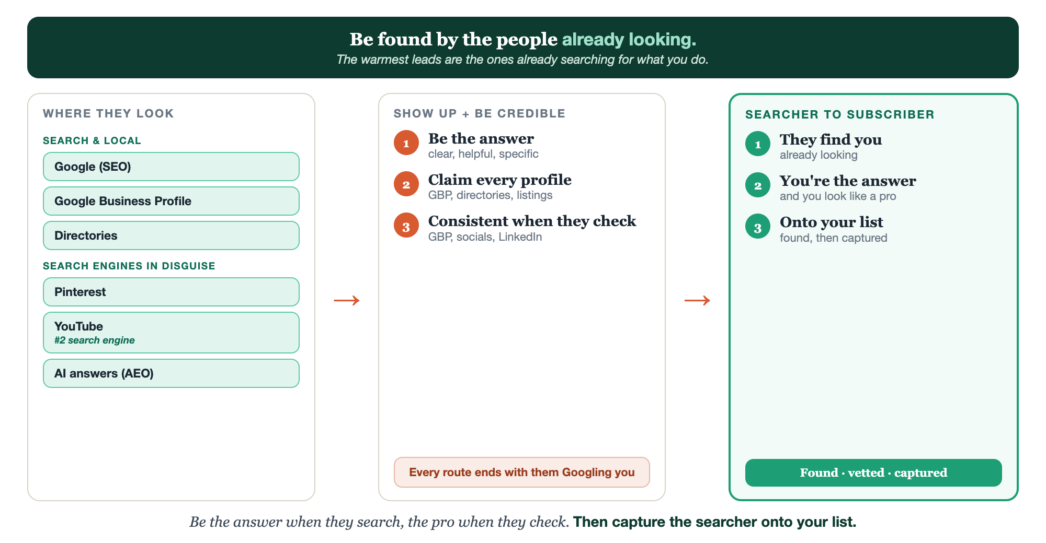
WHERE THEY LOOK · BE THE ANSWER · SEARCHER TO SUBSCRIBER
Get found, end to end.

Slide 10
PUT YOUR SECOND MATE TO WORK
More than copy. Your search assistant.
KEYWORDS
PROFILE
BE THE ANSWER
What they search
Profiles + listings
SEO + AEO content
It researches the exact phrases your people type when they're ready.
It writes your Google Business Profile and directory copy.
It drafts clear, helpful pages built to be found, and to be the answer.
Copy-paste example prompts are in the library: How to Prompt Your Second Mate.

Slide 11
YOUR FIRST BRICK
Three keywords, one profile.
1
Three keywords
Write the three phrases your people actually type when they're ready. (The Your Search Plan worksheet.)
2
Your Google Business Profile
Claim and fully fill out your profile, the highest-return hour you'll spend.
3
Capture the searcher
Make sure every page offers the magnet and a way onto your list.

Slide 12
WANT A HAND WITH THIS PART?
Three ways to get unstuck.
GROUP
ONE-ON-ONE
DONE WITH / FOR YOU
Professor Hours
Book a 1:1
Hire us
Bring your specific question to office hours and ask it live.
We work on yours, screen to screen, until it's done right.
Consultant or coach. We build it with you, or we build it for you.

Slide 13
BUILT WITH YOU, NOT TAUGHT AT YOU
Be found by the people
already looking.
You can list three keywords and claim your profile today. Turning your whole presence into something that gets found, and passes the look-you-up test, is the work we do together. The warmest leads are the ones already searching.
We build it with you →
Next → 3.10 Paid: paying to reach the right people.
Post the three keywords your people search. Questions? Bring them to this week's Professor Hours.

