Slide 1
MARKETING JOURNEYS · THE TRADEWINDS METHOD · CAPTURE
Session 3.8
Partnerships &
Collaborations
Who nearby has my exact audience, and no competing offer?

Slide 2
THE MOST LEVERAGED ROUTE OF ALL
Borrow an audience.
Build your list.
Every route so far built your reach one person at a time. This one reaches a whole room at once. Somewhere nearby is a business with exactly your audience, and no competing offer. Today you find them and partner up.

Slide 3
THE HEADWIND HERE IS THE VANITY TRAP
Who already has your audience?
The Vanity Trap says build your own audience from scratch, for years. Skip it. Somewhere nearby is a business with exactly your people and no competing offer, and that is the magic combination. A wedding planner has couples but doesn't sell honeymoons, that's yours. A yoga studio has members but doesn't run wellness retreats, that's yours. A venue hosts events but needs people to fill it. Find the business whose audience is your audience, and whose offer is not.
The perfect partner has your exact audience, and no offer that competes with yours.

Slide 4
A REAL WIN FOR THEIR AUDIENCE
The right offer, the right moment.
A partnership lives or dies on offering the right thing at the right moment. The wedding planner's couples are thinking about the honeymoon exactly when they book the wedding, so that is when your honeymoon offer belongs. The yoga studio's members dream of a retreat as the season turns. Read the moment your partner's audience is already in, and bring the offer that fits it. Right offer, wrong moment, falls flat. Right offer, right moment, feels like a gift.
Meet their audience at the moment they're already primed for what you do.

Slide 5
MAKE IT EASY TO SAY YES
The pitch that gets a yes.
Now the pitch to the partner, and the secret is to make it all about them. Lead with the win for their audience and for them, never for you. Be specific: here is exactly what I'd offer your couples, here is how it makes you look great to them, here is what you get. Make it concrete, low-effort on their side, and clearly a win for them. You are not asking a favor, you are handing them something good for their people. That is a pitch that gets a yes.
Don't pitch what you want. Pitch what they and their audience get. Make yes the easy answer.

Slide 6
TWO BRANDS, BOTH LISTS
Co-market cleanly.
When you promote together, keep each brand itself. You stay the travel expert; they stay the planner, the studio, the venue. Don't blur into a muddy joint thing nobody understands. Co-host the event, cross-promote the offer, share the moment, but each of you stays clearly you. And here is the generous part that keeps partners for life: feed both lists. Their audience meets you, your audience meets them. Everybody grows.
Keep both brands distinct, and grow both lists. A partnership where both win is one that lasts.

Slide 7
WHERE THIS LEADS: THE GO-TO PERSON
You become the connector.
Do this enough, with enough partners, and you turn into the most valuable thing in any local market: the connector. The go-to person who seems to know everybody. You get there by giving first, sending business to your partners, introducing people who should meet. You become the hub, and hubs get everything routed through them, including travelers. Give referrals freely, and they come back to you multiplied.
Be the person who connects everyone. The connector is the first name the whole market thinks of.

Slide 8
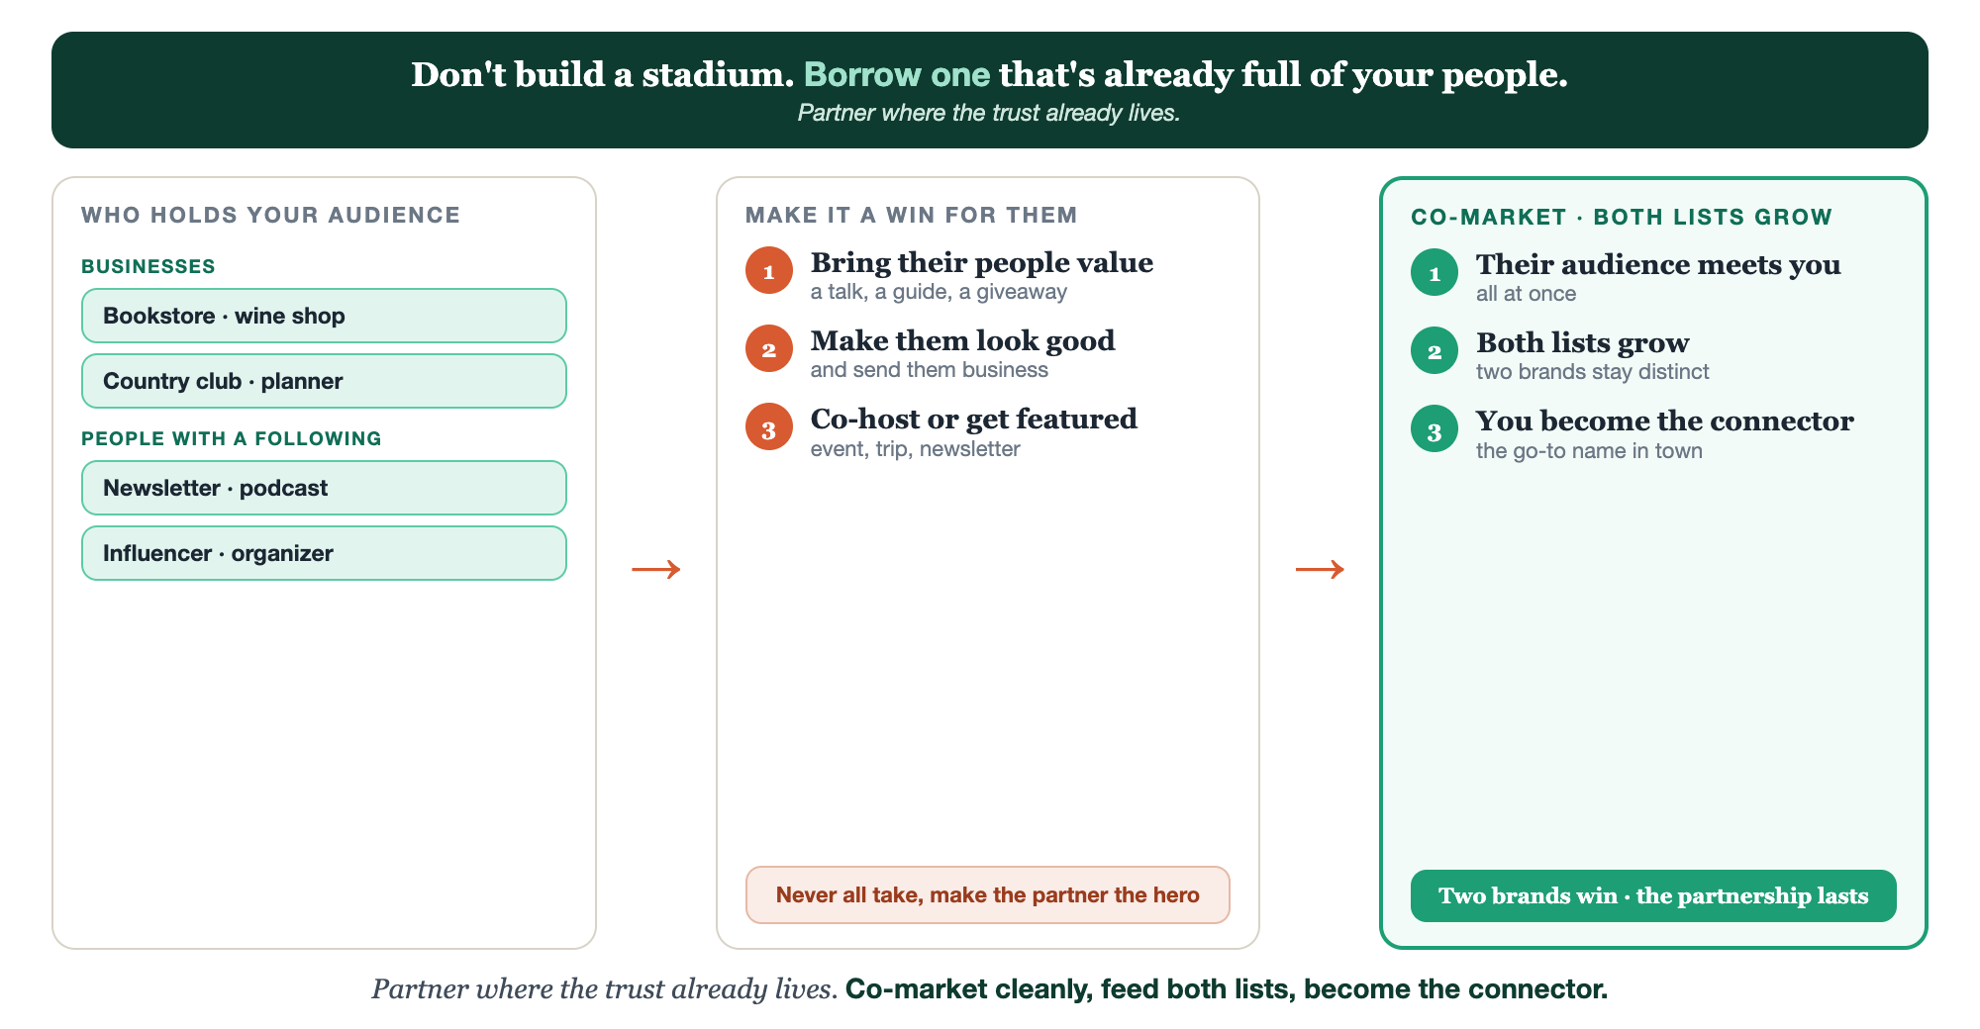
WHO HOLDS THEM · A WIN FOR THEM · BOTH LISTS GROW
Borrowed audiences, end to end.

Slide 9
PUT YOUR SECOND MATE TO WORK
More than a pitch. Your partnership scout.
SCOUT
THE PITCH
THE COLLAB
Find partners
Tailored to each
Plan the co-market
It lists local businesses with your audience and no competing offer.
It writes the partnership pitch tailored to that exact business and its people.
It outlines a clean co-hosted event or cross-promotion that feeds both lists.
Copy-paste example prompts are in the library: How to Prompt Your Second Mate.

Slide 10
YOUR FIRST BRICK
Find three partners.
1
Three partners
List three businesses with your audience and no competing offer. (The Your Partners worksheet.)
2
The win for their audience
For your top pick, write the offer and the moment it fits.
3
Your pitch
Draft the pitch that leads with their win, and feeds both lists.

Slide 11
WANT A HAND WITH THIS PART?
Three ways to get unstuck.
GROUP
ONE-ON-ONE
DONE WITH / FOR YOU
Professor Hours
Book a 1:1
Hire us
Bring your specific question to office hours and ask it live.
We work on yours, screen to screen, until it's done right.
Consultant or coach. We build it with you, or we build it for you.

Slide 12
BUILT WITH YOU, NOT TAUGHT AT YOU
Borrow an audience.
Build your list.
You can name three partners and draft one win-for-them pitch today. Turning a cold idea into a real co-marketing partnership that feeds both lists, and becoming the connector everyone routes through, is the work we do together.
We build it with you →
Next → 3.9 The people already searching for you.
Post the one partner you'll approach, and the win you'll offer them. Questions? Bring them to this week's Professor Hours.

