Slide 1
MARKETING JOURNEYS · THE TRADEWINDS METHOD · CAPTURE
Session 3.7
Community
How do I become the trusted name in a room full of my people?

Slide 2
BETTER THAN ATTENDING: BELONGING
A room where
your people gather.
3.6 was working other people's rooms. A community is a room built around a shared passion, where your people gather again and again. Join the right one, or build it.

Slide 3
THEY'RE ALREADY GATHERING SOMEWHERE
Join groups around your niche.
Your people already cluster around what they love. Book clubs, motorsports forums, wellness circles, LGBTQ travel groups, alumni associations, hobby groups, local Facebook groups for every passion under the sun. Find the ones that overlap your niche and go where the gathering already is. You don't have to create the crowd, you just have to show up in it, consistently and usefully.
A community for "travel" is no one's home. A community for your people is. The niche is the key.

Slide 4
OR MAKE THE ROOM YOURSELF
Or build your own, and own it.
Sometimes the perfect room doesn't exist yet. So build it. Start the Facebook group, the monthly meetup, the email circle for exactly your kind of traveler. It's more work, but the host has something no member can buy: the most trust in the room. When you create the place your people gather, you're not a guest anymore, you're the center of it.
The host earns the most trust in the room. Sometimes the best move is to build the room.

Slide 5
WHICH ONE IS RIGHT FOR YOU?
Join, or build?
Join when...
Build when...
A healthy group of your people already exists. Faster and lighter, you borrow the gathering. Your job is to be its most useful member.
No room fits, or you want to own the trust. Slower and more work, but you host the room and become its center.
Most people should join first. Build once you know exactly who you serve and how.

Slide 6
THE HEADWIND HERE IS THE VANITY TRAP
Serve before selling.
Here is the one rule that makes communities work, and the trap that ruins them. Serve before selling. The Vanity Trap shows up as the person who joins only to promote themselves, dropping links, pitching, making it all about them. Everyone tunes them out instantly. Do the opposite. Be the most helpful person in the room. Answer questions, share what you know, celebrate others, make introductions. Give, with no pitch attached.
Nobody trusts the person who only promotes. Everybody trusts the person who always helps.

Slide 7
FROM HELPFUL TO BOOKED, NATURALLY
Helpful to booked.
Here is how being helpful quietly becomes business, without you ever hard-selling. You answer enough questions well, and you become known as the person who actually knows travel. Then it happens on its own: someone messages you, hey, you clearly know your stuff, could you help me plan mine? That is the whole path. Helpful, to trusted, to asked, to booked, and onto your list. You earned it by serving, so it never feels like selling.
Be useful long enough and the booking comes to you. Helpful is the best sales strategy there is.

Slide 8
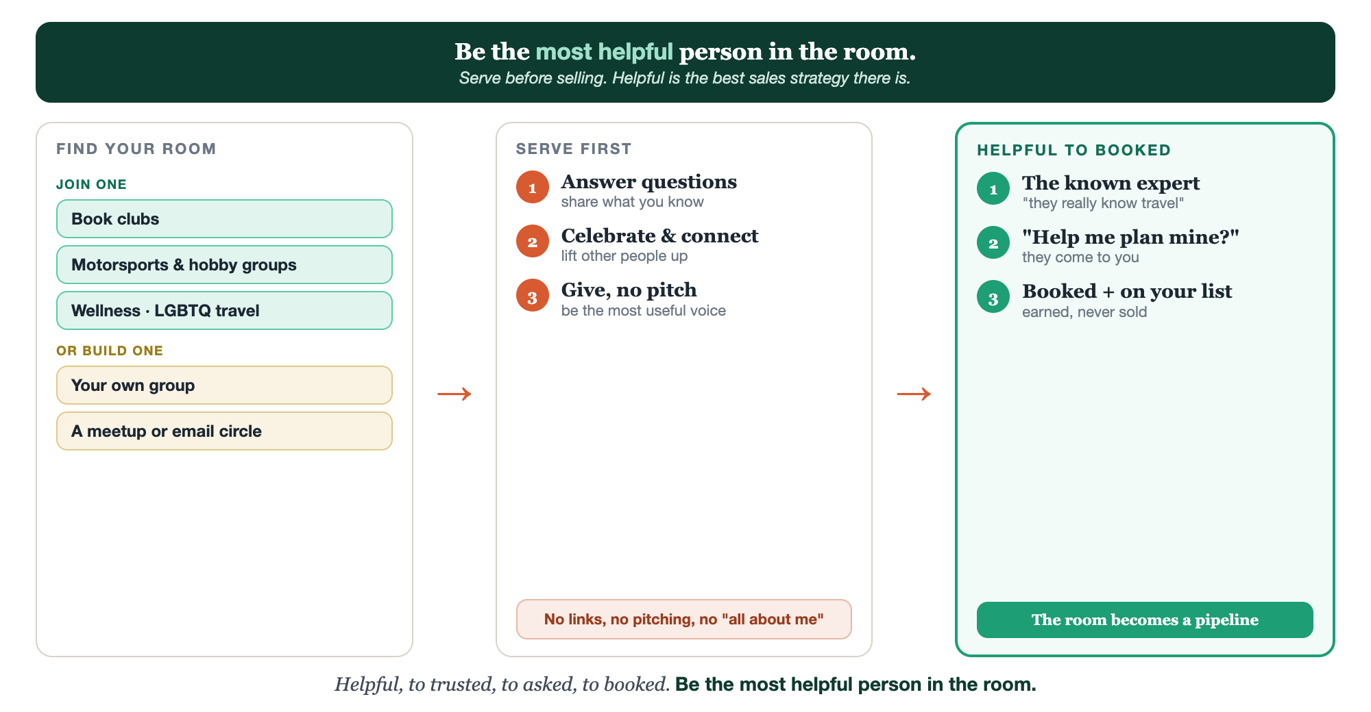
JOIN OR BUILD · SERVE FIRST · HELPFUL TO BOOKED
Community, end to end.

Slide 9
PUT YOUR SECOND MATE TO WORK
More than posts. Your helpful voice.
FIND
SERVE
POSTS
Find the rooms
Helpful answers
Posts that give
It surfaces communities and groups built around your niche.
It drafts genuinely useful answers to questions in the group, no pitch.
It helps you write share-worthy posts that serve first, sell never.
Copy-paste example prompts are in the library: How to Prompt Your Second Mate.

Slide 10
YOUR FIRST BRICK
Pick one community.
1
Join or build one
Choose one community to join, or one to build, around your niche. (The Your Community worksheet.)
2
How you'll serve first
Decide the helpful thing you'll do, answers, shares, introductions, before any pitch.
3
Show up weekly
Be present and useful on a cadence you can keep. Helpful compounds.

Slide 11
WANT A HAND WITH THIS PART?
Three ways to get unstuck.
GROUP
ONE-ON-ONE
DONE WITH / FOR YOU
Professor Hours
Book a 1:1
Hire us
Bring your specific question to office hours and ask it live.
We work on yours, screen to screen, until it's done right.
Consultant or coach. We build it with you, or we build it for you.

Slide 12
BUILT WITH YOU, NOT TAUGHT AT YOU
Be the most helpful
person in the room.
You can join or start one community this week. Becoming its trusted center, the name they think of first, is the slow, compounding work we do together. Serve first, and the room becomes a pipeline.
We build it with you →
Next → 3.8 Partnering with a business that already has your audience.
Post the one community you'll join or build. Questions? Bring them to this week's Professor Hours.

