Slide 1
MARKETING JOURNEYS · THE TRADEWINDS METHOD · CAPTURE
Session 3.6
Networking
How do I meet new people without it feeling fake or transactional?

Slide 2
MEETING THE PEOPLE YOU HAVEN'T MET YET
Not collecting cards.
Starting relationships.
3.5 was the people you already know. This is the people you don't, yet. Networking isn't a stack of cards, it's starting relationships, then following up so they don't fade.

Slide 3
TWO ROOMS, NOT TEN
Find the right rooms.
You don't need every event, you need the right ones. The right room is where your person already gathers, or where the people who refer your person gather. They live in two places: online (niche groups, LinkedIn, virtual summits) and off (BNI, the Chamber, charity galas, alumni mixers, local meetups). Pick two you can show up in regularly. Two rooms worked beats ten rooms visited once.
The right room is where your person, or the people who refer them, already gather.

Slide 4
THE HEADWIND HERE IS THE VANITY TRAP
Relationships, not cards.
Here is the trap: treating a room like a numbers game, collecting fifty cards and calling it a win. A pile of cards is a vanity metric, it feels productive and does nothing. Trade it for three real conversations. Be curious, not transactional. Ask about them. Look for ways to be useful: an introduction, a tip, a connection. You are not there to sell, you are there to start something.
A stack of cards is a vanity metric. Three real conversations is a night well spent.

Slide 5
REMEMBER YOUR SPOKEN PITCH? HERE IT IS
Your intro, out loud.
This is the moment your spoken pitch from 3.2 finally earns its keep. Someone asks what you do, and you don't say I'm a travel agent. You say what you do for people: I take the time and the stress out of planning the trip of a lifetime, so my clients just show up and enjoy it. Short, warm, and it makes them lean in. You already wrote it. Now you get to use it.
Now you see where the elevator pitch comes in. The room is what you built it for.

Slide 6
THE FASTEST WAY TO BE INTERESTING
The question that opens it.
But don't lead with your pitch, lead with curiosity. The fastest way to be interesting is to be interested. Have one good opener ready that gets them talking about themselves. What brought you here tonight? What are you working on these days? People remember how you made them feel, and making them feel heard beats any clever line about you. Your pitch comes second, after you've actually listened.
Be interested, not interesting. The best networker in the room is the best listener.

Slide 7
THE MONEY IS IN THE FOLLOW-UP
The follow-up that converts.
Here is the whole secret of networking, and almost nobody does it. The money is in the follow-up. A hello at an event is worth nothing until you follow up, within a day or two, with a personal note that references your actual conversation, never a copy-paste. Remind them who you are, give a little value, and softly invite them onto your list. That is how a handshake becomes a lead you own.
A hello you don't follow up on is a lead you threw away. The money is in the follow-up.

Slide 8
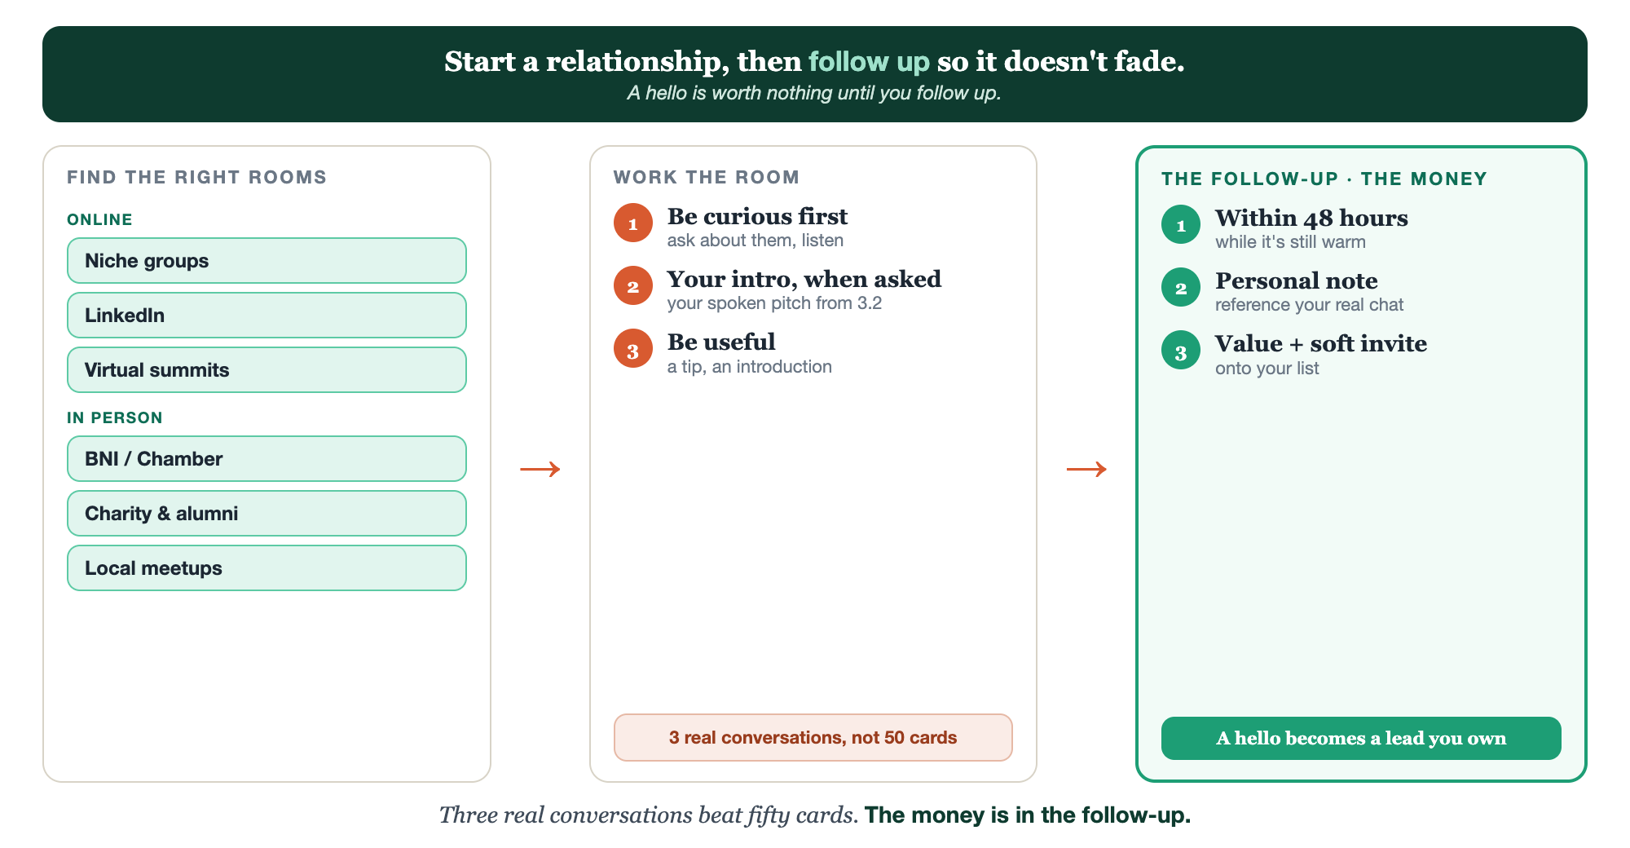
RIGHT ROOMS · WORK THE ROOM · FOLLOW UP
Networking, end to end.

Slide 9
PUT YOUR SECOND MATE TO WORK
More than notes. Your event wingman.
PREP
FIND
FOLLOW UP
Prep your intro
Find the rooms
Write the follow-up
It sharpens your spoken pitch and a few opener questions before you go.
It suggests online and local rooms where your person gathers.
Feed it your conversation notes; it drafts a warm, personal follow-up.
Copy-paste example prompts are in the library: How to Prompt Your Second Mate.

Slide 10
YOUR FIRST BRICK
Pick two rooms.
1
Two rooms
Choose two rooms, one online and one off, where your person gathers. (The Your Rooms worksheet.)
2
Your intro line
Bring your spoken pitch from 3.2, and one opener question to get them talking.
3
Your follow-up plan
Decide exactly how and when you'll follow up, before you ever walk in.

Slide 11
WANT A HAND WITH THIS PART?
Three ways to get unstuck.
GROUP
ONE-ON-ONE
DONE WITH / FOR YOU
Professor Hours
Book a 1:1
Hire us
Bring your specific question to office hours and ask it live.
We work on yours, screen to screen, until it's done right.
Consultant or coach. We build it with you, or we build it for you.

Slide 12
BUILT WITH YOU, NOT TAUGHT AT YOU
The money is
in the follow-up.
You can pick two rooms and ready your intro today. Walking in without dread, and following up so a hello becomes a lead, is the part we practice together. Another sail toward your peace number.
We build it with you →
Next → 3.7 Building or joining a community.
Post the two rooms you'll show up in this month. Questions? Bring them to this week's Professor Hours.

