Slide 1
MARKETING JOURNEYS · THE TRADEWINDS METHOD · CAPTURE
Session 3.5
Your Network
How do I reach the people I know without feeling like a salesperson?

Slide 2
THE WARMEST ROUTE OF ALL
Your warmest leads
already know you.
Social media reaches strangers. This route reaches the people who already know, like, and trust you. The most overlooked route to your list, and the warmest.

Slide 3
THE HEADWIND HERE IS THE VANITY TRAP
The next booking is in your contacts.
Here is a truth that stings a little. While you were chasing likes from strangers, the people most likely to book with you were sitting in your phone the whole time. Past travelers, friends, family, old colleagues, neighbors. They already trust you. That is the Vanity Trap in reverse: applause from strangers feels like progress while the warmest leads you already have go untouched.
You chased strangers for likes while the people who'd actually book sat in your contacts.

Slide 4
FIRST, LET'S NAME THE RESISTANCE
Why you might hold back.
THE FEAR
THE MIX
THE DOUBT
Feeling salesy
Friends and money
Imposter syndrome
You don't want to look like you're using a friendship or being pushy.
Mixing relationships and business feels uncomfortable, even risky.
Who am I to offer this? Am I even good enough yet?
They're going to take that trip with someone. Why not the person who actually cares about getting it right?

Slide 5
WHY PEOPLE ACTUALLY SAY YES
Know, like, and trust.
Now flip it, because this is why reaching out works. People do business with people they know, like, and trust. It is the oldest rule there is, and your network already has all three. A stranger on a platform has to be earned from zero. The people who know you are not starting cold, they are starting warm. You are not imposing, you are offering an easier, better way to do something they already want to do.
A stranger starts at zero. Your network starts at know, like, and trust. Don't waste that.

Slide 6
REACH OUT LIKE A HUMAN
Without the ick.
So how do you reach out without feeling gross? Be a person first, not a pitch. Open with them, not with you. How have you been. I thought of you when. Congratulations on. No hard sell, no copy-paste blast to fifty people at once. You are reconnecting with a human being you genuinely know, and you let the business part come later, and softly. If it would feel weird to say in person, don't type it.
Lead with the person, not the pitch. Reconnect first, business second.

Slide 7
GIVE FIRST, THEN INVITE
Value first, then the list.
Once you have reconnected like a human, lead with value, not a request. Share something genuinely useful: a tip for the trip they mentioned, an article, an answer to a question they had. Give before you ask. And then, only then, comes the soft invite. By the way, I send out a few of these a month, want me to add you? You earned the invite by being useful first.
Give something useful before you ask for anything. The invite is the easy part.

Slide 8
SO YOU ACTUALLY DO IT
A simple cadence.
The whole thing falls apart if it lives in your head as someday. So make it a tiny habit. A few reconnects a week, five names every Monday, whatever you will actually keep. Not a frantic blast to everyone you have ever met, just a steady trickle of genuine reconnections. Small and consistent beats big and never. This is Cruising Altitude, applied to the people you already know.
One genuine reconnect this week could already be your next booking.

Slide 9
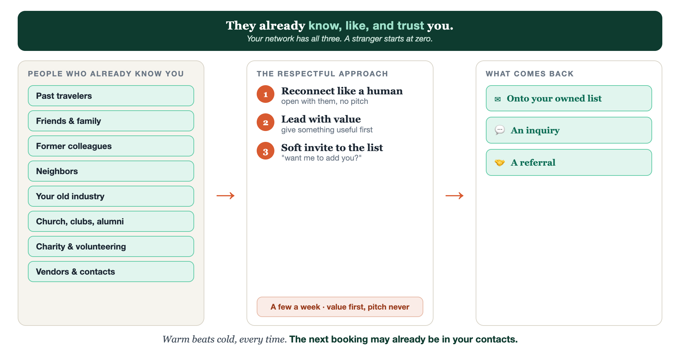
WARM LIST · RESPECTFUL APPROACH · WHAT COMES BACK
The network system, end to end.

Slide 10
PUT YOUR SECOND MATE TO WORK
More than mail merge. Your outreach partner.
THE LIST
PERSONALIZE
THE OPENER
Surface who to call
Never a copy-paste blast
Warm, never salesy
It helps you brainstorm the people who already know and trust you.
It tailors each message to the real person and your history together.
It drafts human openers that lead with them, not with your pitch.
Copy-paste example prompts are in the library: How to Prompt Your Second Mate.

Slide 11
YOUR FIRST BRICK
Reach ten people.
1
Your ten names
Use the Christmas-card-list or dinner-party trick: who would you invite? List ten who already know you. (The Your Network worksheet.)
2
Your opening message
Write one warm, human opener that leads with them, not a pitch.
3
Send a few this week
Pick a cadence, value first, then a soft invite to your list.

Slide 12
WANT A HAND WITH THIS PART?
Three ways to get unstuck.
GROUP
ONE-ON-ONE
DONE WITH / FOR YOU
Professor Hours
Book a 1:1
Hire us
Bring your specific question to office hours and ask it live.
We work on yours, screen to screen, until it's done right.
Consultant or coach. We build it with you, or we build it for you.

Slide 13
BUILT WITH YOU, NOT TAUGHT AT YOU
The next booking
may already know you.
You can list ten names and write one warm opener today. One route rarely reaches your peace number alone, which is exactly why we run more than one.
We build it with you →
Next → 3.6 Meeting new people, the right way.
Post the names of three people you'll reconnect with this week. Questions? Bring them to this week's Professor Hours.

