Slide 1
MARKETING JOURNEYS · THE TRADEWINDS METHOD · CAPTURE
Session 3.4
Social Media
Which platform, and how do I make it actually pay off?

Slide 2
YOU'RE NOT POSTING FOR THE SAKE OF IT
Now you know
why you post.
3.3 gave you pillars and a rhythm. Social media is a route, not the destination. You're not chasing applause, you're pointing the right people toward a list you own.

Slide 3
ONE, RUN WELL
Pick one platform, not five.
The biggest mistake advisors make is trying to be everywhere at once, posting thinly across five platforms and exhausting themselves on all of them. Don't. Pick one platform and run it well. One channel you actually show up on beats five you neglect. You can always add a second once the first is humming.
Five platforms run badly is still zero. One platform run well is a business.

Slide 4
HOW TO CHOOSE YOUR ONE
Two filters: fit and fit.
Run every platform through two filters. First, does it fit your niche, is your exact person already scrolling there? Second, does it fit you, is it a format you will genuinely keep up, video, photos, or writing? The best platform is the one where your person lives and you will actually show up. Ignore where everyone says you should be.
The right platform is where your person already is, in a format you'll actually keep.

Slide 5
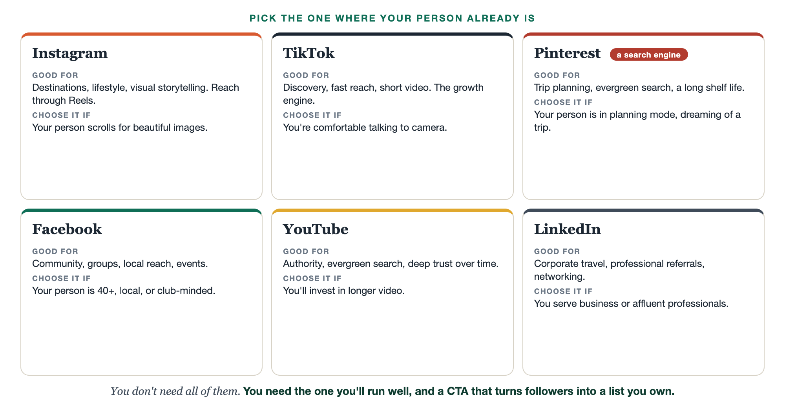
WHERE YOUR PERSON ALREADY IS
The major channels, at a glance.

Slide 6
YOUR PROFILE HAS ONE JOB: CAPTURE
A profile that captures.
Most people treat their profile like a nameplate. Yours is a funnel. Three pieces do the work. Your bio says who you help and why it's worth it, your proof line from 1.2. Your link sends them somewhere that captures, your landing page from 2.5, not just a homepage. And your offer, the magnet, gives them a reason to click right now. Bio, link, offer, every one pointed at the list.
Platform-by-platform setup how-tos (Instagram, TikTok, and more) live in the Specialty Library.

Slide 7
CONSISTENCY BEATS INTENSITY
A rhythm you can keep.
The secret to the rhythm is that it's not about posting more, it's about posting in a way you can sustain. Use your pillars and your batch from 3.3, so you're never starting from a blank page. Then pick a cadence you can actually keep. Three times a week, every week, beats daily for nine days and then silence. The algorithm rewards the marathon, not the sprint.
A rhythm you keep for a year beats a burst you abandon in a month.

Slide 8
THE HEADWIND HERE IS THE VANITY TRAP
Followers to subscribers.
Here is the whole point, and the trap to dodge. Followers are not yours. They're borrowed, rented from a platform that can change the rules or vanish overnight. A follower count is a vanity metric, it feels good and it pays nothing. So every profile and every post has one real job: move a borrowed follower onto a list you own. That's what the call to action does. Come get the free guide. Join the list.
Likes are borrowed. Your list is owned. The call to action is the bridge between them.

Slide 9
PUT YOUR SECOND MATE TO WORK
More than captions. Your channel manager.
PROFILE
CAPTIONS
CALENDAR
Optimize the bio
A month of captions
A posting calendar
It rewrites your bio and CTA to capture, not just describe.
From your pillars, it drafts captions in your voice, ready to schedule.
It lays out a weekly rhythm you can actually keep.
Copy-paste example prompts are in the library: How to Prompt Your Second Mate.

Slide 10
YOUR FIRST BRICK
Set up your one channel.
1
Your one platform
Choose the single platform where your person already is and you'll keep showing up. (The Your Platform worksheet.)
2
A profile that captures
Fix your bio, your link, and your offer so the profile points at your list.
3
Your weekly rhythm
Set a cadence you can keep, and the CTA that moves followers to subscribers.

Slide 11
WANT A HAND WITH THIS PART?
Three ways to get unstuck.
GROUP
ONE-ON-ONE
DONE WITH / FOR YOU
Professor Hours
Book a 1:1
Hire us
Bring your specific question to office hours and ask it live.
We work on yours, screen to screen, until it's done right.
Consultant or coach. We build it with you, or we build it for you.

Slide 12
BUILT WITH YOU, NOT TAUGHT AT YOU
One platform owned
beats five scattered.
You can pick your platform and fix your profile today. Building the rhythm, and learning that one channel deeply enough that it quietly feeds your list every week, is what we do together. One route, run well.
We build it with you →
Next → 3.5 The people you already know: turning your warm network into referrals.
Post your one platform and your new bio in the community. Questions? Bring them to this week's Professor Hours.

