Slide 1
MARKETING JOURNEYS · THE TRADEWINDS METHOD · CAPTURE
Session 3.3
Cruising Altitude
How do the inquiries keep coming, even when I ease off the controls?

Slide 2
YOU WERE PROMISED THIS BACK IN 1.4
This is
Cruising Altitude.
The point where the work gets light and the inquiries keep coming. The marketing version of an athlete in the zone: momentum doing the lifting, not motivation.

Slide 3
HOW FLIGHT ACTUALLY WORKS
Catch the winds, then hold altitude.
Stand near a balloon at liftoff, or a jet down the runway: the burner is roaring, the engines are at full throttle, and honestly, the first time, it feels a little scary. That is the climb, and it takes everything you have. But you don't climb forever. Catch the winds, reach altitude, and the rules change. No more full throttle, just short, regular bursts that hold you right where you are, for a fraction of the effort it took to get up.
The climb is full throttle. Holding altitude is short bursts. Most quit before they feel the difference.

Slide 4
THREE OR FOUR THEMES, FOR YEARS
Your content pillars.
You never invent something new to say. You pick three or four themes you can speak to for years, pulled from your niche and your offer. Every post lives under one of them, so you never face a blank page again.
FROM YOUR NICHE
FROM YOUR OFFER
FROM YOU
Where you go
What you fix
Who you are
The places, the trips, the kind of traveler you serve.
Less time, less hassle, the expertise they can't Google.
Your stories, your taste, the reason they trust you.

Slide 5
STOP STARTING FROM ZERO EVERY DAY
Batch a month in one sitting.
Posting daily from a blank page is the fast road to burnout. Instead you sit down once, in a single focused block, and make a month of content at a time. Same headspace, same momentum, one and done. Then you schedule it and walk away while it works for you.
One sitting a month beats a panicked scramble every morning.

Slide 6
DON'T CREATE MORE. REPURPOSE.
One idea, many pieces.
You do not need a fresh idea for every channel. You need one good idea worked four ways. A single story becomes a post, an email, a reel, and a pin. Four touches across four arenas, from one piece of thinking. That is how a small effort shows up everywhere at once.
One story becomes a post, an email, a reel, and a pin. Think once, show up four times.

Slide 7
THE HEADWIND UP HERE IS "ALWAYS ON"
Momentum, not motivation.
Motivation is the feeling that you have to be everywhere, all the time, or it all falls apart. That is the Always On headwind, and it burns advisors out. Altitude is the answer. A system you actually keep beats a burst of willpower you can't sustain. The light touch is what holds you up.
Always On says do more, forever. Altitude says build the system once, then keep it lightly.

Slide 8
WHAT IT LOOKS LIKE WHEN IT'S WORKING
The system, in motion.
You have an ideal day and an ideal week, and you follow it. You have a content calendar, and you actually post it. You have networking events on the schedule, and you hold them, no excuses to bow out. You follow up and qualify your inquiries. Your past and future travelers hear from you with an email, a newsletter, an article. And they come back to you with inquiries and referrals.
Wash, rinse, repeat. That loop, kept lightly, is Cruising Altitude.

Slide 9
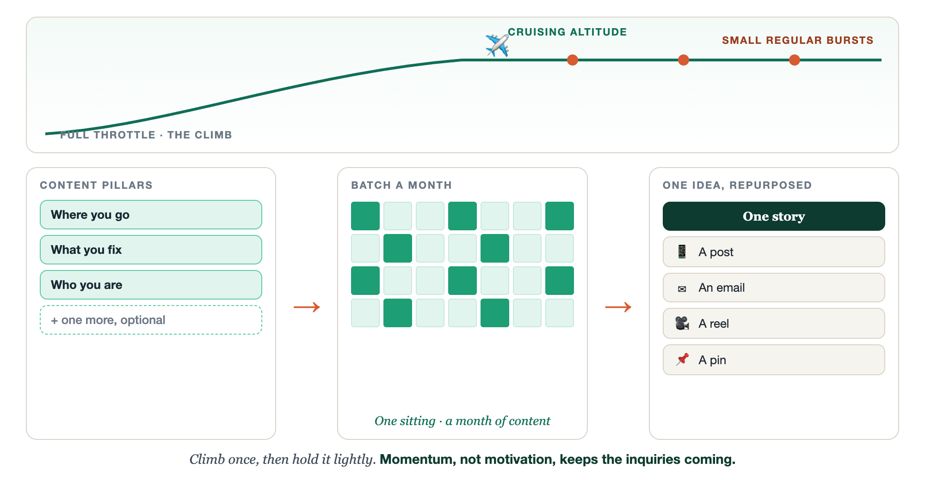
PILLARS, BATCHED, REPURPOSED · ALTITUDE HELD
A small effort that keeps you aloft.

Slide 10
PUT YOUR SECOND MATE TO WORK
More than a writer. Your altitude engine.
PILLARS
BATCH
REPURPOSE
Name your themes
A month at once
One into four
Give it your niche and offer; it proposes your 3 to 4 pillars.
From your pillars, it drafts a month of posts in one sitting.
Hand it one idea; back come a post, an email, a reel, and a pin.
Copy-paste example prompts are in the library: How to Prompt Your Second Mate.

Slide 11
YOUR FIRST BRICK
Set your altitude.
1
Your pillars
Name the three or four themes you can speak to for years. (The Your Altitude worksheet.)
2
One story
Pick one story or idea you will use this week.
3
Work it four ways
Turn that one story into a post, an email, a reel, and a pin.

Slide 12
WANT A HAND WITH THIS PART?
Three ways to get unstuck.
GROUP
ONE-ON-ONE
DONE WITH / FOR YOU
Professor Hours
Book a 1:1
Hire us
Bring your specific question to office hours and ask it live.
We work on yours, screen to screen, until it's done right.
Consultant or coach. We build it with you, or we build it for you.

Slide 13
BUILT WITH YOU, NOT TAUGHT AT YOU
Momentum,
not motivation.
You can name your pillars and batch a week today. Holding altitude month after month, lightly, without burning out, is the rhythm we build and keep with you. That is what turns marketing from a scramble into a system.
We build it with you →
Next → 3.4 Getting Found: choose your one or two routes and go deep.
Post your three or four pillars in the community. Questions? Bring them to this week's Professor Hours.

