Slide 1
MARKETING JOURNEYS · THE TRADEWINDS METHOD · CAPTURE
Session 3.2
Make People Want to Join
My list is live. So why would anyone actually join it?

Slide 2
IN 2.5 YOU BUILT THE MACHINE
Now write
the invitation.
A list this good is wasted if nobody wants in. Today you write the invitation they can't scroll past, the hook, the magnet, and the pitch. Reach was never the point.

Slide 3
THE FIRST 3 SECONDS DECIDE EVERYTHING
The hook: stop the scroll.
A hook is the first line that makes someone stop. It works on curiosity (an open loop they need to close), on specificity (a number, a place, a person), and on a problem they actually feel. Not "travel tips." Try "the one mistake that ruins a first trip to Italy."
If the first line doesn't stop them, nothing after it gets read.

Slide 4
WHY THEY ACTUALLY WANT YOU
Less time, less hassle, all the expertise.
Under every good hook is the real reason someone wants to work with you. You give them their time back. You take away the hassle. And you bring expertise they don't have and can't just Google. That is the promise every hook should point straight at.
Don't sell "travel." Sell their time back, their stress gone, and your expertise on their side.

Slide 5
FROM DELIVERABLE TO DESIRE
A promise they crave.
In 2.5 you built the magnet. Now make it irresistible. The pull is specific, immediate, and theirs, a clear outcome they want, that they can get right now, made for exactly them. "A free 3-day Italy plan" beats "my newsletter" every single time.
Available isn't the same as wanted. Make the promise impossible to ignore.

Slide 6
NOW SAY IT OUT LOUD
Your pitch.
The one line that makes joining, or hiring you, obvious. And you need it in two places: on a screen, and out of your mouth at a party.

Slide 7
"I SELL TRIPS" IS NOT A PITCH
Tight. Succinct. Unique.
A job title ends the conversation. A real pitch passes three tests. Tight: you can say it in one breath. Succinct: every word earns its place. Unique: only you could say it, because if a competitor could say it word for word, it isn't yours yet. One structure that nails all three: "You know how [problem]? I [what you do], so [the payoff]."
The real test: does it make them lean in and ask, "ooh, how do you do that?"

Slide 8
THE WRITTEN ONE-LINER
Your pitch, online.
This is your bio, your profile, the line under your name. Build it on your proof line from 1.2: "I help [who] do [what], so they get their time back, lose the hassle, and have real expertise on their side." Clear enough that a stranger gets it in one read.
If your bio doesn't say who you help and why it's worth it, it's just decoration.

Slide 9
THE COCKTAIL PARTY, BNI, THE CHAMBER
Your pitch, out loud.
Someone asks "what do you do?" and you've got five seconds. Don't say "I'm a travel agent." Say what you do for people: "I take the time and the stress out of planning the trip of a lifetime, so my clients just show up and enjoy it." Practice it until it's natural.
"What do you do?" is the most valuable question you'll get asked. Have the answer ready.

Slide 10
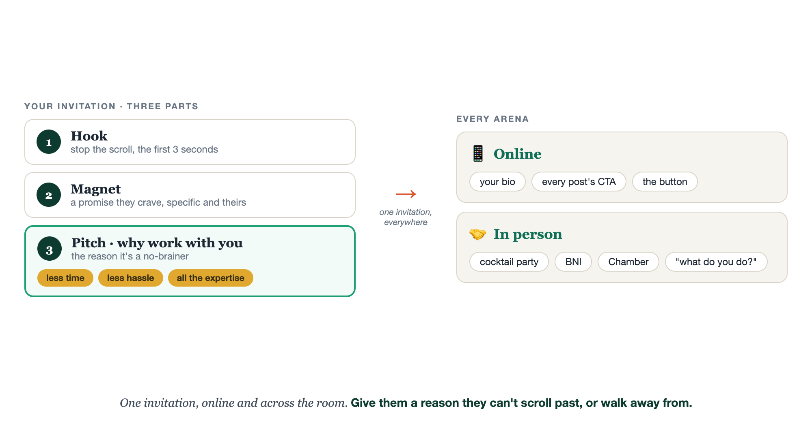
HOOK, MAGNET, PITCH · ONE INVITATION
Online and across the room.

Slide 11
PUT THE INVITATION EVERYWHERE
Everywhere it counts.
Your bio. The call to action under every post. The button on your site. And your spoken pitch at every event, every dinner, every school pickup. Hook and magnet pull them online. The pitch carries you face to face. Same invitation, every arena.
An invitation nobody meets is just a nice idea.

Slide 12
YOUR FIRST BRICK
Write your invitation.
1
Your hook
One scroll-stopping line, pointed at less time, less hassle, all the expertise. (The Invitation worksheet.)
2
Your magnet promise
Make 2.5's magnet irresistible: specific, immediate, theirs.
3
Your pitch, both ways
The online one-liner, and the spoken version for the next time someone asks what you do.

Slide 13
PUT YOUR SECOND MATE TO WORK
More than copy. An invitation writer.
HOOKS
THE PROMISE
THE PITCH
10 scroll-stoppers
Sharpen the magnet
Online + out loud
Give it your magnet and niche, get 10 hooks to test.
It rewrites your magnet as a promise people crave.
It drafts your bio line and your spoken elevator pitch.
Copy-paste example prompts are in the library: How to Prompt Your Second Mate.

Slide 14
WANT A HAND WITH THIS PART?
Three ways to get unstuck.
GROUP
ONE-ON-ONE
DONE WITH / FOR YOU
Professor Hours
Book a 1:1
Hire us
Bring your specific question to office hours and ask it live.
We work on yours, screen to screen, until it's done right.
Consultant or coach. We build it with you, or we build it for you.

Slide 15
BUILT WITH YOU, NOT TAUGHT AT YOU
Give them a reason
they can't scroll past.
You can draft a hook and a pitch today. Sharpening them until they actually stop the scroll and roll off your tongue at a party is the work, and the reps matter. That's what we do together, until your invitation lands online and across the room.
We build it with you →
Next → 3.3 Cruising Altitude: the momentum that keeps the inquiries coming.
Post your spoken pitch in the community and read it out loud once. Questions? Bring them to this week's Professor Hours.

