Slide 1
MARKETING JOURNEYS · THE TRADEWINDS METHOD · CAPTURE
Session 3.10
Paid Lead Gen
Is paying to reach people actually worth it for me?

Slide 2
THE LAST ROUTE, THE ONLY ONE YOU PAY FOR
You don't need
a big budget.
Every other route cost time and effort, not cash. This one costs money, but not much. You need a small, smart test that tells you whether paying to reach people is worth it for you.

Slide 3
DON'T PAY UNTIL THIS IS TRUE
When paid makes sense.
Paid is not where you start, it is where you pour fuel on something that already works. So before you spend a dollar, two things must be true. You have an offer people actually want, your magnet. And you have a place that captures them, your landing page and list from 2.5. Paid traffic with no offer and nowhere to capture is money poured straight onto the ground. Get those right first, then paid multiplies them.
Paid amplifies what works. With no offer and no capture, it just amplifies zero.

Slide 4
THE MENU, OLD AND NEW
Where you can pay.
Digital (start here)
Traditional (still works)
Paid social, boost a post. Pay-per-click, Google Ads on your 3.9 keywords. Paid directory listings.
Newspaper. Yellow Pages. Local magazines. Often a fit for older or hyper-local audiences.
Or split the cost: co-op an ad with a partner from 3.8, a realtor, a local business. Shared audience, shared bill.

Slide 5
START SMALL AND SIMPLE
Your first ad.
Don't overthink your first one. The simplest place to start is a promoted, or boosted, post on the platform you already use: take a post that did well and pay to put it in front of more of the right people. Or a simple ad pointing at your magnet. One clear audience, one clear offer, one clear next step, join the list. You are not building a campaign, you are running an experiment.
Your first ad is one post, one audience, one offer. Keep it simple enough to actually launch.

Slide 6
THE SMARTEST PAID MONEY
Don't pay for strangers. Remarket.
Here is the highest-return paid move there is, and almost no advisor uses it: remarketing. You load your own list into Facebook, or you target only people who have already visited your website, people who already know you. You can also build a lookalike audience, people who behave like your best subscribers or who visit similar sites. Warm beats cold every time. Showing your offer to someone who already raised their hand costs a fraction of chasing total strangers, and it converts far better.
Warm beats cold. Remarket to your list and your visitors before you pay to reach strangers.

Slide 7
YOU NEED LESS THAN YOU THINK
A small test budget.
You do not need a war chest. You need just enough to get a real signal, and no more. A small daily amount over a few days, an amount that would not hurt to lose entirely, because you might. This is tuition, not a bet on the business. The goal of the first spend is not profit, it is information: does paying to reach these people actually produce leads? That answer is worth the test budget by itself.
Spend only what you can afford to learn from. The first budget buys an answer, not customers.

Slide 8
THE HEADWIND HERE IS THE VANITY TRAP
Watch one number.
Here is why most ads fail: they are built to win likes and views, not inquiries, and the platforms happily sell you reach and impressions that feel amazing and mean nothing. You are not buying applause. You are paying to build a mailing list you can act on again and again. So ignore the vanity numbers and watch one: what did it cost to get one new lead onto your list? Cost per lead. A thousand likes and zero signups failed; five signups for a few dollars each is a win.
Paid will sell you likes. Buy leads. Watch one number: the cost to add one person to your list.

Slide 9
READ THE RESULT HONESTLY
Keep, kill, or scale.
When the test ends, you make one of three honest calls. Keep: it is working at a cost that makes sense, leave it running. Kill: it is not producing leads at a price you can live with, so stop, no ego, you learned something cheaply. Or scale: it is working beautifully, so put more fuel in and reach more of them. Test small, read honestly, then decide. That discipline is what separates spending from investing.
Keep what works, kill what doesn't, scale what's great. Read the number, not your feelings.

Slide 10
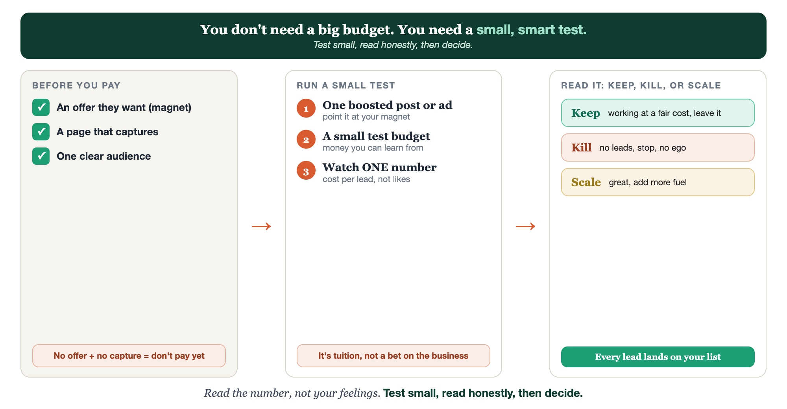
BEFORE YOU PAY · RUN A SMALL TEST · KEEP, KILL, OR SCALE
Paid, as a test.

Slide 11
PUT YOUR SECOND MATE TO WORK
More than copy. Your media buyer.
WRITE
TARGET
READ
Ad variations
Who to reach
Read the results
It writes several versions of your ad to test against each other.
It suggests the audience and the offer angle most likely to land.
Paste your numbers; it tells you keep, kill, or scale, in plain English.
Copy-paste example prompts are in the library: How to Prompt Your Second Mate.

Slide 12
YOUR FIRST BRICK
Run one small test.
1
Your test budget
Set a small amount you can afford to learn from. (The Your Test worksheet.)
2
Your one ad
Boost one post, or run one simple ad pointing at your magnet.
3
The single number
Pick the one number you'll watch, cost per lead, then keep, kill, or scale.

Slide 13
WANT A HAND WITH THIS PART?
Three ways to get unstuck.
GROUP
ONE-ON-ONE
DONE WITH / FOR YOU
Professor Hours
Book a 1:1
Hire us
Bring your specific question to office hours and ask it live.
We work on yours, screen to screen, until it's done right.
Consultant or coach. We build it with you, or we build it for you.

Slide 14
BUILT WITH YOU, NOT TAUGHT AT YOU
Test small.
Read honestly.
You can launch one small ad this week. Reading the number without ego, and knowing when to kill or scale, is what we do together. The last route, your sails full.
We build it with you →
Next → Part 4, Confirm: turning all this interest into bookings.
Post your one number, cost per lead, after your test. Questions? Bring them to this week's Professor Hours.

