Slide 1
MARKETING JOURNEYS · THE TRADEWINDS METHOD · CAPTURE
Session 3.1
Build Your Mailing List
I post everywhere. So why do I own nothing to show for it?

Slide 2
WELCOME TO CAPTURE · THE FIRST OF THE FOUR C'S
The one thing
nobody can take from you.
Before any route, you build the list it all flows into. This is the asset that finally beats The Vanity Trap.

Slide 3
THE WHOLE SESSION IN ONE LINE
Rent the routes. Own the list.
Instagram, Facebook, TikTok, you don't own any of them. They change the rules, throttle your reach, suspend you, or just disappear, and your followers vanish with them. Your email list is the one asset that's yours, a direct line to every name, forever.
Borrowed reach can be taken overnight. An owned list can't. No list, no business.

Slide 4
WHY THIS IS WORTH THE WORK
What a powerful list actually buys you.
Three things a real list gives you. Control: announce a trip and fill it yourself, no algorithm deciding who sees it. Repeat and referral: past clients who rebook and send friends. And demand on command: the end of feast or famine, because you can reach everyone at once.
Likes and followers don't pay the bills. A list of 1,000 of the right people does.

Slide 5
HOW THIS FITS WITH 2.4
Your list and your Manifest.
They work together, not instead of each other. The Manifest is your system of record, where every name lives with its stage. The mailing list is your reach, how you actually speak to all of them at once. A new name lands in both.
The Manifest remembers them. The list lets you reach them.

Slide 6
CHOOSING AN EMAIL PLATFORM · SIMPLE WINS
Pick one you'll actually send from.
DESIGN-FORWARD
BEST-KNOWN
SIMPLE & CHEAP
Flodesk
Mailchimp
MailerLite
Flat fee, beautiful templates. An advisor favorite.
Free to start, everywhere, lots of guides.
Clean, generous free tier. Easy first list.
Don't agonize. The best platform is the one you'll actually send from. Simple beats powerful.

Slide 7
WHERE PEOPLE ACTUALLY JOIN
Your sign-up path.
One clear place to join: a form on your site, a link in every bio, the button under your lead magnet. If there's nowhere to join, there's no list.

Slide 8
THE MOST IMPORTANT EMAIL YOU'LL SEND
Your welcome email.
The second someone joins, one email goes out. It delivers what you promised, says who you are and who you help, and sets the tone for everything after. It's the highest open-rate email you'll ever send. Don't waste it on silence.
A warm welcome turns a brand-new name into a relationship.

Slide 9
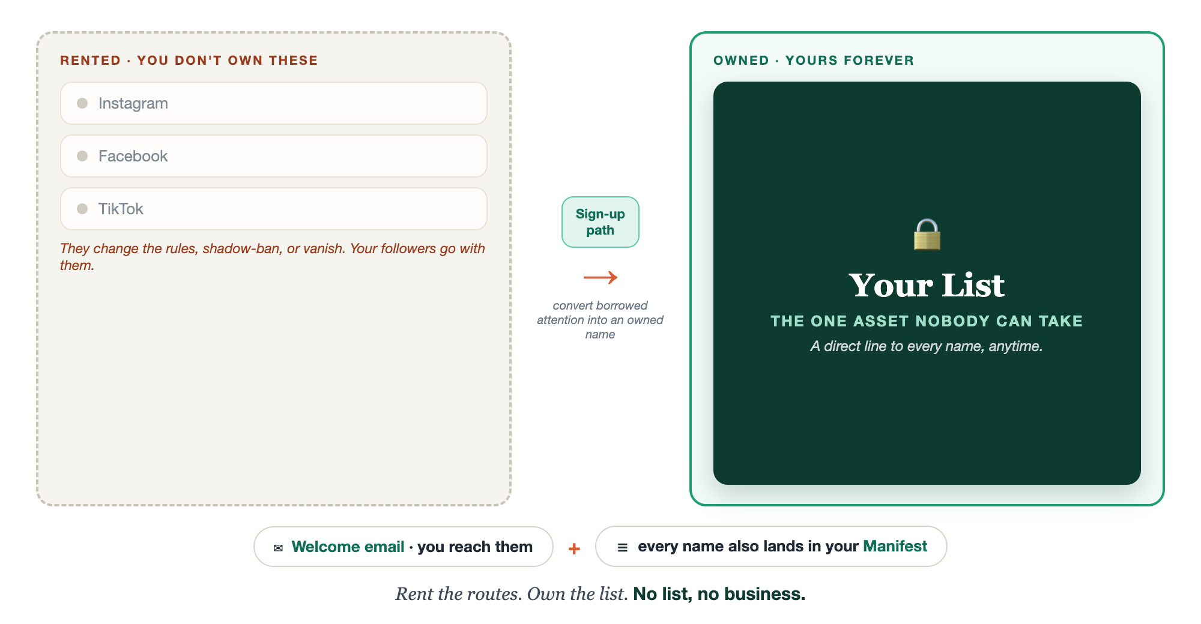
RENT THE ROUTES, OWN THE LIST
The one asset you own.

Slide 10
BUT I DON'T WANT TO ANNOY ANYONE
Not spam. Service.
Hear this clearly, we are not telling you to nag people or clutter their inbox. The opposite. You email when you have something worth their time: a tip, a story, an opening they'd want. People don't unsubscribe from value, they drift away from silence. Going quiet is the bigger disservice.
Serve, don't sell. They're going to book with someone, stay useful and it might as well be you.

Slide 11
LIST HYGIENE, THE BASICS
Stay out of spam.
Only email people who asked (permission, never bought lists). Make unsubscribing easy. Clean out hard bounces. Start slow instead of blasting thousands on day one. A clean list lands in the inbox. A sloppy one lands in spam.
Deliverability is earned: permission in, easy out, kept clean.

Slide 12
WHY THIS IS THE NON-NEGOTIABLE
This asset makes the rest possible.
Every follow-up in Confirm, every win-back and past-client touch in Cultivate, runs on this list. Without it, there's nothing to follow up with and nothing to nurture. Build the list now, and the rest of the Four C's has something to work on.
No list, no Confirm, no Cultivate. No list, no business.

Slide 13
YOUR FIRST BRICK
Set up your list.
1
Your platform
Pick one of the three and create the account today. (The List worksheet.)
2
Your sign-up path
Decide the one place people join, and put the link in your bio.
3
Your first welcome line
Write the first line of your welcome email. Just the first line.

Slide 14
PUT YOUR SECOND MATE TO WORK
More than copy. A list-builder.
SIGN-UP COPY
WELCOME EMAIL
SEQUENCE
The invitation
The first hello
The first week
It writes the sign-up form and button copy that get people to join.
It drafts your welcome email in your voice, delivering what you promised.
It writes the 2-3 emails after the welcome, so new names stay warm.
Copy-paste example prompts are in the library: How to Prompt Your Second Mate.

Slide 15
WANT A HAND WITH THIS PART?
Three ways to get unstuck.
GROUP
ONE-ON-ONE
DONE WITH / FOR YOU
Professor Hours
Book a 1:1
Hire us
Bring your specific question to office hours and ask it live.
We work on yours, screen to screen, until it's done right.
Consultant or coach. We build it with you, or we build it for you.

Slide 16
BUILT WITH YOU, NOT TAUGHT AT YOU
No list,
no business.
You can create the account and write your first welcome line today. Standing up the platform, the sign-up path, the welcome email, and clean deliverability is the work. That's what we set up with you, screen to screen, until your first test sign-up lands.
We build it with you →
Next → 3.2 Now make people want to join it: hooks, lead magnets, and your pitch.
Post your sign-up link in the community so we can all join and test it. Questions? Bring them to this week's Professor Hours.

