Slide 1
MARKETING JOURNEYS · THE TRADEWINDS METHOD · BUILD
Session 2.6
Reading Your Dashboard
Which numbers actually matter, and which am I wasting time on?

Slide 2
BEFORE YOU PANIC ABOUT NUMBERS
You are not
a data analyst.
You need three or four numbers that tell you whether the foundation works and what to do next. This is how you confirm you've beaten the Secret Agent headwind: proof, not a hunch.

Slide 3
THE TOOLS, IN PLAIN ENGLISH
Analytics & Insights, demystified.
Google Analytics tells you who visits your site and what they do there. Facebook and Instagram Insights tell you what's actually reaching people. You don't need to master either one. You need to find a handful of numbers inside them and ignore the rest.
These tools have a thousand numbers. You'll use four.

Slide 4
WHAT PEOPLE ACTUALLY TYPE
Keyword basics.
Keywords are the words people type into Google when they want what you do. "Accessible travel to Italy." "First-timer Indy 500 tickets." Knowing them tells you what to write, what to name your lead magnet, and whether you're showing up for the right searches.
Speak the words your person is already searching.

Slide 5
NOW THE PART THAT MATTERS
The three or four numbers
that predict bookings.
Everything else is decoration. These are the ones that tell you the machine is working.

Slide 6
THE HEADLINE NUMBER
Did your Manifest grow?
This is the one that matters most. Start the month with 10 contacts in Tern, end with 15, you grew by five. That is real. But start with 10 and end with 10, and you can post all month and tell yourself you were busy. Did you actually do anything?
Net new names, not busywork. If the Manifest didn't grow, the month didn't either.

Slide 7
THE REST OF THE FOUR
Then: rate, inquiries, bookings.
Opt-in rate, the share of visitors who raise a hand, is your capture working? Inquiries, how many are ready to talk. And bookings, the money. Four numbers, and they line up into a path: visit, opt in, inquire, book.
Each number predicts the next. Watch for where the path leaks.

Slide 8
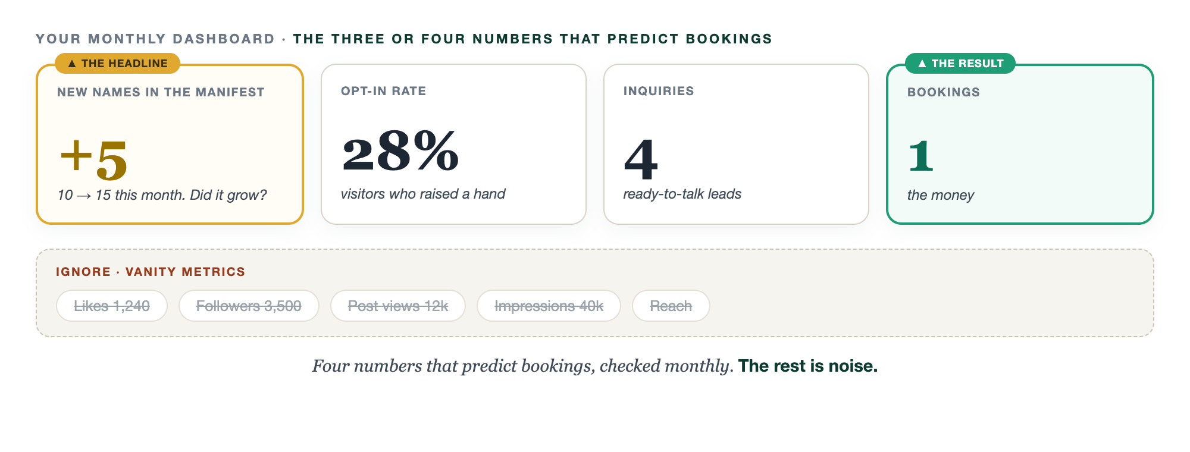
THE WHOLE THING, ON ONE SCREEN
Four numbers. One screen.

Slide 9
THIS IS THE VANITY TRAP, MEASURED
Ignore the vanity metrics.
Likes, followers, post views, impressions, reach. They feel wonderful and they predict almost nothing. A thousand likes and zero new names in the Manifest is a busy month with nothing to show. Don't let a vanity number talk you out of the truth.
Vanity metrics flatter you. The four numbers tell you the truth.

Slide 10
HOW OFTEN TO LOOK
A monthly check, not a daily obsession.
Checking these every day only makes you anxious and reactive. Once a month, sit down for fifteen minutes, write the four numbers, and compare to last month. That's it. Trends matter. Daily wiggles don't.
A few numbers, checked monthly, beat a dashboard you never open.

Slide 11
YOUR FIRST BRICK
Build your monthly check.
1
Your three or four numbers
New names in the Manifest, opt-in rate, inquiries, bookings. (The Dashboard worksheet.)
2
When you'll check
Pick one day a month. Same day, fifteen minutes.
3
Your baseline today
Write today's numbers. You can't see growth without a starting line.

Slide 12
PUT YOUR SECOND MATE TO WORK
More than a read-back. Your analyst.
COMPUTE
FIND THE LEAK
THE MEMO
It does the math
Where you lose them
State of the business
Raw numbers in, opt-in and conversion rates out, in plain English.
It pinpoints the one step in the path that's leaking, and why.
Your four numbers become a monthly note with one prioritized move.
Copy-paste example prompts are in the library: How to Prompt Your Second Mate.

Slide 13
WANT A HAND WITH THIS PART?
Three ways to get unstuck.
GROUP
ONE-ON-ONE
DONE WITH / FOR YOU
Professor Hours
Book a 1:1
Hire us
Bring your specific question to office hours and ask it live.
We work on yours, screen to screen, until it's done right.
Consultant or coach. We build it with you, or we build it for you.

Slide 14
BUILT WITH YOU, NOT TAUGHT AT YOU
A few numbers, checked monthly,
beat a dashboard you never open.
You can pick your four numbers and write your baseline today. Setting up analytics, finding the signal in the noise, and building the monthly habit is the work, and we'll read your first dashboard together until you trust it.
We build it with you →
Your foundation is built. From here, the Four C's engine takes over, starting with Capture.
Post your baseline numbers today, then again next month and watch them move. Questions? Bring them to this week's Professor Hours.

