Slide 1
MARKETING JOURNEYS · THE TRADEWINDS METHOD · BUILD
Session 2.5
Your Lead Capture
I get the likes and the views. So where are the actual leads?

Slide 2
WHY YOUR POSTING ISN'T PAYING OFF
Every route needs
somewhere to send people.
Today you build the opt-in and landing page that turn attention into a name you own. You keep fighting Secret Agent, and you start beating The Vanity Trap.

Slide 3
HOW NAVIGATION ACTUALLY WORKS
You don't fly in a straight line.
A pilot points at one beacon, reaches it, then adjusts to the next, and the next. That is how you actually get anywhere. Your lead magnets and opt-ins are those beacons: the points people steer toward and take action on, one raised hand at a time.
Lead capture isn't a straight shot. It's a beacon people aim for, and act on.

Slide 4
PICK YOUR BEACON
Something they'll gladly trade an email for.
Five that work: a newsletter (real insider value, not just "updates"), a free report, a mini consultation, a brochure, or insider access. Pick the one that fits your niche and your exact person.
Whatever the form, the bar is the same: specific, useful, and worth a real email address.

Slide 5
25 YEARS BEHIND A DESK TAUGHT ME THIS
A clearer offer, a clearer conversation.
In 25 years as an advisor, the clearer I was on what I had to offer, the clearer every conversation got. The moment I had a specific brochure or guide to hand someone, the whole conversation changed. I wasn't fumbling, I was handing them something real.
When you know exactly what you offer, so does everyone you talk to.

Slide 6
THE PART NOBODY TELLS YOU
Your deliverable sets the guardrails.
That packet did more than capture an email. It answered the frequently asked questions before they were asked, and it stopped me from over-promising, because the guardrails, what's included and what's not, were baked right into the deliverable.
An offer with no guardrails becomes a promise you can't keep.

Slide 7
WHERE THE MAGNET LIVES
The landing page:
one clear promise.
One page, one job, one promise: get the lead magnet by giving an email. No menu, no distractions, no escape routes. Just the trade.

Slide 8
KEEP IT SHORT ON PURPOSE
The opt-in form: ask for less.
First name and email. That's it. Every extra field you add costs you sign-ups. You can learn the rest once they're in the Manifest. Lower the bar to the raised hand.
The shorter the form, the longer your list.

Slide 9
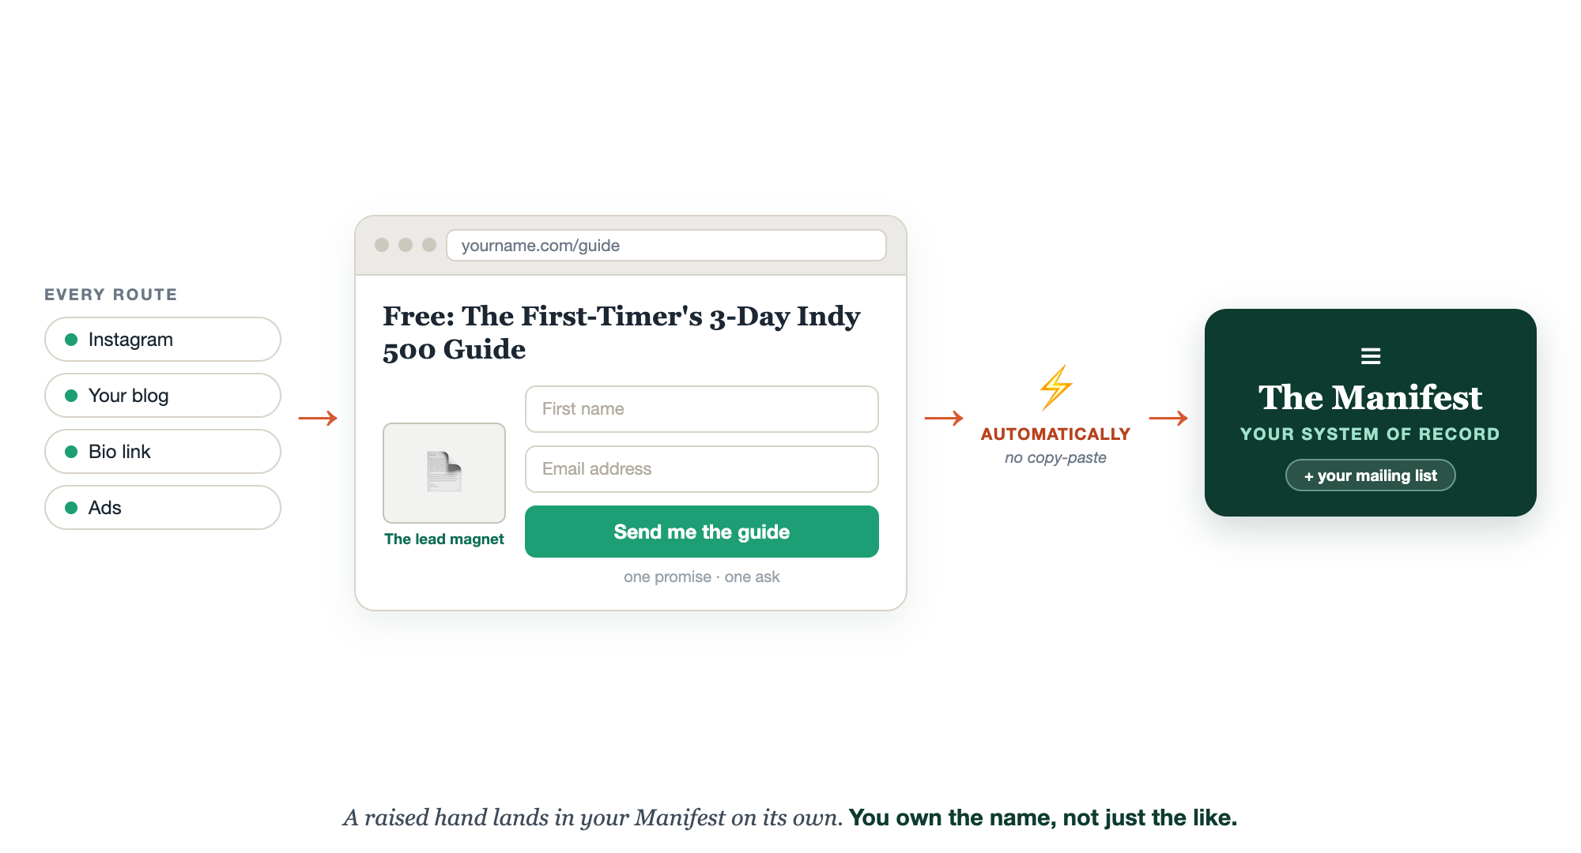
THE WHOLE THING, WIRED UP
Attention in, a name out.

Slide 10
THE MAGIC IS THE WIRING
Wired to the Manifest, automatically.
Connect the form to your mailing list and your CRM, so the second someone opts in, they land in the Manifest on their own. No copy-paste, no sticky note, no "I'll add them later." The system does the catching.
A raised hand should land in your Manifest on its own.

Slide 11
DON'T TRUST IT, TEST IT
Opt in yourself. Watch it work.
Before you send a single person, opt in with your own email. Did the lead magnet arrive? Did your name show up in the Manifest? If yes, you have a machine. If no, better you found it than a lost lead.
An untested opt-in is a leak you can't see.

Slide 12
THIS IS HOW YOU BEAT THE VANITY TRAP
Own the list, not the likes.
A thousand likes you don't own. One email you do. Every opt-in moves someone off a platform you rent and onto a list you own. That is the whole point of capture, and the end of posting into the void.
Likes are borrowed. Your list is owned.

Slide 13
YOUR FIRST BRICK
Build your opt-in.
1
Your lead magnet
Name one specific, useful thing your person would trade an email for. (The Lead Capture worksheet.)
2
Your one promise
Write the single promise of the landing page: give an email, get this.
3
Where it lands
Decide the list and CRM the email flows into, your Manifest.

Slide 14
PUT YOUR SECOND MATE TO WORK
More than the page. It builds the magnet.
BUILD IT
IDEAS
SEQUENCE
The whole deliverable
From real searches
The follow-up emails
It writes the guide or checklist itself, your guardrails baked in.
Feed it your keywords, get ranked magnet ideas worth an email.
The delivery email plus the first nurture emails, written for you.
Copy-paste example prompts are in the library: How to Prompt Your Second Mate.

Slide 15
WANT A HAND WITH THIS PART?
Three ways to get unstuck.
GROUP
ONE-ON-ONE
DONE WITH / FOR YOU
Professor Hours
Book a 1:1
Hire us
Bring your specific question to office hours and ask it live.
We work on yours, screen to screen, until it's done right.
Consultant or coach. We build it with you, or we build it for you.

Slide 16
BUILT WITH YOU, NOT TAUGHT AT YOU
A raised hand should land
in your Manifest on its own.
You can sketch your lead magnet today. Building the landing page, wiring the form to your list and CRM, and creating the magnet itself is the work, and it's fiddly. That's what we build with you, live, until you watch your own test opt-in land.
We build it with you →
Next → 2.6 Know If It's Working: the last Build step, your dashboard.
Post your lead magnet idea and your landing-page promise. Questions? Bring them to this week's Professor Hours.

