Slide 1
MARKETING JOURNEYS · THE TRADEWINDS METHOD · BUILD
Session 2.4
Build Your Manifest
My leads are scattered everywhere. How do I get a grip?

Slide 2
YOU'VE HEARD THIS NAME BEFORE
The Manifest, made real.
In the free intro it was an idea: the owned list every booking comes from. Today we build it for real, the move that fights the Secret Agent headwind and starts plugging The Leaky Bucket.

Slide 3
WHY A CRM AT ALL
Cards work. Follow-up doesn't scale.
You could build this whole Manifest on 3x5 cards or a day-timer, and the system would still work, capture is capture. But the follow-up, the second touch, the check-in a year later, by hand that gets laborious fast.
Welcome to the modern era. Have a CRM. The system is what matters, the CRM is what makes it effortless to run.

Slide 4
YOUR BOOKING & CRM SYSTEM
Choosing a CRM: simple wins.
MOST-RATED
LIGHTWEIGHT
WHAT WE RUN
Travefy
TravelJoy
Tern
The most-reviewed advisor CRM. Deep features when you want them.
Simple and friendly. A great start for new or small advisors.
Our system of record, and the one we demo, screen to screen.
The big three advisor CRMs. The best one is the one you'll actually open every day. Simple beats powerful.

Slide 5
OUR PICK, AND WHY IT FITS
Why we run Tern.
BOTH BUSINESSES
KEEP THE KEYS
RUNS THE LOOP
Sell + serve, together
Your data, your control
Capture to cultivate
Itineraries and your process in one place. The whole machine, one tool.
One source of truth that honors the 2.3 rule: yours to keep, yours to move.
It powers the follow-up later, so the system does the heavy lifting.
And we actually run it. We teach the system we use, not theory.

Slide 6
THE ONE RULE THAT MAKES IT WORK
One system of record.
Everyone goes in.
Every single name, number, and email. No exceptions. This is the one place that is always true.

Slide 7
EVEN WHEN YOU USE OTHER TOOLS
Two tools, one source of truth.
Maybe your mailing list lives in one tool and your reservations in another. Fine. But every name still funnels into the one system of record. The other tools are spokes. The Manifest is the hub.
If it's not in the Manifest, it doesn't exist.

Slide 8
SET UP YOUR PIPELINE
Five stages, because the profit is in the follow-up.
New inquiry. Nurturing. Booked. Past client. Advocate. A raised hand lands in New inquiry. If they don't book yet, they go to Nurturing, not the trash. Booked when they commit. Past client when they travel. Advocate when they start sending you people.
Most advisors keep two stages and throw away the money: the maybes they never nurture, and the advocates who'd refer. Now and later.

Slide 9
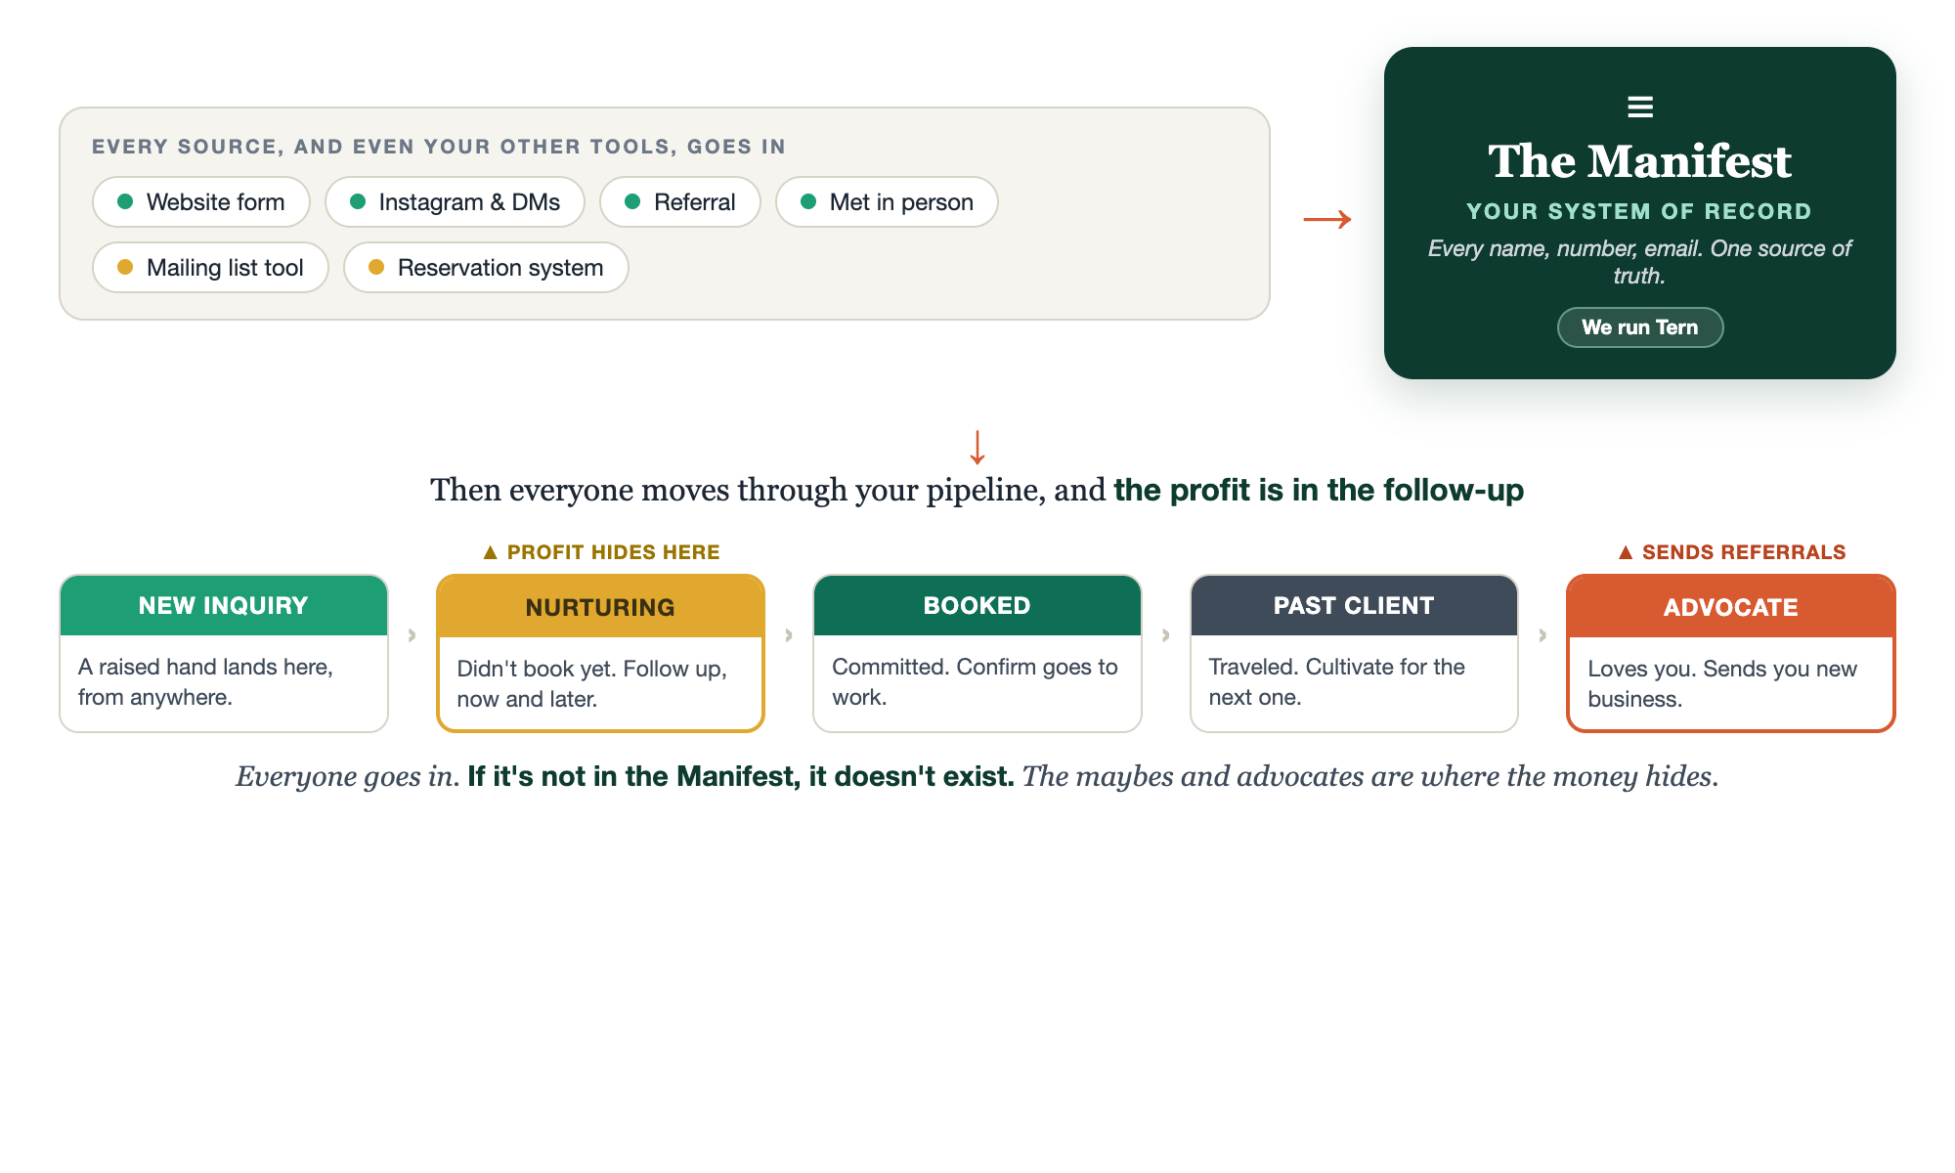
THE MANIFEST · YOUR SYSTEM OF RECORD
Everyone goes in.

Slide 10
START PLUGGING THE LEAKY BUCKET
Every raised hand has a home.
The whole point: a lead can come from anywhere, and the second it arrives, it has exactly one place to land. No more names lost in a DM, a sticky note, or your memory. It goes in, and it stays.
This is how you start plugging The Leaky Bucket: a lead with nowhere to land is one you'll forget by Friday.

Slide 11
KEEP IT ALIVE
A few minutes, every day.
Open it once a day. Add anyone new. Move one card forward. Send one follow-up. That light rhythm is the difference between a living Manifest and a graveyard of old names.
A CRM you never open is just an expensive address book.

Slide 12
WHY THIS MATTERS SO MUCH
The engine for everything next.
This one list is what powers Confirm and Cultivate later. Every follow-up system, every past-client touch, runs off the Manifest. Build it right now, and the rest of the method has something real to run on.
Capture feeds the whole machine. This is where it's stored.

Slide 13
YOUR FIRST BRICK
Set up your stages.
1
Pick your CRM
One of the big three, or the simplest thing that reliably holds a name. Just pick. (The Manifest worksheet.)
2
Set your three stages
Inquiry, Booked, Past client. Name them in your own words.
3
Your daily rhythm
Decide when you'll open it. Same time, every day.

Slide 14
PUT YOUR SECOND MATE TO WORK
More than canned replies. An operator.
CLEAN UP
TRIAGE
REPLIES
Tame your contacts
Is it worth my time?
A response per stage
Dump the mess, it dedupes, standardizes, and tags everyone by stage.
It scores a new inquiry for fit so you nurture the right maybes.
It writes the canned response for each pipeline stage, in your voice.
Copy-paste example prompts are in the library: How to Prompt Your Second Mate.

Slide 15
WANT A HAND WITH THIS PART?
Three ways to get unstuck.
GROUP
ONE-ON-ONE
DONE WITH / FOR YOU
Professor Hours
Book a 1:1
Hire us
Bring your specific question to office hours and ask it live.
We work on yours, screen to screen, until it's done right.
Consultant or coach. We build it with you, or we build it for you.

Slide 16
BUILT WITH YOU, NOT TAUGHT AT YOU
If it's not in the Manifest,
it doesn't exist.
You can set up your stages today. Getting every scattered name into one system of record, with canned responses and a rhythm that actually sticks, is the work. That's what we set up together, screen to screen.
We build it with you →
Next → 2.5 Your Lead Capture: the assets that fill the Manifest.
Post your three pipeline stages and the time of day you'll work them. Questions? Bring them to this week's Professor Hours.

