Slide 1
MARKETING JOURNEYS · THE TRADEWINDS METHOD · BUILD
Session 2.3
Your Website
I have a website. So why does it just sit there?

Slide 2
FIRST, WHAT A WEBSITE IS FOR
A front door, not a brochure.
It has one job: turn a stranger into a name.
A door with a doorbell, built to turn a visitor into a name. Your answer to the Secret Agent headwind: a site that captures, not one that just sits there.

Slide 3
STOP TRYING TO IMPRESS
The homepage has one job: capture.
Not to win a design award. Not to list every place you've ever booked. To make one clear promise and make it easy to raise a hand. Impress less, capture more.
A pretty site nobody acts on is a brochure. A plain site that captures is a business.

Slide 4
AND THE ONES YOU DON'T
The handful of pages you actually need.
HOME
ABOUT
OFFER
The front door
Why you
Your signature trip
One promise, one clear ask, proof you're real.
Your niche and your story. The human they hire.
The packaged thing from 2.1, with a way to ask.
Inquire isn't a page, it's a button on every page. Skip the rest until these three convert.

Slide 5
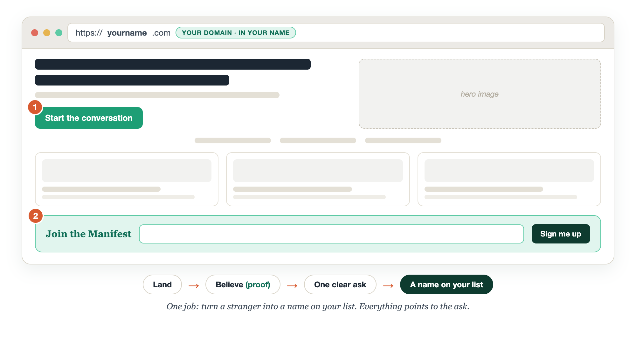
THE BOOKING PATH, ON ONE SCREEN
The front door, drawn.

Slide 6
WRITE FOR THE VISITOR, NOT THE AWARD
Clarity over clever.
Say who you help and what to do next, in plain words. "I plan trips for book lovers. Start the conversation." A confused visitor never books. A clever headline they don't understand is just confusion in a nicer font.
If they can't tell what you do in five seconds, the copy is too clever.

Slide 7
THE LESSON THAT SAVES BUSINESSES
Own your domain.
Separate from your website.
Your domain is your address. Keep it in your own account, in your name, no matter who builds the building. The address is yours. The building is rented.

Slide 8
DONE-FOR-YOU IS FINE. LOCKED-OUT IS NOT.
Keep the keys.
Update your own pictures. Write your own blog. Add a page. Change a word without a bill. No long-term contract. And the big one: you can export all your files and information and move to another platform without going dark.
Hiring it out is smart CEO leverage. Getting locked out of your own business is not.

Slide 9
A REAL ONE, AND IT'S WHY WE STRESS THIS
One missed payment.
The whole business went dark.
An advisor paid a service to design their site on a locked-in platform. They missed a single payment, and their entire business was shut down online. They didn't own the keys.

Slide 10
TWO HONEST PATHS, BOTH FINE
Build it yourself, or have it built.
Build it yourself
Have it built
Wix is fine, and the real win is you'll actually finish. A simple site that exists beats a perfect one that doesn't.
Smart leverage, on one condition: you keep every key, can edit your own content, and can port everything out.
Got a template from your host agency? Use it. Filled with your key info, it beats nothing.

Slide 11
WHATEVER YOU BUILD ON
Speed and mobile win.
Most visitors are on a phone, and a slow page loses them before they read a word. Heads up: Wix and Squarespace carry a lot of overhead, they load heavier and they're less SEO-friendly. Keep it light.
A fast, simple site beats a slow, fancy one every single time.

Slide 12
YOUR FIRST BRICK
Map your site.
1
The pages you need
Home, About, your Offer. That's the whole list to start. (The Site Map worksheet.)
2
Your homepage headline
Who you help, in plain words. "I plan trips for ____."
3
Your one primary call to action
The single thing you want every visitor to do. Just one.

Slide 13
PUT YOUR SECOND MATE TO WORK
More than copy. A whole-site build.
DRAFT
CLARITY TEST
KEEP THE KEYS
All three pages
The 5-second read
Don't get locked in
Home, About, Offer, plus an SEO title and meta for each, from one intake.
It role-plays a first-time visitor and tells you what's unclear.
It drafts the control questions to ask any developer.
Copy-paste example prompts are in the library: How to Prompt Your Second Mate.

Slide 14
WANT A HAND WITH THIS PART?
Three ways to get unstuck.
GROUP
ONE-ON-ONE
DONE WITH / FOR YOU
Professor Hours
Book a 1:1
Hire us
Bring your specific question to office hours and ask it live.
We work on yours, screen to screen, until it's done right.
Consultant or coach. We build it with you, or we build it for you.

Slide 15
BUILT WITH YOU, NOT TAUGHT AT YOU
A site that captures
beats a site that impresses.
You can map your pages today. Standing up a fast, capture-focused site, with the domain in your own name and every key in your hand, is the work. That's what we build together, done with you or for you, and always portable.
We build it with you →
Next → 2.4 Your Manifest: the place you keep every name you capture.
Post your homepage headline and your one call to action in the community. Questions? Bring them to this week's Professor Hours.

