Slide 1
MARKETING JOURNEYS · THE TRADEWINDS METHOD · BUILD
Session 2.2
Your Brand
It's just me. So how do I look like a pro?

Slide 2
WHY THIS MATTERS BEFORE THE PRETTY STUFF
Consistency is trust.
Recognizable beats fancy.
Same look enough times and they decide you're the real thing. This is how you beat the Secret Agent headwind: forgettable becomes recognizable.

Slide 3
YOU ONLY HAVE TO DECIDE THREE THINGS
Color. Font. A simple mark.
COLOR
FONT
MARK
Two or three
One and one
A wordmark
A dominant, a second, and one accent you own.
One for headlines, one for reading. Then stop.
Your name, set well, beats a fussy logo. Start there.
Decide these once. Then every asset gets easier, forever.

Slide 4
HOW TO ACTUALLY PICK THEM
Pick for your niche
and the feeling you want to give.
Not your favorite color. The feeling the right client should get the second they land on you.

Slide 5
THE FEW RULES THAT DO THE WORK
Steal the feeling, not the logo.
Color speaks before words do. 60 / 30 / 10: one dominant, one second, one accent. Pull from your niche's world, podium gold, racing green, ink on cream paper.
And the font is a color too. Our Industry headline is sharp and condensed, it reads like speed, movement, the timing screen. The form is the message.

Slide 6
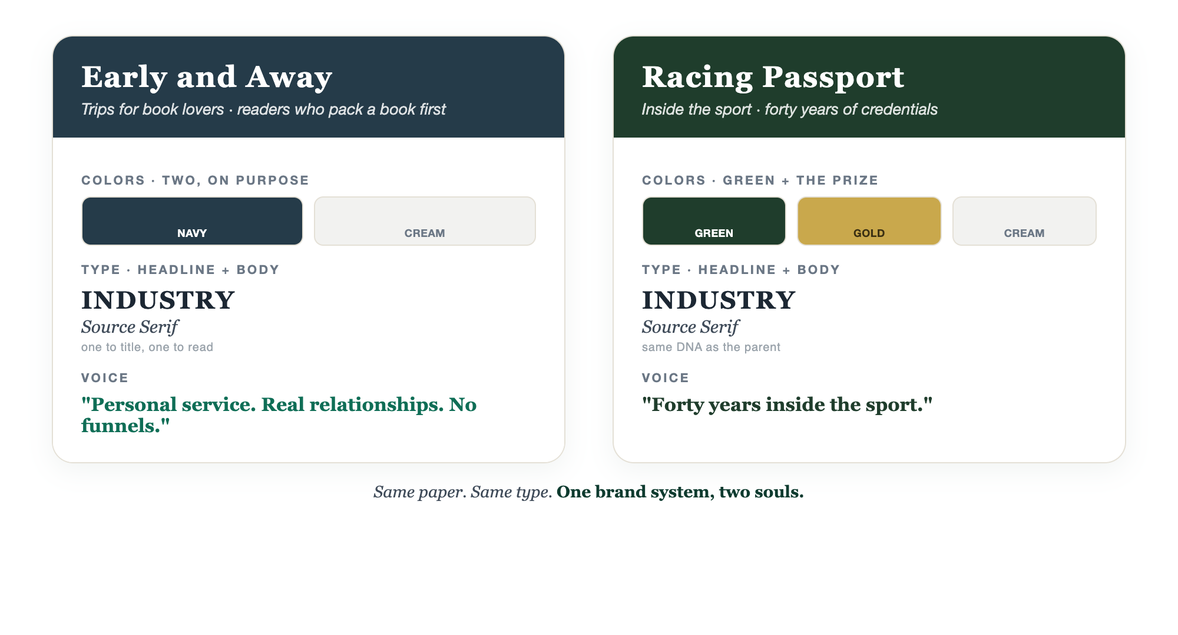
OURS · TWO BRANDS, ONE DISCIPLINE
Walk the talk.

Slide 7
SAME SYSTEM, BUILT FOR A DIFFERENT HEART
Same paper. Different soul.
Early and Away
Racing Passport
"I plan trips for book lovers. For book clubs ready to travel, readers who want to go somewhere meaningful, and anyone who packs a book before anything else." Navy ink on cream, like a clothbound first edition.
"I get racing fans inside the sport, opening doors that forty years of credentials unlock." Racing green and podium gold, sharp and fast.

Slide 8
DON'T OVERTHINK TYPE
Two fonts. Done.
One for headlines that carries the feeling. One clean one for the body that gets out of the way. The same two everywhere: your site, your decks, your emails, your Instagram.
A third font is the moment you start looking amateur.

Slide 9
NOW MAKE IT IMPOSSIBLE TO GET WRONG
The Canva Brand Kit:
one click, on brand.
Load your colors and fonts once. Every asset you ever make is one click from on-brand. We walk through the setup together in its own how-to.

Slide 10
YOUR BRAND ALSO HAS A SOUND
Your voice, in a few words.
Three words for how you sound. Warm or sharp? Playful or buttoned-up? Pick them, then write everything that way. Ours, off our own site:
"Personal service. Real relationships. No funnels."

Slide 11
THE PERMISSION SLIP
Consistency beats perfection.
Done and consistent wins.
You do not need a designer or a perfect logo. You need the same three decisions, used every single time.

Slide 12
YOUR FIRST BRICK
Build your kit.
1
Your colors and fonts
Two or three colors, two fonts. Write them down. (The Brand Kit worksheet.)
2
Your wordmark
Set your name well. That is a logo for now.
3
Your three voice words
And your one-line pitch: I plan trips for ____.

Slide 13
PUT YOUR SECOND MATE TO WORK
More than options. A brand engine.
GENERATE
CODIFY
AUDIT
Palette + fonts + names
Your reusable voice
Catch the drift
Niche and 3 feeling words in, a full brand direction out, with real hex codes.
It reads your writing and builds a voice guide you feed every future prompt.
Show it your posts and site, it flags where you're off-brand.
Copy-paste example prompts are in the library: How to Prompt Your Second Mate.

Slide 14
WANT A HAND WITH THIS PART?
Three ways to get unstuck.
GROUP
ONE-ON-ONE
DONE WITH / FOR YOU
Professor Hours
Book a 1:1
Hire us
Bring your specific question to office hours and ask it live.
We work on yours, screen to screen, until it's done right.
Consultant or coach. We build it with you, or we build it for you.

Slide 15
BUILT WITH YOU, NOT TAUGHT AT YOU
Recognizable
beats fancy.
You can pick your colors and fonts today. Turning three decisions into a real Canva Brand Kit, a wordmark, and a voice that sounds like you across everything is the work. That's what we build together.
We build it with you →
Next → 2.3 Your Website: the home base every route points to.
Post your three voice words and your one-line pitch in the community. Questions? Bring them to this week's Professor Hours.

