Slide 1
MARKETING JOURNEYS · THE TRADEWINDS METHOD · BUILD
Session 2.1
Package Your Offer
I book anything for anyone. So why am I forgettable?

Slide 2
REMEMBER THE TWO BUSINESSES?
What you sell. How you serve.
Both businesses, running at once.
Package both, and your whole machine is finally on one page. Your first strike at the Secret Agent headwind: the forgettable order-taker becomes findable.

Slide 3
TWO PACKAGES · MOST ADVISORS BUILD NEITHER
What you sell, and how you serve.
What you sell
How you serve
Your signature trip. The magnet that fills the chair. Business #2.
Your every-time process. The craft, made repeatable. Business #1.

Slide 4
BACK WHEN PLANES HAD MAGAZINES
3 Days in Austin. 4 Nights in Paris.
What's your three days?
Every one was a packaged, editorial, specific itinerary. That's the format.

Slide 5
HOW PACKAGED IS PACKAGED?
Down to the coffee on day three.
Could you describe your signature trip down to where they have coffee on the morning of day three, and the photo spot for day four?
Most advisors have never asked themselves that question. That question is the package.

Slide 6
HERE'S MINE
The Indy 500 is packaged.
I know what day to arrive. Which tickets to buy. Where to park. Where to stay. Where to sit, and it's different every day. What to do before the race, and after.
That's a packaged trip. Not "I do Indy."

Slide 7
THE EASY ON-RAMP
Start with a trip you already love.
Your favorite trip. Your last FAM. The one you'd talk about for an hour. Give it a name, a story, a who-it's-for. You're not inventing, you're packaging what you already know cold.
A named offer is a findable offer.

Slide 8
THE OTHER PACKAGE
Now, how you serve.
They don't just buy the trip. They buy the experience of working with you. Package that too.

Slide 9
YOUR SIGNATURE PROCESS
The same way, every time.
Initial consultation. Online questionnaire. Planner sheet. The Zoom call. The 3-way call with the destination. The proposal.
Stop winging every client. A named process makes you the pro, and lets you charge like one.

Slide 10
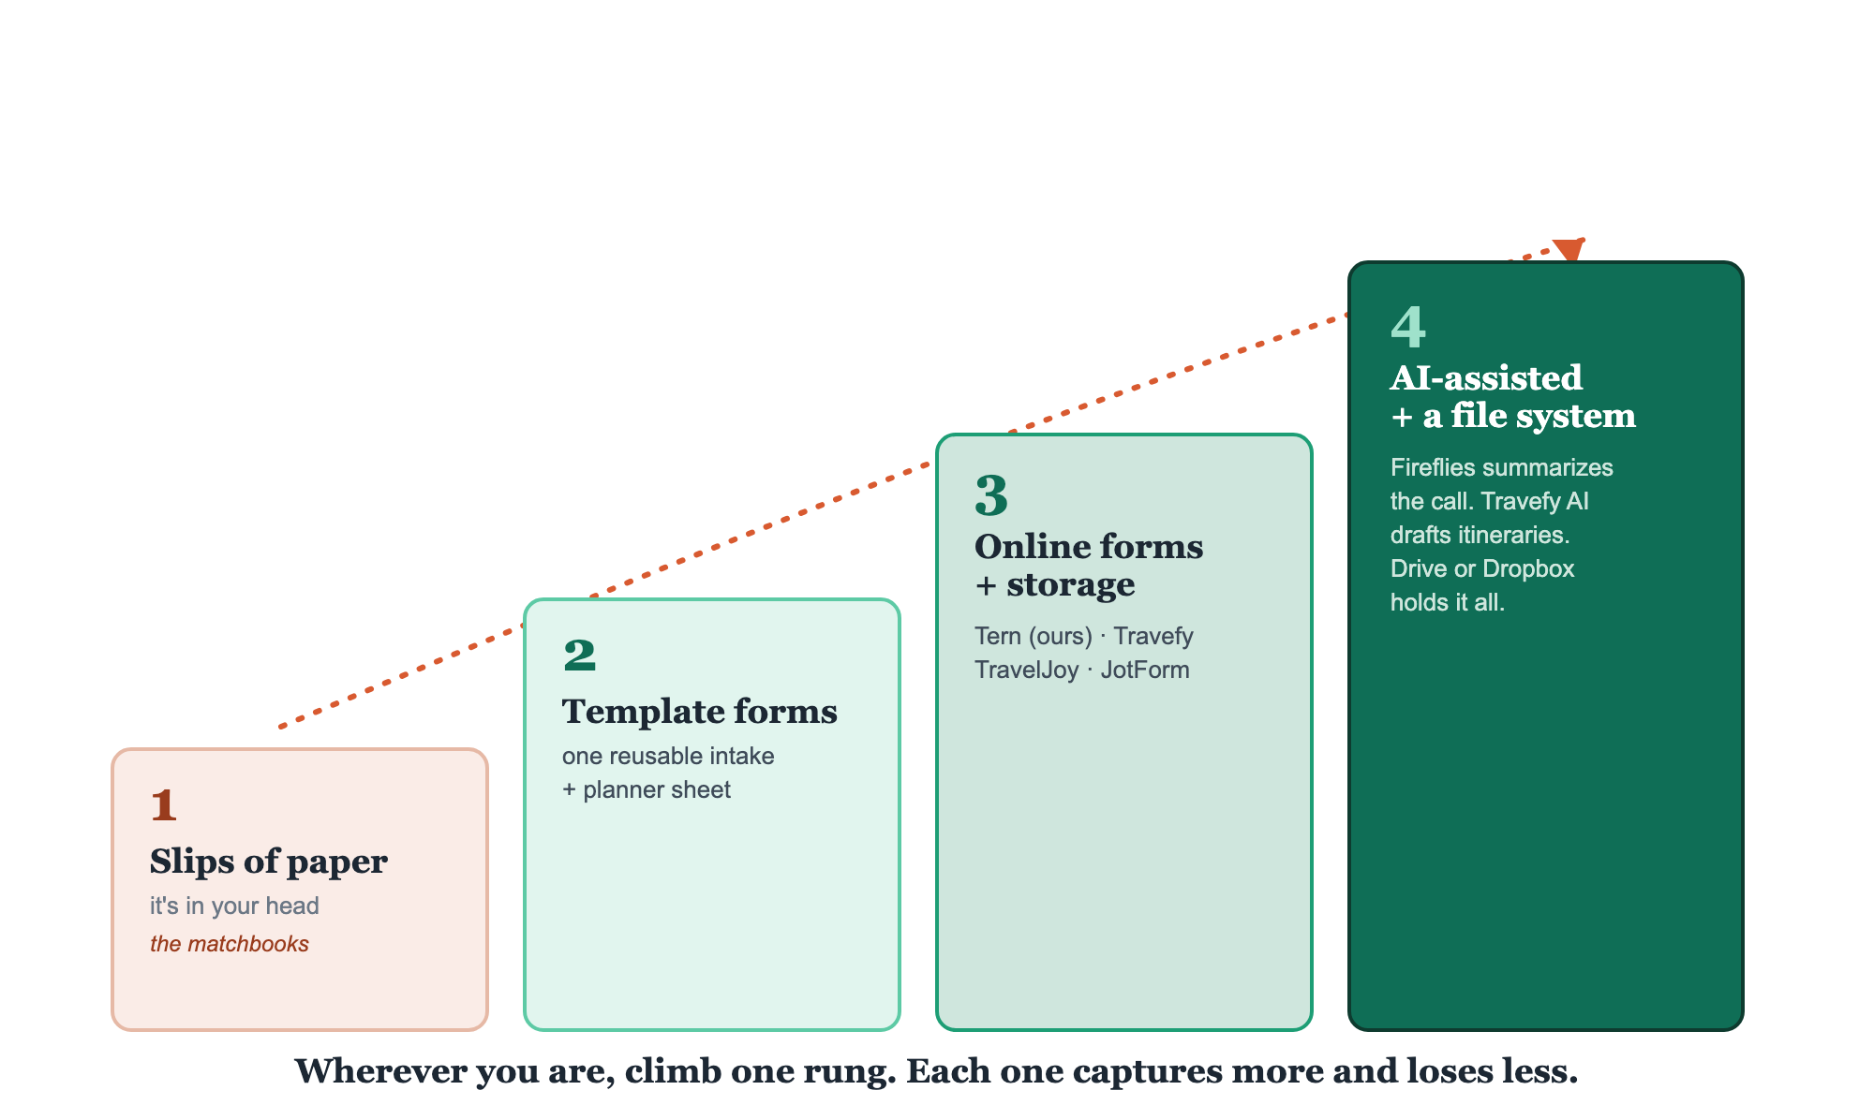
WHEREVER YOU ARE, CLIMB ONE RUNG
Level up your process.

Slide 11
GIVE THEM NAMES
Name the offer. Name the method.
"Four Nights on the Amalfi Coast." "The First-Timer's Indy 500." And your process: "The [Your Name] Way." Named things get remembered, referred, and booked.
If it doesn't have a name, it isn't a package. It's a maybe.

Slide 12
YOUR FIRST BRICK
Build your offer.
1
Your three days
Package one trip you love to the coffee-on-day-three level. (The Signature Trip Builder.)
2
Your process
Map the steps you run every time, and name it.
3
Your rung
Find where you are on the ladder, and take the next step up.

Slide 13
PUT YOUR SECOND MATE TO WORK
More than a writer. A packaging partner.
DECONSTRUCT
PRESSURE-TEST
MAP
To the coffee on day 3
Find the gaps
Name your process
It interviews you and pulls a whole trip out of your head into a package.
It role-plays your client and pokes holes before a real one does.
Dump your steps, it returns a named, repeatable checklist.
Copy-paste example prompts are in the library: How to Prompt Your Second Mate.

Slide 14
WANT A HAND WITH THIS PART?
Three ways to get unstuck.
GROUP
ONE-ON-ONE
DONE WITH / FOR YOU
Professor Hours
Book a 1:1
Hire us
Bring your specific question to office hours and ask it live.
We work on yours, screen to screen, until it's done right.
Consultant or coach. We build it with you, or we build it for you.

Slide 15
BUILT WITH YOU, NOT TAUGHT AT YOU
A named offer
is a findable offer.
You can draft both packages today. Turning a draft into a polished, sellable offer and a process that runs without you is the work. That's what we do together, with the templates.
We build it with you →
Next → 2.2 Your Brand: now make it look the part.
Post your first brick in the community. Questions? Bring them to this week's Professor Hours.

