Slide 1
MARKETING JOURNEYS · THE TRADEWINDS METHOD
Session 1.8 · Free-Intro Finale
Meet Your Second Mate
Why is a room full of pros using AI to rewrite emails?

Slide 2
A ROOM FULL OF PROS, ASKED ABOUT AI
“I use it to rewrite
my emails.”
No social. No planning. No content. No research. The most powerful tool of our lifetime, used as a spell-checker.

Slide 3
HERE'S WHAT THAT IS
A co-pilot to hand you a napkin.
You hire a brilliant co-pilot who can fly the instruments, read the weather, take the long boring stretches off your hands. And you ask them to proofread.
The email rewrite is the tip. There's a whole mountain underneath.

Slide 4
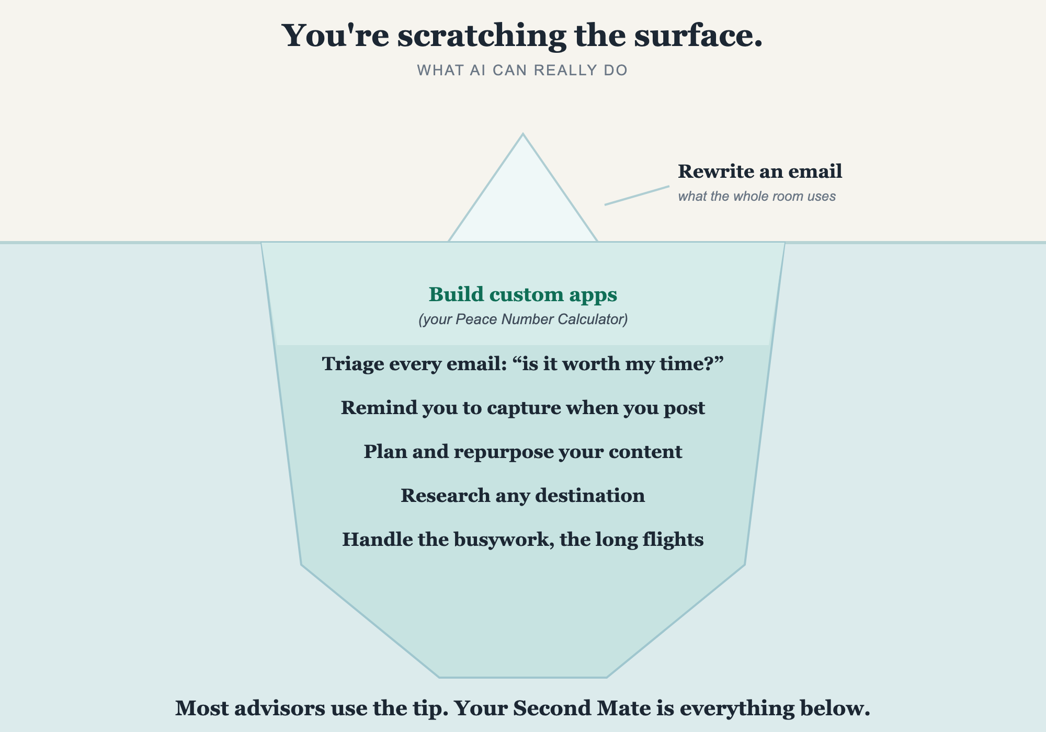
THE EMAIL REWRITE IS THE TIP
You're scratching the surface.

Slide 5
MEET THE CREW MEMBER PROPERLY
You stay the pilot.
You, the pilot
Your Second Mate
The relationships. The trust. The taste. The judgment. The final call. The you.
The drafts, research, planning, repurposing, the busywork, the long flights.
Not here to replace you. Here so you're not the whole crew, alone, at 11pm.

Slide 6
BE CLEAR ABOUT THE SPLIT
What it will, and won't, do.
It will
It won't
Draft captions and emails. Research a destination in seconds. Turn one trip into a week of content. Plan and do the busywork.
Be you. Feel the room. Hold the relationship. Make the final call. Care the way you do.
AI without you is generic. You without AI are exhausted. Together is the Second Mate.

Slide 7
NOT THEORY · WHAT WE'VE ACTUALLY BUILT
What a real Second Mate does.
ONE · CUSTOM APPS
TWO · GUARDS YOUR TIME
THREE · PROTECTS CAPTURE
The Peace Number Calculator
“Is it worth my time?”
The post-and-capture reminder
We built it with AI. The same one you used in 1.3. It builds you things, not just words.
A workflow reads every email in, so you protect your hours for your DPAs (from 1.7).
Post on social and it reminds you to add the call to action, so a post never just collects likes (from 1.5).
Rewrite an email? That's not even the beginning.

Slide 8
THE HEADWIND WE'VE BEEN CIRCLING
This is the real answer
to Always On.
The busywork lived in your head with no one to hand it to. Now there is. The Second Mate takes the long flights, so you stay on your one thing and still close the laptop.

Slide 9
TODAY IS JUST THE INTRODUCTION
Meet your AI Marketing Crew.
The Scribe writes in your voice. The Lookout watches trends and researches. The Artist makes your visuals.
The Navigator plans your content and your week. The Quartermaster handles admin and operations.
First, you teach the crew your voice, so none of it sounds like a robot.
We go deep on every one in the class. One tired person becomes a captain with a full crew.

Slide 10
EIGHT SESSIONS AGO YOU WERE ON THE ROLLERCOASTER
Look how far you've come.
1.1 named the problem. 1.2 found your niche. 1.3 your Peace Number. 1.4 the whole map.
1.5 why you capture, your Manifest. 1.6 picked your routes. 1.7 run it like a business.
1.8 your Second Mate. Your map, your number, your routes, and your crew.
That's not nothing. That's the foundation of a real business.

Slide 11
YOUR FIRST BRICK
Your first Second Mate task.
1
Name one task
Just one, that you'll hand off this week. The thing you dread, the thing that eats your time.
2
Write the first prompt
Don't overthink it. Start the conversation. In the class, we build the real prompts together.

Slide 12
THAT'S THE FREE INTRO · THE DOOR IS OPEN
You stay the pilot.
The Second Mate works the instruments.
You can see the whole iceberg now. Building your Second Mate, your prompts, and your crew alone is a year of work, and knowing isn't doing. You don't have to.
We build it with you →
The map got you ready. The class is where you fly. The door is open.
Post your first brick in the community. Questions? Bring them to this week's Professor Hours.

