Slide 1
MARKETING JOURNEYS · THE TRADEWINDS METHOD
Session 1.7
Run It Like a Business
You're a travel advisor now. Why does everyone do that little face?

Slide 2
THE COLD OPEN
Here she goes again.
The candles. The leggings. The oils. And now, I'm a travel advisor.
You watch their face do the little thing. Oh. Okay. Here she goes again.
That look ends today.

Slide 3
WHAT NOBODY IN YOUR LIFE SEES
We see all of it.
On top of everything. Never off. The guilt. The myth of balance. Building it alone at the kitchen table at eleven at night.

Slide 4
THE HONEST PART
Every one of these gets its own session.
Your time
Turning it off
Not alone
and the myth of balance
without the guilt
building it as a woman, with a crew
We go deep on all of it. None of it helps until you make one decision.

Slide 5
THE TURN
Dabble, or run it like a business.
That's the whole ballgame.
Not your logo. Not your talent. The decision. A hobby pays hobby money. A business pays you.

Slide 6
THE TRAP THAT GETS EVERYBODY
Redesign the logo only so many times.
Tweak the logo. Reorder the cards. Change the font, again. Exhausted, felt busy, made zero dollars.
That's not running a business. That's hiding from it.

Slide 7
DOLLAR-PRODUCING ACTIVITIES
A short list makes the money.
The later money
The now money
Run your route. Capture the names. Fill the Manifest.
Follow up. Turn inquiries into bookings.
Everything else supports those few, or hides from them.

Slide 8
THE 80/20 PRINCIPLE
20% of what you do makes 80% of the money.
The tragedy: most advisors burn 80% of their time on the 20% that barely matters.
Find your 20%. Protect it with your life.

Slide 9
THE ONE THING · GARY KELLER
What's the one thing?
What's the one thing I can do, such that by doing it, everything else gets easier or unnecessary?
Fill the Manifest. Run the route, capture the names, every day.

Slide 10
PROTECT IT
Not on the calendar, doesn't happen.
Block your DPA time, every day, before the noise fills it up. Guard it like your most important client.
A real business protects the time that makes the money.

Slide 11
BE A PROFESSIONAL
Make it real on paper too.
Separate account
Proper insurance
Pay yourself first
business money, not grocery money
one bad day can't wipe you out
profits matter. Money, on purpose.
A service business is only as valuable as its database. The Manifest is the asset.

Slide 12
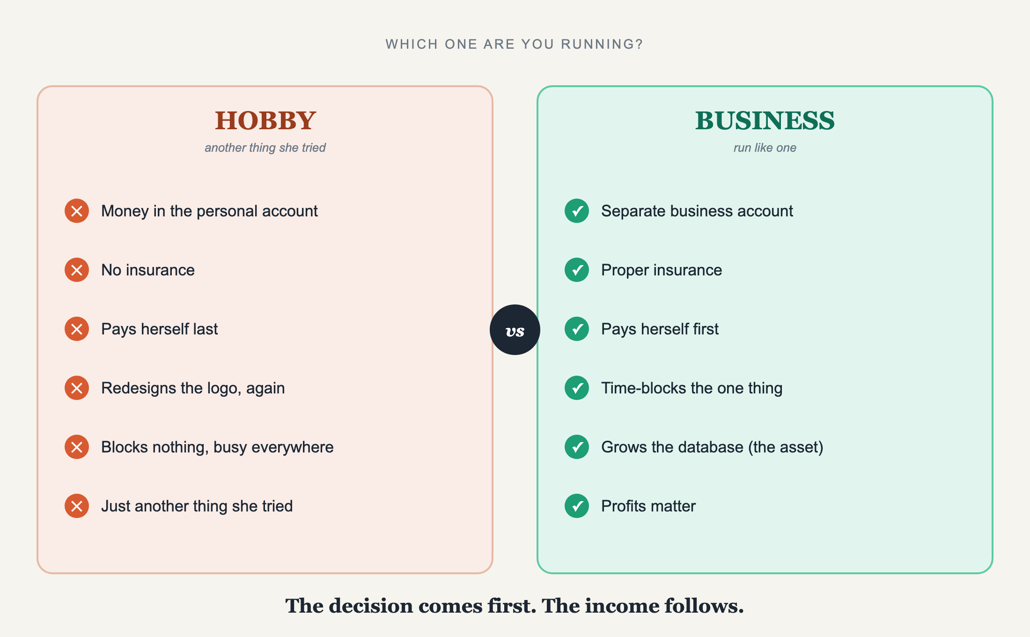
WHICH ONE ARE YOU RUNNING?
Hobby vs. Business

Slide 13
THE GIFT ON THE OTHER SIDE
Earn the right to turn it off.
One thing done in its block, you close the laptop and you're at dinner. No guilt. The system is holding.
Fully on when you're on. Off when you're off. Not alone, the crew carries the rest.

Slide 14
YOUR FIRST BRICK
Make the decision.
1
Declare it
Out loud and in writing: hobby or business. Choose.
2
The basics
Separate account, look into insurance, pay yourself first.
3
Block it
Open the calendar now. Block your one thing for tomorrow.

Slide 15
BUILT WITH YOU, NOT TAUGHT AT YOU
The decision comes first.
The income follows.
You can name the trap and your one thing now. But deciding and knowing isn't the systems set up, or someone holding you to the block. Alone, that's a year of slipping.
We build it with you →
Next → 1.8 Meet Your Second Mate: the crew member who guards the busywork.
Post your first brick in the community. Questions? Bring them to this week's Professor Hours.

