Slide 1
MARKETING JOURNEYS · THE TRADEWINDS METHOD
Session 1.6
Pick Your Routes
I'm doing a little of everything. Why am I still invisible?

Slide 2
WHERE YOU'VE BEEN
A point in every direction.
The middle, going nowhere.
A little social. A networking thing. A boosted post. A dead group. A site you never finished. That's the all-star. Busy everywhere, getting nowhere.

Slide 3
THE WHOLE MENU
Seven ways to fill your Manifest.
Your Network · Social · Networking · Community · Partnerships · Get Found · Paid.
Your Network is the warmest names you'll ever get. The other six each reach a different room.
Seven roads. You do not need all of them. You need the one or two that fit you.

Slide 4
BEFORE YOU PICK
Every route, one job.
Warm or cold, loud or quiet, all seven exist to do the thing we named last session: get a name into your Manifest.
The route is the road. The Manifest is the destination. Don't marry a road.

Slide 5
WHY ONE OR TWO BEATS SEVEN
Sharpen the ax.
Give a person six hours to chop a tree, they spend the first four sharpening the ax. Focus and expertise are the same move.
Seven dull tools
Two sharp ones
Forgettable on seven platforms.
The name people remember.

Slide 6
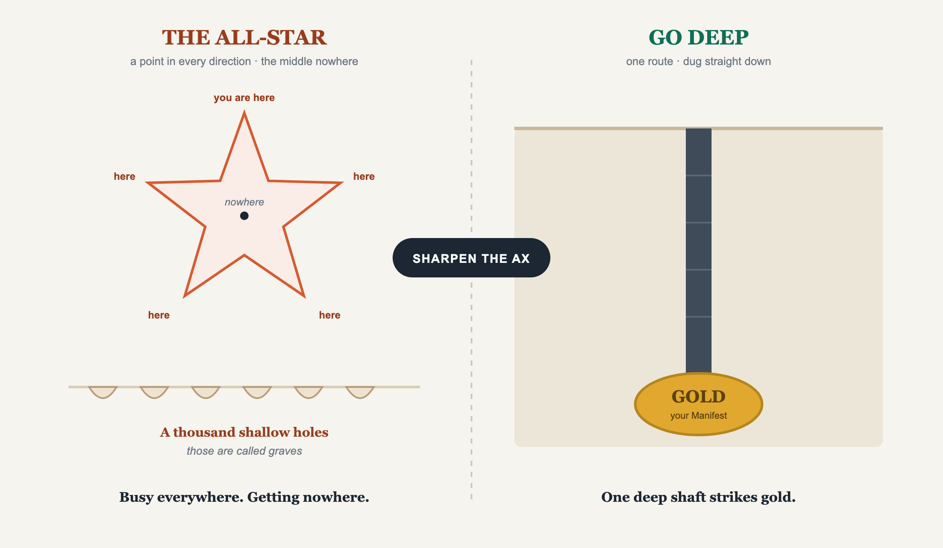
HOW YOU ACTUALLY STRIKE GOLD
Mining, not graves.

Slide 7
THE HARD TRUTH
A thousand shallow holes?
Those are called graves.
Depth strikes gold. Don't dig your own grave seven times. Dig one hole that hits gold.

Slide 8
YOU'RE NOT TRYING TO BE FAMOUS
Win your number, not the internet.
Your Peace Number is finite and knowable. It doesn't take seven routes to hit it. It takes one or two you run well.
Stop trying to win the internet. Win your number.

Slide 9
HOW TO PICK
Three questions for each route.
1
Fit my niche?
Are the people you serve actually there?
2
Will I do it?
Every week, even tired and busy. A route you abandon is worth nothing.
3
Fit who I am?
The one nobody tells you. It matters more than the other two combined.

Slide 10
QUESTION THREE, THE UNLOCK
Your personality is the data.
If you're an introvert
If you're an extrovert
Get Found, Partnerships, written Social. The work happens quietly, on your terms.
Networking, Community, live Social. Your energy in the room is the product.
Not a weakness to overcome. It's the data telling you which holes to dig. (Your Network is for everyone.)

Slide 11
THE TEST THAT SETTLES IT
There is no right route.
There is your right route.
The perfect route you'll quit in three weeks loses to the lesser one you'll run for three years. Consistency beats brilliance.

Slide 12
THE CURE FOR THE ALL-STAR
Go deep. Quit the rest with relief.
Pick one. Maybe two. Go deep, get sharp. The other five or six you let go. Today, on purpose. You're not quitting because you failed, you're quitting because you finally chose.
Two sharp tools beat seven dull ones. Two deep holes beat a thousand graves.

Slide 13
YOUR FIRST BRICK
Pick your lane.
1
Score the seven
Rate each 1 to 5: fits my niche, I'll do it weekly, fits who I am. Add them up.
2
Pick one or two
Your highest scores. That's your lane. We sharpen it together.
3
Name what you quit
Write the holes you stop digging, and let them go with relief.

Slide 14
BUILT WITH YOU, NOT TAUGHT AT YOU
Two routes done well
beat seven done poorly.
You can see your lane now. Picking it is not the same as running it. The weekly playbook that makes a route produce is a year of trial and error alone. You don't have to.
We build it with you →
Next → 1.7 Run It Like a Business: earning the right to turn it off.
Post your first brick in the community. Questions? Bring them to this week's Professor Hours.

