Slide 1
MARKETING JOURNEYS · THE TRADEWINDS METHOD
Session 1.5
Why You Capture
A thousand likes, and not one name. Why?

Slide 2
A COLD NIGHT OUTSIDE SEATTLE
I was ten. Dad sent me to clean out the car.
Scraps of paper. Matchbook covers. I thought it was trash.

Slide 3
WHAT THOSE SCRAPS WERE
The names are the gold.
Dad was in sales. Those matchbook covers were names and numbers, people he needed to call back.
He wasn't chasing applause. He was chasing names. He had the instinct exactly right.

Slide 4
BUT HERE'S WHAT HE LACKED
Instinct, minus the system.
HE HAD NO
HE HAD NO
HE HAD NO
System
Training
Discipline
no single place every name lived
nobody taught him how to do it right
a panic at month end, not a daily rhythm
The instinct you may have. The three, we hand you.

Slide 5
NOW FLIP TO TODAY
Do social. Run ads. Post. Build a website.
Every route has exactly one job: capture a name.

Slide 6
THE VANITY TRAP
A thousand looked. Zero names.
You post a great trip photo. A thousand views. A hundred likes. It feels like marketing.
How many gave you a name and an email? Almost every time, none. You can't reach one of them tomorrow.
A like is not a lead.

Slide 7
WHY ZERO NAMES
There was no door.
A call to action is the one clear instruction telling a person exactly what to do next. "Comment ITALY and I will send the guide." Not a hint. A direct ask.
No call to action, no capture. The door is the whole game.

Slide 8
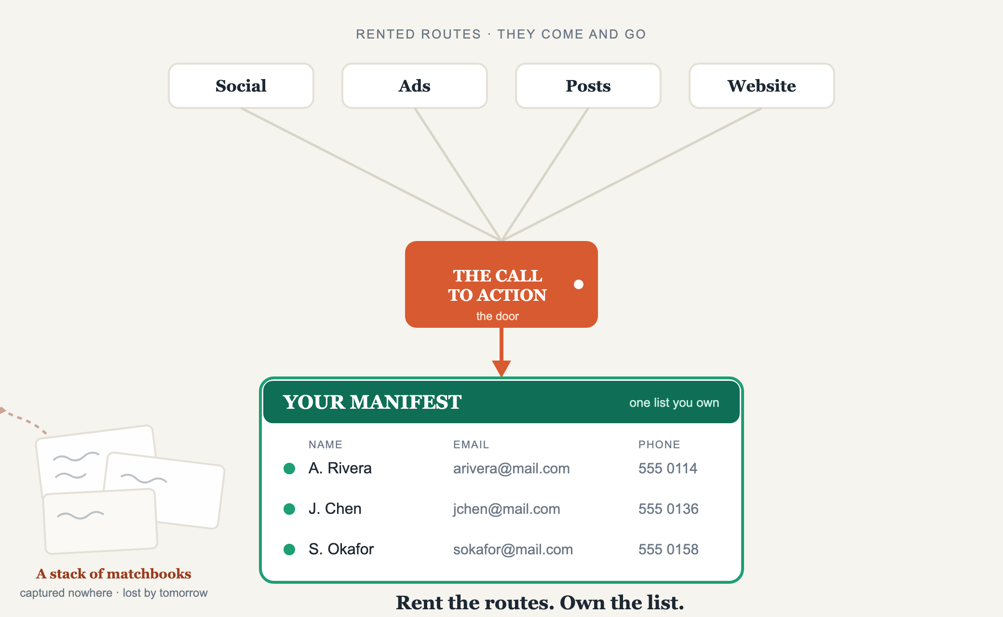
ROUTES · THE DOOR · YOUR MANIFEST
Rent the routes. Own the list.

Slide 9
THE LIST YOU OWN
Your Manifest.
On a balloon, the manifest is the record of everyone aboard. In your business, the same: every person who raised a hand and said tell me more.
Every platform, you rent. The Manifest is the one thing you own.

Slide 10
NOBODY BUYS ON YOUR SCHEDULE
A captured name is a booking you haven't made yet.
Some are ready now. Most are dreaming, months out. Capture them, or they Google a stranger when the timing is right.
Then Confirm, Care, Cultivate, until an inquiry becomes a client for life.

Slide 11
PUT IT PLAINLY
Sell your business tomorrow,
the only thing of value is the database.
Not the logo. Not the feed. The list. Everything else is decoration around it.

Slide 12
YOUR FIRST BRICK
Find your matchbooks.
1
Count
Names and emails you own in one place right now. Not followers. Write the number.
2
Find
Your phone, inbox, old confirmations, a notebook in a drawer. They're scattered everywhere.
3
Gather
Start one list you control, together we finish it. Don't be a stack of matchbooks.

Slide 13
BUILT WITH YOU, NOT TAUGHT AT YOU
A like is not a lead.
Rent the routes, own the list.
You can see it now: the names are the gold. Building the capture system, gathering the list, and the follow-up that turns it into clients for life is a year of work alone, and you'd lose names along the way. Knowing is not doing. You don't have to do it alone.
We build it with you →
Next → 1.6 Pick Your Routes: which one or two actually fit you.
Post your first brick in the community. Questions? Bring them to this week's Professor Hours.

