Slide 1
MARKETING JOURNEYS · THE TRADEWINDS METHOD
Session 1.4
The Map
How do all the pieces actually fit together?

Slide 2
WHERE YOU ARE NOW
You already started.
1.1 you named the problem. 1.2 you found your north. 1.3 you set a real number.
You're standing on the runway with a destination and a number. Most advisors never get this far.
Today, the whole trip on one page.

Slide 3
HERE'S WHAT NOBODY TOLD YOU
You run two businesses.
Most people are great at one and broke because of the other.

Slide 4
THE TWO BUSINESSES
Serve the trip vs. fill the chair.
#1 · Serve the trip
#2 · Fill the chair
Booking, fams, proposals, suppliers. The craft. 90 to 95% of all training lives here.
Find you, choose you, return, refer. Almost nobody teaches it. This is the class.

Slide 5
STICK WITH ME
Best equipment. Best chairs. Best dentist.
If nobody's in the chair, are you even in business?

Slide 6
BRING IT HOME
Everything works. Nobody's aboard.
A cruise ship
A plane
An amusement park
sailing empty across the ocean
flying the route, no one in the seats
every ride running, nobody paying
That's not a business. It's a very expensive hobby.

Slide 7
THE REFRAME
It's not bragging. It's not sales. It's contribution.
When you care enough about service, you build a system. Being findable is the job, not ego. The people you're meant to help can't hire you if they can't find you.
They're going to work with someone. It might as well be you.

Slide 8
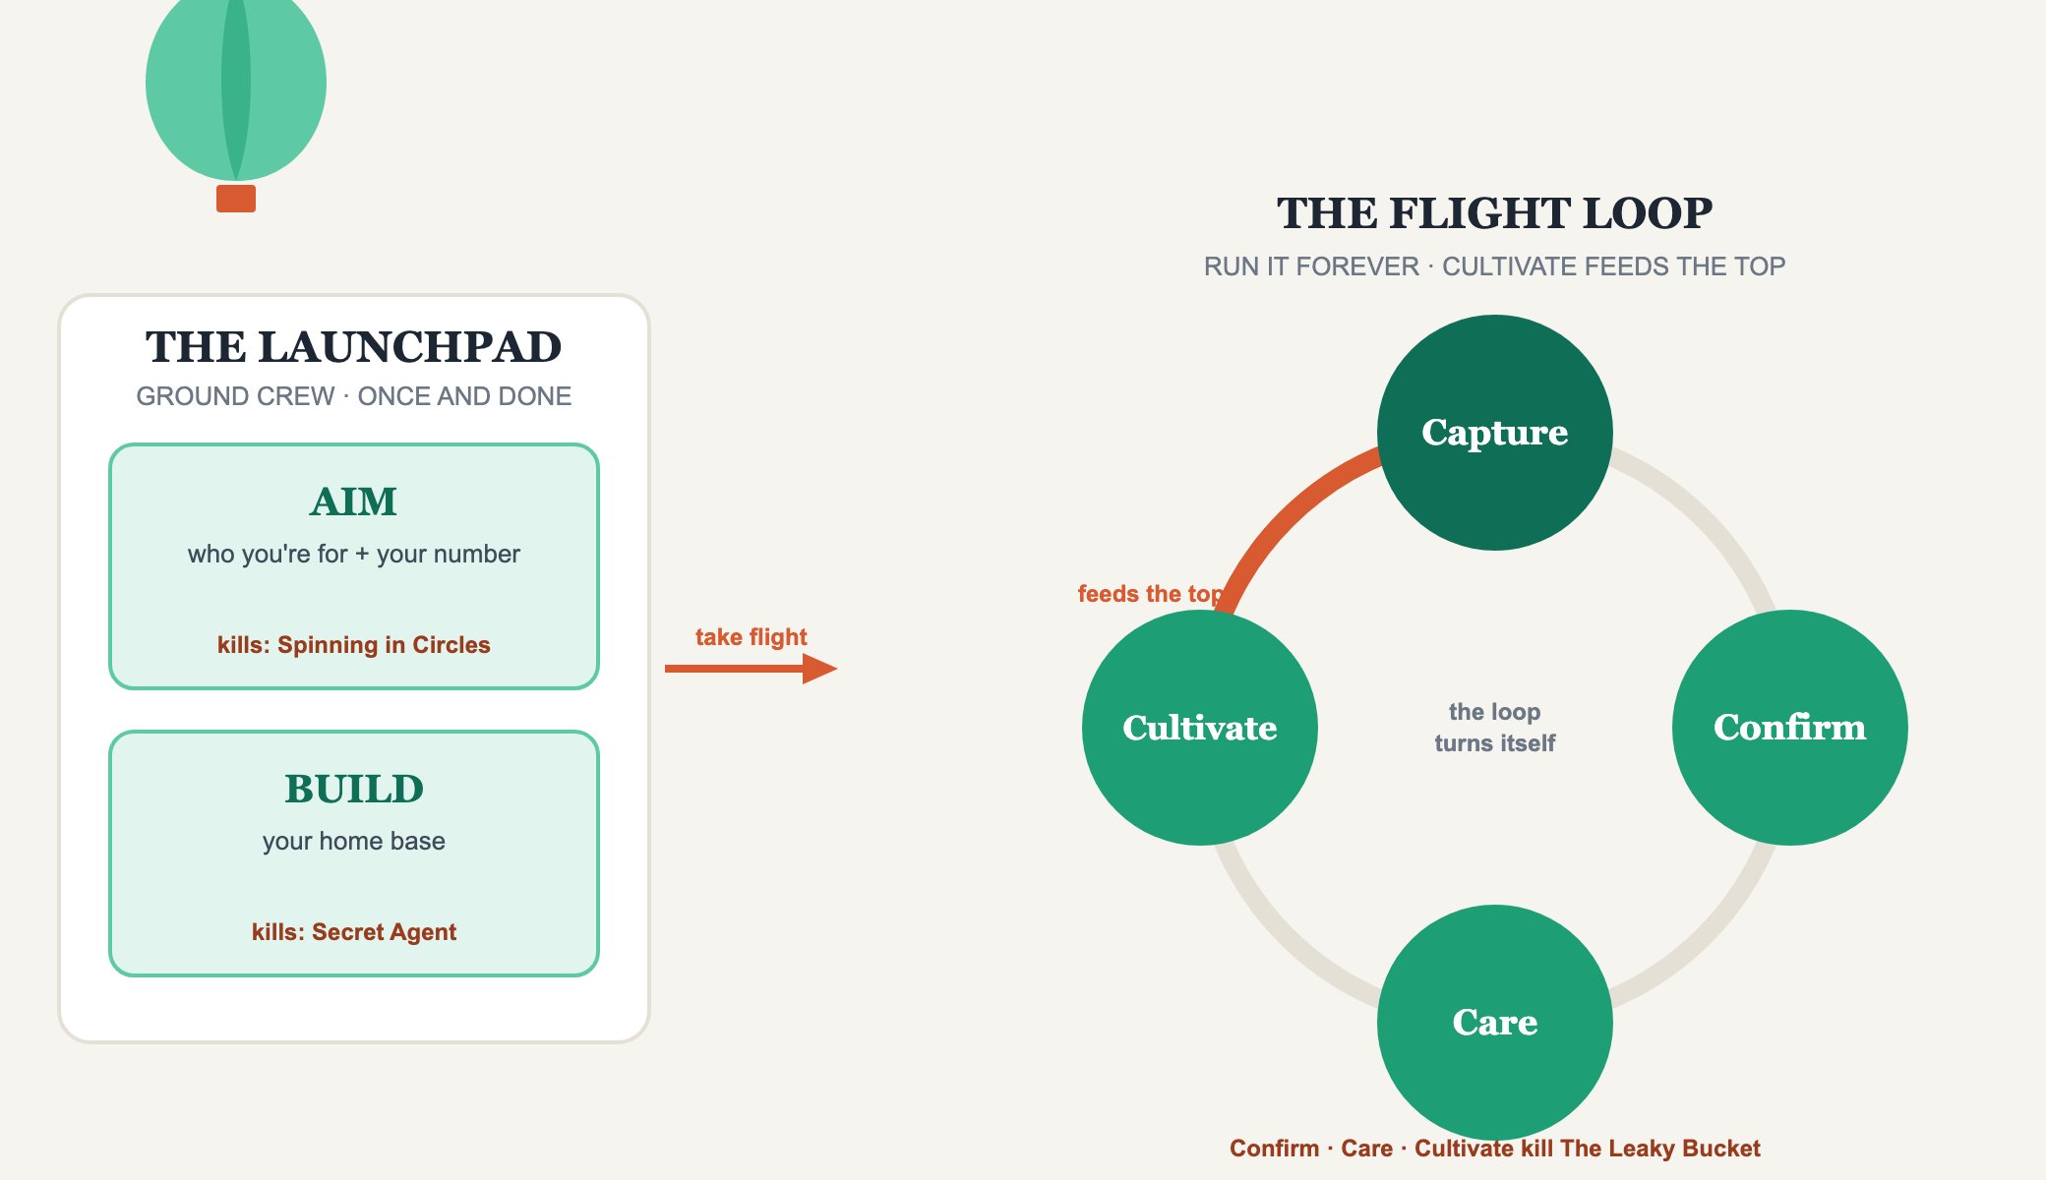
THE TRADEWINDS METHOD ON ONE PAGE
The Map

Slide 9
THE PROMISE OF THIS CLASS
Every headwind has a home.
Spinning in Circles → Aim. Secret Agent → Build. The Vanity Trap → Capture.
The Leaky Bucket → Confirm, Care, Cultivate. Always On → your Second Mate.
Feast or Famine → the whole system working together.
There's no headwind on this map without an answer.

Slide 10
WHERE THIS IS GOING
Cruising Altitude.
The point where the Loop runs itself and the bookings come to you. You stop pushing the balloon, the trade winds carry it.

Slide 11
HOW THE SYSTEM CARRIES YOU
Not magic. Earned.
You earn it by running the Loop until Cultivate feeds Capture on its own. Then every happy client makes the next two cheaper and easier to get.
Early on you push hard. Later, the same effort produces far more.

Slide 12
YOUR FIRST BRICK
Which business are you neglecting?
1
The split
Out of every 10 hours and 10 dollars, how many go to #1 vs #2? Write it down.
2
The pin
Drop a YOU ARE HERE pin on the map. Most land at the start of Build.
3
The headwind
Circle the one hurting you most. That's where we start, together.

Slide 13
BUILT WITH YOU, NOT TAUGHT AT YOU
A system you run,
not a scramble you survive.
You can see the whole map now. Building all of it alone is a year of work, and you'd get pieces wrong. You don't have to.
We build it with you →
Next → 1.5 Why You Capture: the most important spot on the map.
Post your first brick in the community. Questions? Bring them to this week's Professor Hours.

